Slide 1
Chapter Three Volumetric Properties of Pure Fluids
1. The pure substance , define a Pure substance: a material with homogeneous and invariable composition.
To elaborate pure substances can have multiple phases: an ice-water mixture is still a pure substance.
• An air-steam mixture is not a pure substance.
• Air, being composed of a mixture of N2, O2, and other gases, is formally not a pure substance. However, experience shows that we can often treat air as a pure substance with little error.

Slide 2
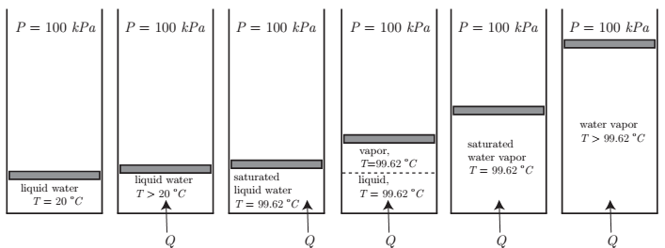
We slowly add heat to the cylinder, and observe a variety of interesting phenomena. A sketch of what we observe is given in Fig. 3.2. We notice the following behavior:
Figure 3.1: Sketch of experiment in which heat is added isobarically to water in a closedpiston-cylinder arrangement.

Slide 3
The pressure remains at a constant value of 100 kP a. This is an isobaric process.
• The total volume increases slightly as heat is added to the liquid.
• The temperature of the liquid increases significantly as heat is added to the liquid.
• At a special value of temperature, observed to be T = 99.62 ◦C , we have all liquid, but cannot add any more heat and retain all liquid. We will call this state the saturated liquid state. We call T = 99.62◦C the saturation temperature at P = 100 kP a. As we continue to add heat, We have just boiled water! We sketch this process in the temperature-specific volume plane,
that is, the T - v plane, in Fig. 3.2. Note that the mass m of the water is constant in this.

Slide 4
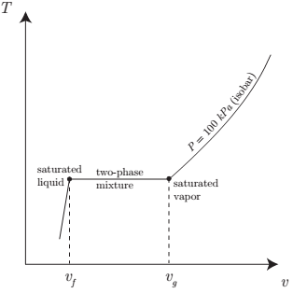
Figure 3.2: Isobar in the T - v plane for our thought experiment in which heat is added isobarically to water in a piston-cylinder arrangement.

Slide 5
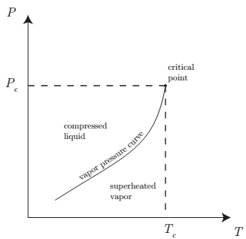
Figure 3.3: Saturation pressure versus saturation temperature sketch.

Slide 6
• Saturated liquid: the material is at T and is all liquid.
• Saturated vapour: the material is at Tsat and is all vapour.
• Compressed (subcooled) liquid: the material is liquid with T < Tsat.
• Superheated vapor: the material is vapor with T > Tsat .
• Two-phase mixture: the material is composed of co-existing liquid and vapor with both at Tsat .

Slide 7
2. Some Definitions
Triple point: triple point of a substance is the temperature and pressure at which the three phases (gas, liquid, and solid) of that substance coexist in thermodynamic equilibrium. Also it is the point at wich three curves are met (sublimation, fusion and vaporization).
Critical point: The point at highest temp. (Tc) and Pressure (Pc) at which a pure chemical species can exist in vapour/liquid equilibrium. The point critical is the point at which the liquid and vapour phases are not distinguishable; because of the liquid and vapour having same properties.

Slide 8
Fluid region: it is a region of higher temperature and pressure than Tc and Pc, and it is termed supercritical.
3. PVT BEHAVIOR OF PURE SUBSTANCES
3.1 The P-T or Phase Change Diagram
This is called phase diagram since all three phases are separated from each other by three lines. Most pure substances exhibit the same behavior.

Slide 9
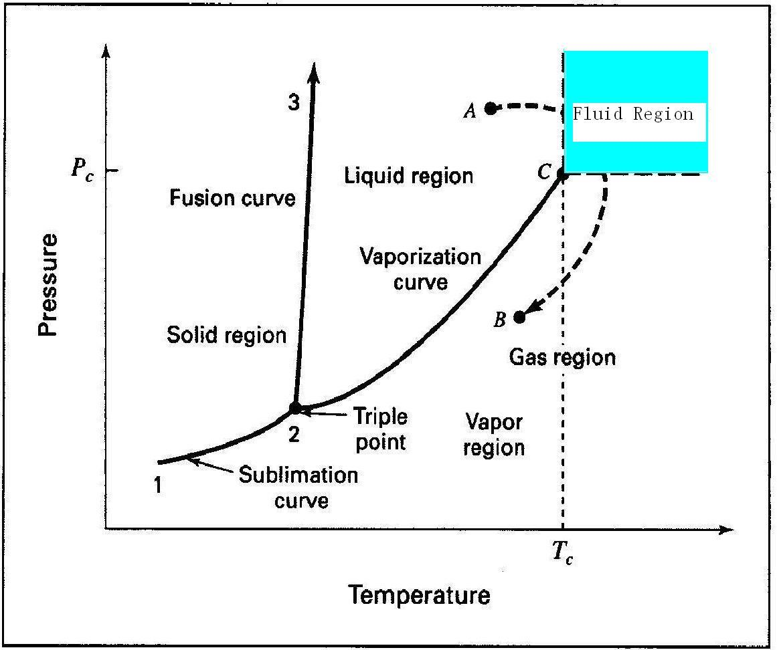
Figure 3.4 PT digram for pure substance

Slide 10
There are two ways that a substance can pass from solid phase to vapour phase i) it melts first into a liquid and subsequently evaporates, ii) it evaporates directly without melting (sublimation).
• The sublimation line (1-2) separates the solid and the vapor.
• The vaporization line (2-C) separates the liquid and vapour regions
• The melting or fusion line (2-3) separates the solid and liquid and gives the
solid/liquid equilibrium relationship
• These three lines meet at the triple point, where the three phases coexist in equilibrium.

Slide 11
From A to B lead from the liquid region to the gas region without crossing a phase boundary. The transition from liquid to gas is gradual. On the other hand, paths which cross phase boundary 2-C include a vaporization step, where an abrupt change from liquid to gas occurs.
If P<PTP, the solid phase can change directly to a vapour phase.

Slide 12
At P<PTP ,the pure substance cannot exist in the liquid phase. Normally (P>PTP) the substance melts into a liquid and then evaporates.
The triple point is invariant (F = 0). If the system exists along any of the two-phase lines of Fig. 3.4, it is univariant (F = 1), whereas in the single-phase regions it is divariant (F = 2).
The gas region is sometimes divided into two parts, as indicated by the dotted vertical line of Fig. 3.4. A gas to the left of this line, which can be condensed either by compression at constant temperature or by cooling at constant pressure, is called a vapor.

Slide 13
The region everywhere to the right of this line, where T > Tc in
cluding the fluid region, is termed supercritical.
3.2 P-V Diagram
Figure 3.5shows the liquid, liquid/vapour, and vapour regions of the P V diagram, with four isotherms superimposed. Isotherms on Fig. 3.4 are vertical lines, and at temperatures greater than Tc, do not cross a phase boundary. On Fig. 3.5 the isotherm labelled T > Tc is therefore smooth.The lines labelled Tl and T are for subcritical temperatures, and consist of three segments. The horizontal segment of each isotherm represents all possible mixtures of liquid and vapours in equilibrium, ranging from 100% liquid at the left end to 100% vapours at the right end.

Slide 14
The locus of these end points is the dome-shaped curve labelled BCD, the left half of which (from B to C) represents single-phase (saturated) liquids at their vaporization (boiling) temperatures, and the right half (from C to D), single-phase (saturated) vapours at their condensation temperatures.

Slide 15
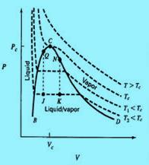
Figure 3.5 PV diagrams for a pure substance. Showing liquid, liquid/vapour, and vapour regions with isotherms

