Slide 1
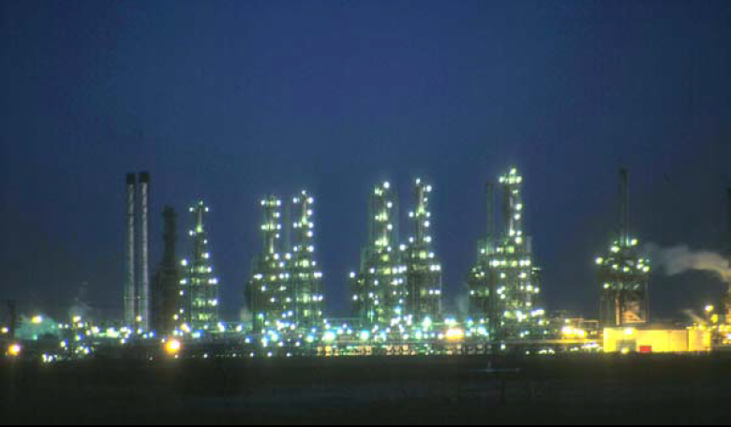
Lect./1 Petroleum refinery
Fourth Year - Chemical Process Eng. Branch
Petroleum Refinery Eng. Lectures
By
Dr. Adnan A. Abdul Razak

Slide 2
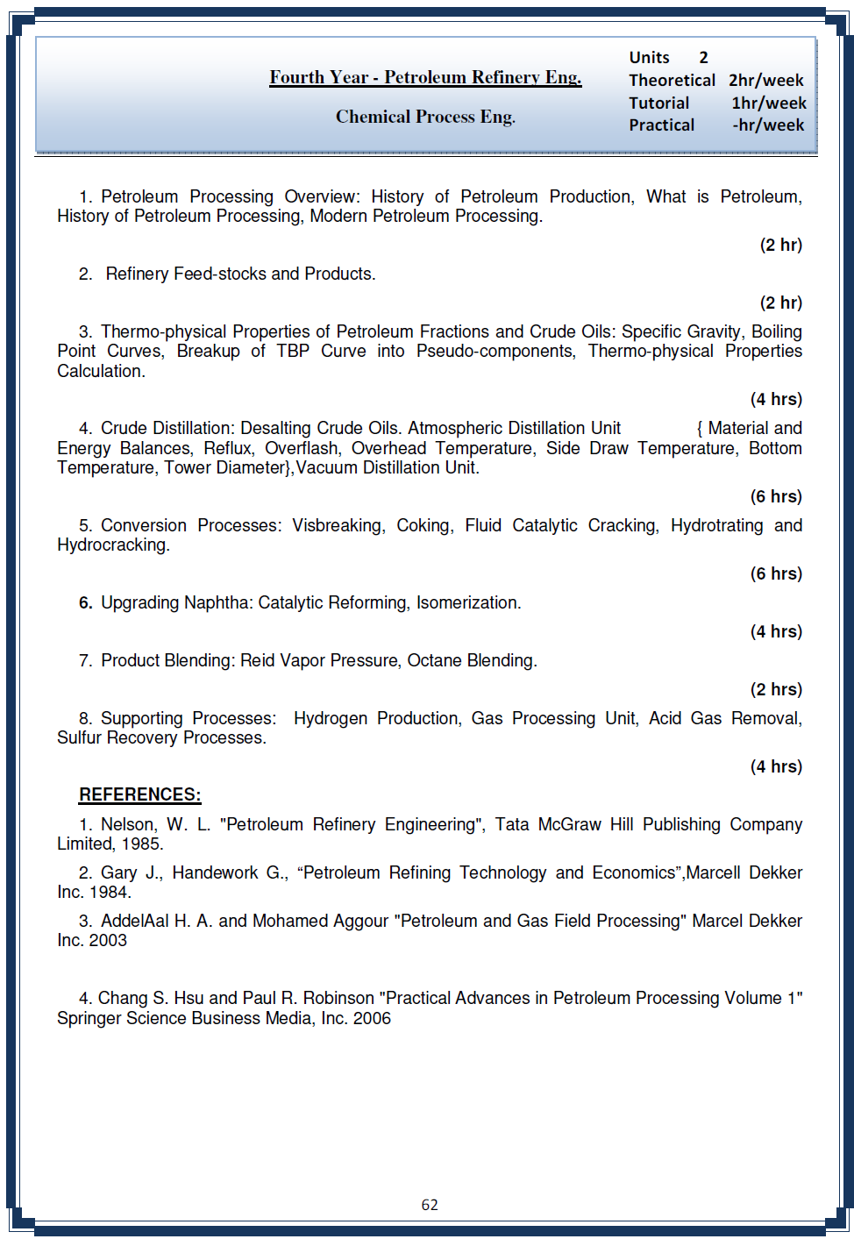

Slide 3
Petroleum Processing Overview

Slide 4
Petroleum Processing Overview
Actually, crude oil straight from the ground has some value, but not a lot.
Table 1 shows the history of petroleum before 1861.
Before 1859, oil that was mined or that simply seeped up out of the ground was used to water-proof ships, as an adhesive in construction, for flaming projectiles, and in a wide variety of ointments.
After 1859, petroleum became more and more important to the world’s economy, so important that today, without a steady flow of oil.
It provides fuels and lubricants for our trucks, trains, airplanes, and automobiles. Ships are powered by fuel oil derived from petroleum. Bottom-of-the-barrel petroleum derivatives pave our roads and provide coke for the steel industry.

Slide 5
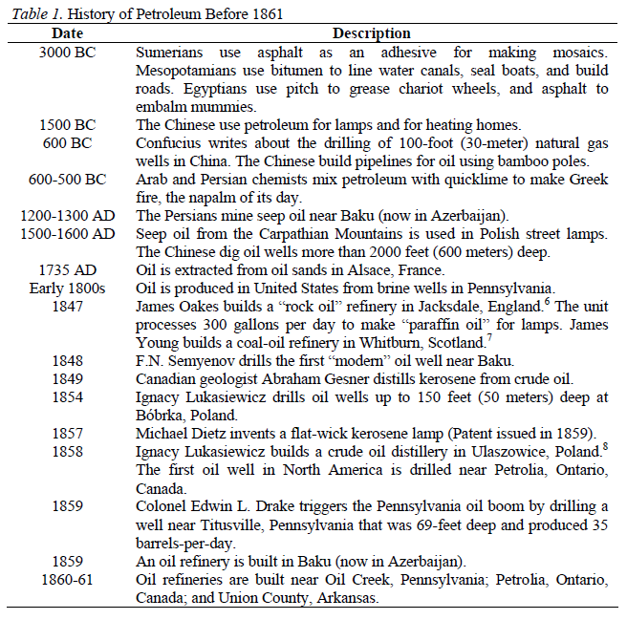

Slide 6
Petroleum Processing Overview
At the end of 2003, the world was consuming 78 million barrels of oil per day.
In August 2005, that volume of petroleum was worth $4.6 billion per day, or $1.7 trillion per year.
The availability of kerosene got a sudden boost on August 27, 1859, when Edwin L. Drake struck oil with the well he was drilling near Titusville, Pennsylvania.

Slide 7
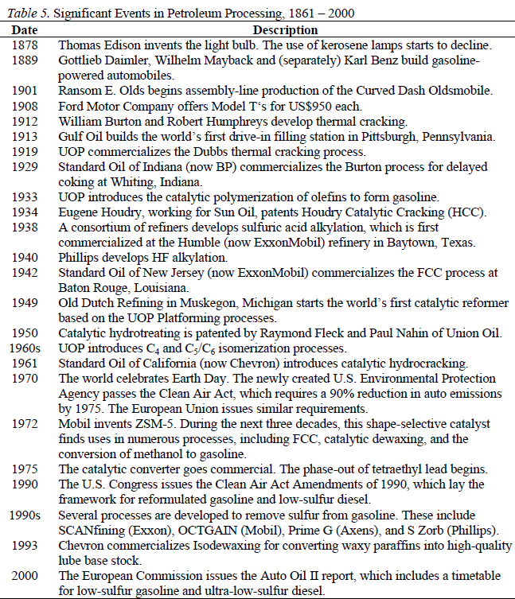
History of Petroleum Processing

Slide 8
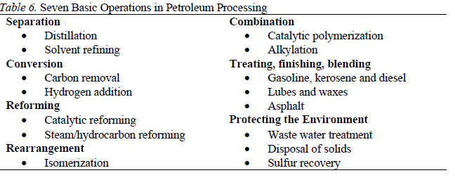
Modern Petroleum Processing
All refineries are different.
Oil refining separates everything into useful substances.
The petroleum refining industry converts crude oil into more than 2500 refined products, including liquefied petroleum gas, gasoline, kerosene, aviation fuel, diesel fuel, fuel oil, lubricating oil and petrochemical industry feedstock.
Most refineries perform the seven basic operations named

Slide 9
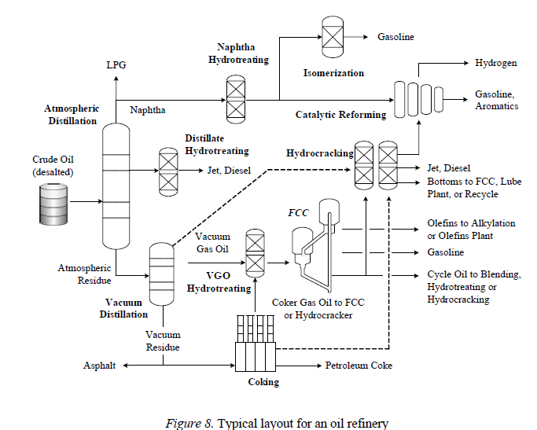

Slide 10
Petroleum Refinery Feed-Stocks and Products

Slide 11
• What is Petroleum or Crude Oil?
–Petroleum (Latin Petroleum derived from Greek πέτρα (Latin petra) - rock + έλαιον (Latin oleum) - oil) or crude oil is a naturally occurring liquid found in formations in the earth consisting of a complex mixture of hydrocarbons (mostly alkanes) of various lengths
– The approximate length range is C5H12 to C18H38. Any shorter hydrocarbons are considered natural gas or natural gas liquids, while long-chain hydrocarbons are
more viscous, and the longest chains are paraffin wax.
–In its naturally occurring form, it may contain other nonmetallic elements such as sulfur,
oxygen, and nitrogen.
–Crude oil vary from light coloured volatile liquids to thick, dark oils-so viscous that difficult to pump.
– To use the different parts of the mixture, they must be separated – refining.
• What is natural gas?
– A mixtures of hydrocarbons with small molecules.
– These molecules are made of atoms of C and H i.e. CH4.

Slide 12
• Why are oil and gas so useful?
– Oil is a liquid. Meaning that oil may be transported and delivered through pipes.
– Compare oil to coal-coal is a solid, which comes in lumps. To get it, miners have to work underground.
– HC with small molecules makes good fuels. Methane (smallest molecules, gas) used for cooking, heating and generating electricity. Gasoline, diesel, jet fuel and fuel oil are all liquid fuels.
– HC molecules can be split up into small ones, built up into bigger ones, altered in shape or modified by adding other atoms.
– Even the thick black tarry residue left after distillation is useful – bitumen (for road surfacing and roofing).
Due to its
􀂃 high energy density
􀂃 easy transportability
􀂃 relative abundance
It has become the world's most important source of energy since the mid-1950s. Petroleum is also the raw material for many chemical products, including pharmaceuticals, solvents, fertilizers, pesticides, and plastics; the 16% not used for energy production is converted into these other
materials.

Slide 13
Origin of Petroleum
Theories broadly classified into non-biogenic & biogenic :
• Non-biogenic : from inorganic sources
Metal carbides + H2O…..> Hydrocarbons
CaCO3 --->CaC2--->Acetylene--->Petroleum hydrocarbons
Reaction of CO2, in presence of alkali and alkaline earth metals, with water is also postulated to form hydrocarbons
Theory did not receive much recognition
•Biogenic : from organics, by bacterial transformation :
Organic matter (carbohydrates/proteins//lipid/ ligninboth from plant & animal origin -------->Decay in presence and/or absence of air into HC rich sediments which in presence of micro organism undergoes biological/physical and chemical alterations to form Kerogen (geopolymer) which may be coaly or sapropelic
Sapropelic Kerogen under high pressure and temperature further gets converted into Oil & Gas.
Widely accepted theory

Slide 14
Formation of Oil and Gas
• Where have crude oil and natural gas come from?

Slide 15
Accumulation of Oil and Gas
• The oil, gas, and salt water occupied the pore spaces between the grains of the sandstones.
• Whenever these rocks were sealed by a layer of impermeable rock, the cap rock, the petroleum accumulating within the pore spaces of the source rock was trapped and formed the petroleum reservoir.

