Slide 1
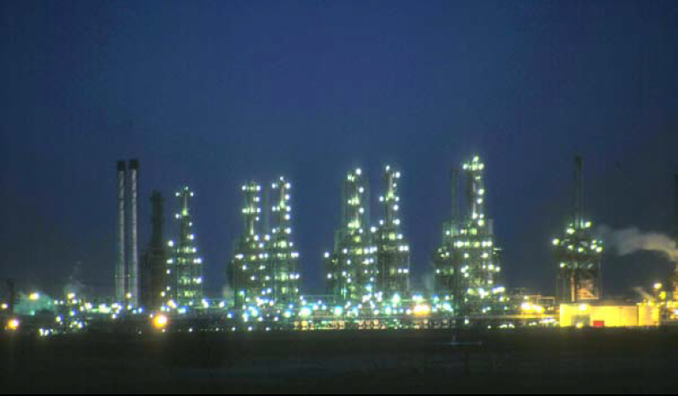
Lect./2 Petroleum refinery
Fourth Year - Chemical Process Eng. Branch
Petroleum Refinery Eng. Lectures
By
Dr. Adnan A. Abdul Razak

Slide 2
Refinery Feedstocks and Products

Slide 3
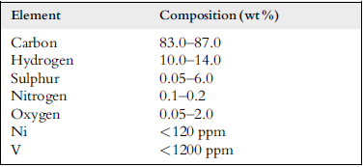
Chemical Composition of Petroleum
Petroleum is a mixture of hundreds of hydrocarbons of all type with water, salts, sulfur and nitrogen containing compounds and some metal complexes.
The elementary composition of crude oil usually falls within the following ranges.
The proportion of hydrocarbons in the mixture is highly variable and ranges from as much as 97% by weight in the lighter oils to as little as 50% in the heavier oils and bitumens.
Four different types of hydrocarbon molecules appear in crude oil. The relative percentage of each varies from oil to oil, determining the properties of each oil.
Table 2.1 Elemental composition of crude oils

Slide 4
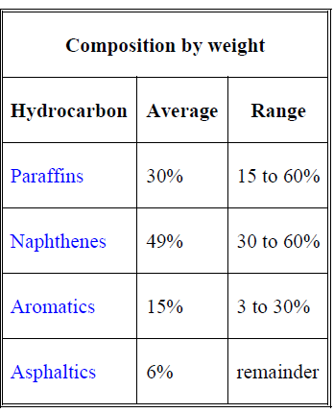

Slide 5
Paraffins
The paraffin series of hydrocarbons is characterized by the rule that the carbon atoms are connected by a single bond and the other bonds are saturated with hydrogen atoms. The general formula for paraffins is C_{n}H_{2n+2}. The simplest paraffin is methane, CH₄, followed by the homologous series of ethane, propane, normal and isobutane, normal, iso-, and neopentane, etc. (Fig. 1).
Figure( 1 ) Paraffins in crude oil.

Slide 6
Saturated alkanes: (n-alkane and i-alkane)
General formula C_{n}H_{2n+2}
Boiling point and density increase with increasing no. of C atoms.
Branched alkanes (iso-alkanes) is very small in quantity
Boiling point of straight chains > iso-alkanes with the same # of C

Slide 7
Naphthenes or cycloparaffins
Cycloparaffin hydrocarbons in which all of the available bonds of the carbon atoms are saturated with hydrogen are called naphthenes. Typical examples of these are cyclopentane, cyclohexane, etc. (Figure 2). General formula C_{n}H_{2n} for one ring compounds
Figure 2: Naphthene compounds

Slide 8
Aromatics
The aromatic series of hydrocarbons is chemically and physically very different from the paraffins and cycloparaffins (naphthenes). Aromatic hydrocarbons contain a benzene ring which is unsaturated but very stable and frequently behaves as a saturated compound. Some typical aromatic compounds are shown in (Figure 3).
Figure 3: Aromatic compounds

Slide 9
Olefins
Olefins do not naturally occur in crude oils. However, they are formed during its processing. They are very similar to paraffins, but they exhibit double bonds, usually one per molecule (Figure 4), although some di-olefins (two double bonds in the same molecule, ( Figure 5) can be found.
Figure 4: Olefin compounds
Figure 5: Di-olefin compounds

Slide 10
Sulfur Compound
(might be present in inorganic and organic forms)
(hydrogen sulfide, sulfides, disulfides, elemental sulfur).
Each crude oil has different amounts and types of sulfur compounds (sulfur concentration can range from 0.1 to more than 8 weight percent ), but as a rule the proportion, stability, and complexity of the compounds are greater in heavier crude-oil fractions.
Hydrogen sulfide is a primary contributor to corrosion in refinery processing units. Other corrosive substances are elemental sulfur and mercaptans.
Moreover, the corrosive sulfur compounds have an obnoxious odor.
The combustion of petroleum products containing sulfur compounds produces undesirables such as sulfuric acid and sulfur dioxide.
Catalytic hydrotreating processes such as hydrodesulfurization remove sulfur compounds from refinery product streams.
Sweetening processes either remove the obnoxious sulfur compounds or convert them to odorless disulfides, as in the case of mercaptans.

Slide 11
Oxygen Compounds
less than 1% (found in organic compounds such as carbon dioxide, phenols, ketones, carboxylic acids)
Carboxylic (OH-C=O bonded to a benzene ring)
Phenolic (OH bonded to a benzene ring)
Oxygen compounds are responsible for petroleum acidity

Slide 12
Nitrogen Compounds
less than 1% (basic compounds with amine groups)
carbazole (2 benzene rings separated by 1 N atom) – neutral
Quinoline (2 benzene rings with 1 N atom on 1 ring) – basic
Nitrogen oxides can form in process furnaces. The decomposition of nitrogen compounds in catalytic cracking and hydrocracking processes forms ammonia and cyanides that can cause corrosion.

Slide 13
Metals
less than 1% (nickel, iron, vanadium, copper, arsenic)
Often found in crude oils in small quantities and are removed during the refining process.
Burning heavy fuel oils in refinery furnaces and boilers can leave deposits of vanadium oxide and nickel oxide in furnace boxes, ducts, and tubes.
It is also desirable to remove trace amounts of arsenic,
vanadium, and nickel prior to processing as they can poison certain catalysts.

Slide 14
Salts
less than 1% (sodium chloride, magnesium chloride, calcium chloride.
Crude oils often contain inorganic salts such as sodium chloride, magnesium chloride, and calcium chloride in suspension or dissolved in entrained water (brine).
These salts must be removed or neutralized before processing to prevent catalyst poisoning, equipment corrosion, and fouling.
Salt corrosion is caused by the hydrolysis of some metal chlorides to hydrogen chloride (HCl) and the subsequent formation of hydrochloric acid when crude is heated.
Hydrogen chloride may also combine with ammonia to form ammonium chloride (NH4Cl), which causes fouling and corrosion.

Slide 15
Naphthenic Acids
Some crude oils contain naphthenic (organic) acids, which may become corrosive at temperatures above 450° F when the acid value of the crude is above a certain level.

Slide 16
Basic products:
Petroleum refineries are large, capital-intensive manufacturing facilities with extremely complex processing schemes. They convert crude oils and other input streams into dozens of refined (co-)products, including: The basic products from fractional distillation are:

Slide 17
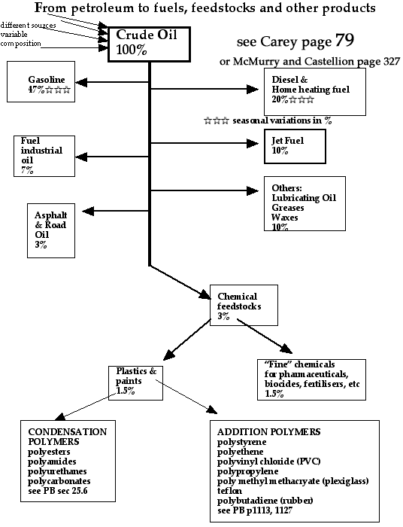

Slide 18
Liquid petroleum gas (LPG) :
Used for heating, cooking, making plastics
Small alkanes (1 to 4 carbon atoms)
Commonly known by the names methane, ethane, propane, butane
Boiling range < 90 degrees Fahrenheit / < 27 degrees Celsius
Often liquified under pressure to create LPG (liquified petroleum gas)

Slide 19
Gasoline - motor fuel:
Its main use is as fuel for internal combustion engines.
Liquid
Mix of alkanes and cycloalkanes (5 to 7 carbon atoms)
Boiling range = 90-220 degrees Fahrenheit / 27-93 degrees Celsius

Slide 20
Naphtha :
Intermediate that will be further processed
to make gasoline
Mix of 6 to 10 carbon atom alkanes
Boiling range = 220-315 degrees Fahrenheit / 93-177 degrees Celsius

Slide 21
Kerosene :
Used for heating, fuel for jet engines and tractors; starting material for making other products
Liquid
Mix of alkanes (10 to 15 carbons) and aromatics
Boiling range = 315-450 degrees Fahrenheit / 177-293 degrees Celsius

Slide 22
Gas oil or Diesel distillate:
Used for diesel fuel and heating oil; starting material for making other products
Liquid
Alkanes containing 13-18 carbon atoms
Boiling range = 450-650 degrees Fahrenheit / 293-315 degrees Celsius

Slide 23
Lubricating oil :
Used for motor oil, grease, other lubricants
Liquid
Long chain (20 to 50 carbon atoms) alkanes, cycloalkanes, Aromatics
Boiling range = 572 to 700 degrees Fahrenheit / 300 to 370 degrees Celsius

Slide 24
Heavy gas or Fuel oil :
Used for industrial fuel; starting material for making other products
Liquid
Long chain (16 to 40 carbon atoms) alkanes, cycloalkanes, Aromatics
Boiling range = 650-800 degrees Fahrenheit / 315-565 degrees Celsius

Slide 25
Residuals :
Coke, asphalt, tar, waxes; starting material for making other products
Solid
Multiple-ringed compounds with 40 or more carbon atoms
Boiling range = greater than 800 degrees Fahrenheit / 565 degrees Celsius

