Slide 1
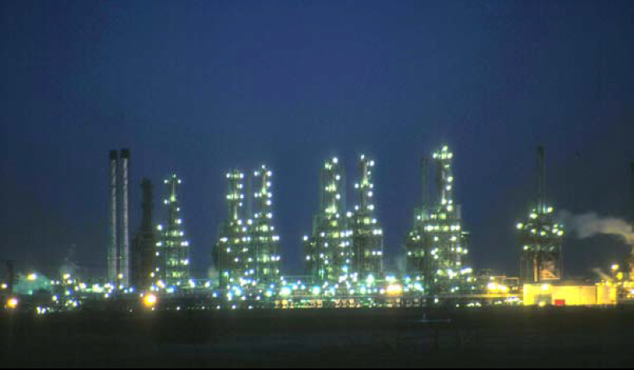
Lect./3 Petroleum refinery
Fourth Year - Chemical Process Eng. Branch
Petroleum Refinery Eng. Lectures
By
Dr. Adnan A. Abdul Razak

Slide 2
Thermo-physical Properties of Petroleum Fractions and Crude Oils

Slide 3
Classification of Petroleum
Objective of Crude Oil Characterisation / Crude Assay
Marketing / Pricing of Crude Oil
Transportation of Crude Oil
Design of Grass Root Refinery
Processing of a new crude oil in an operating Refinery
Expansion / Modification of an operating Refinery –Primary / Secondary operations
Optimization of the product yields
Value Addition

Slide 4
The petroleum industry generally classifies crude oil
By the geographic location it is produced in (e.g. West Texas, Brent, or Oman),
Its API gravity (an oil industry measure of density), and
By its sulfur content.

Slide 5
According to Location
West Texas Intermediate (WTI), a very high-quality, sweet, light
oil delivered at Cushing, Oklahoma for North American oil
Brent Blend, comprising 15 oils from fields in the Brent and
Ninian systems in the East Shetland Basin of the North Sea. The oil is landed at Sullom Voe terminal in the Shetlands. Oil production
from Europe, Africa and Middle Eastern oil flowing West tends to
be priced off the price of this oil, which forms a benchmark
Dubai-Oman, used as benchmark for Middle East sour crude oil
flowing to the Asia-Pacific region
Tapis (from Malaysia, used as a reference for light Far East oil)
Minas (from Indonesia, used as a reference for heavy Far East oil)
The OPEC Reference Basket, a weighted average of oil blends
from various OPEC (The Organization of the Petroleum Exporting
Countries) countries

Slide 6
According “API” Gravity
Specific gravity and API (American Petroleum Institute) gravity are expressions of the density or weight of a unit volume of material.
The specific gravity is the ratio of the weight of a unit volume of oil to the weight of the same volume of water at a standard; both specific gravity and API gravity refer to these constants at 60 ⁰F(16 ⁰ C).
• Light Crude Oil >31
• Mixed Based 22-31
• Heavy crude<22
API is a major factor for Crude pricing

Slide 7
According to Sulfur Content
Crude oil naturally contains sulfur compounds.
Crudes are classed as sweet or sour depending on their sulfur content.
If a crude has less than 0.5% sulfur in it, it is considered to be "sweet".
If has greater than 2.5% sulfur, it is "sour".
A crude with a sulfur content between these two endpoints is called "intermediate".

Slide 8
Light crude oil is more desirable than heavy oil
since it produces a higher yield of gasoline,
While sweet oil commands a higher price than sour oil because it has fewer environmental problems
and requires less refining to meet sulfur standards imposed on fuels in consuming countries.

Slide 9
According to types of hydrocarbons ( parafffins , naphthenes , and aromatics).
This rating is important to the refinery since the value of the crude oil decreases from classification 1 to 6
Crude Classifications (in order of decreasing value):
1) Paraffinic Crudes
• paraffins + naphthenes > 50%
• paraffins > naphthenes
• paraffins > 40%
2) Naphthenic Crudes
• paraffins + naphthenes >50%
• naphthenes > paraffins
• naphthenes >40%
3) Paraffinic – Naphthinic Crudes
• aromatics < 50%
• paraffins < 40%
• naphthenes < 40%
4) Aromatic – Naphthenic Crudes
• aromatics > 50%
5) Aromatic - Intermediate Crudes
• aromatics > 50%
• paraffins >10%
6) Aromatic – Asphaltic Crudes
• naphthenes > 25%
• paraffins < 10%

Slide 10
Quantitative Basis
Approach based on determining the base of a crude oil by one of the following methods :
US Bureau of Mines Classification based on degree API:
Note | API | Pressure | Boiling point | Key Fraction
 | > 40 (Paraffinic Base) 33<API >40 (Intermediate Base) API < 33 (Napthene Base) | atm. | 482-527 | No. 1
The presence of wax is noted by cloud point (if below 5) it indicates little wax (Wax-free) | > 30 (Paraffinic Base) API < 22 (Napthene Base) 22<API<30 (Intermediate Base) | (40-mm)Hg 1 atm | 527-572 733-779 | No. 2

Slide 11
Characterization Factor: (C.F), (K)
The most widely used index is characterization factor (Watson, Nelson and Murphy).
It was originally defined as:
In which:
TMABP is the molal average boiling point ( R)
Sp. gr. : is the specific gravity at 60 ⁰F
It has since related to viscosity, aniline, temperature, molecular weight, critical temperature, percentage of hydrocarbon etc.
K≥ 12.15 (Paraffinic Base)
K< 11.5 (Napthene Base)
K between 11.5-12.15 (Intermediate Base)

Slide 12
ii) Bureau of Mines Correlation Index (BMCI):
Like (C.F) related to boiling point and gravity
The correlation index is useful in evaluating individual fractions from crude oils.
The CI scale is based upon straight-chain paraffins having a CI value of 0 and benzene having a CI value of 100.
The CI values are not quantitative, but the lower the CI value, the greater the concentrations of paraffin hydrocarbons in the fraction;
and the higher the CI value, the greater the concentrations of naphthenes and aromatics.

Slide 13
Analysis of Crude Petroleum
When a refining company evaluate its own crude oils to determine the most desirable processing sequence to obtain the required products,
Its own laboratories will provide data concerning the distillation and processing of the oil and its fractions.
The first step in refinery is distillation in which the crude oil separated into fractions according to its boiling point.
There are at least three types of distillation curves or ways of relating vapor temperature and percentage vaporized.
True-boiling-point (T.B.P)
Equilibrium or Flash Vaporization (EFV)
ASTM or no fractionating distillation

Slide 14
1. True-boiling-point (T.B.P)
Fractional, run only on crude oil, batch . Fig (4.7)
This test enlightens the refiners with
All possible information regarding the percentage quantum of fractions,
Base of crude oil and
The possible difficulties beset during treatment operation etc.
Distillation characteristics of a crude are assessed performing a preliminary distillation called "True Boiling Point" analysis (TBP).
True boiling point (TBP) and gravity-mid percent curves can be developed:
The first is the portion of the distillation at atmospheric pressure and up to 527 ⁰F (275 ⁰C) end point, the second at 40 mm Hg total pressure to 572 ⁰F (300 ⁰C) end point. Table (1)
The distillation temperatures reported in the analysis be corrected to 760 mm Hg pressure , by use of chart Fig. (1)
The gravity mid- percent curve is plotted on the same chart with TBP. Fig .(3)

Slide 15
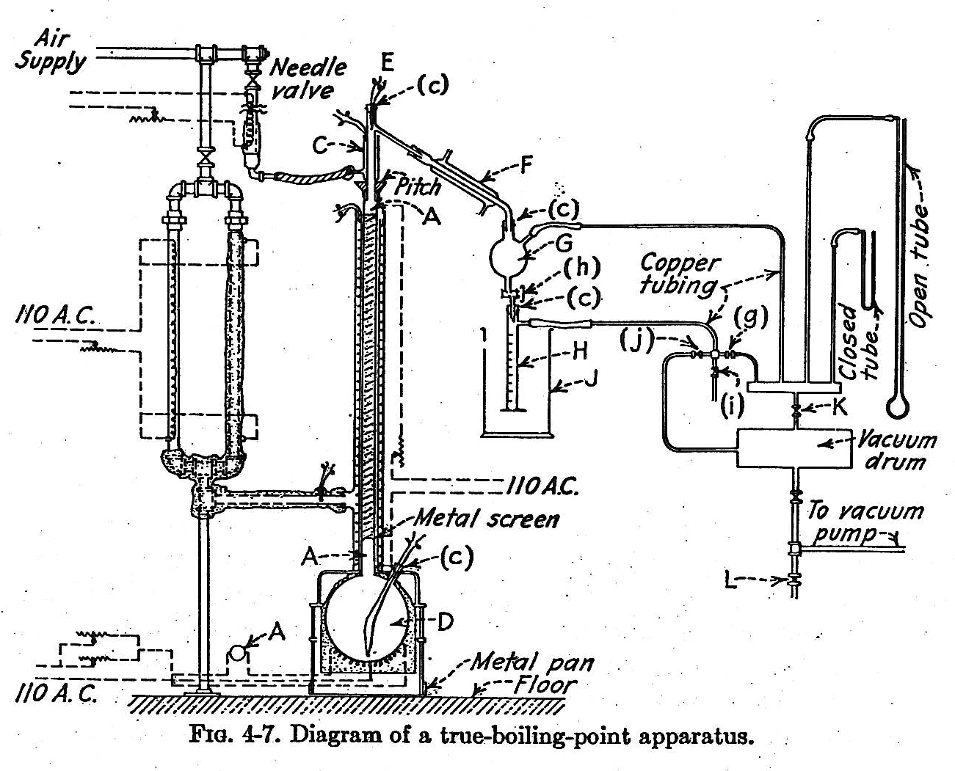

Slide 16
Table (1) U.S Bureau of Mines crude petroleum analysis (From Gary and Handwerk, 2001)

Slide 17
Figure (1) Boling point at 760 mmHg versus boiling point at 40mmHg (From Gary and Handwerk, 2001)

Slide 18
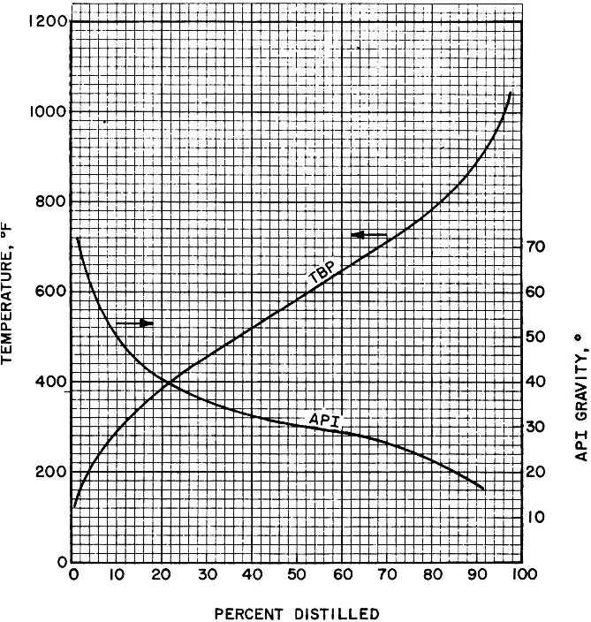

Slide 19
2. Equilibrium or Flash Vaporization (EFV).
The feed material is heated as it flows continuously through a heating coil.
As vapor is formed it kept cohesively with liquid at some temperature and a sudden release of pressure quickly flashes or separates the vapor from the mixture without any rectification.
By successive flash evaporation like this the stock can be progressively distilled at different increasing temperatures. a curve of percentage vaporized vs. temperature may be plotted.
Travels along in the tube with remaining liquid until separation is permitted in a vapor separator or vaporizer.
By conducting the operation at a series of outlet temperature, a curve of percentage vaporized vs. temperature may be plotted.

Slide 20
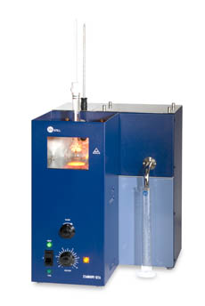
3. ASTM or no fractionating distillation:
(no fractional , run on fractions) .
It is supposed to be like EFV, a non fractionating distillation system.
It is a simple distillation carried out with standard ASTM flasks 100,200,500 ml flasks.
The data obtained is similar to TBP data
Fractionation column like (IP24 or D86).

Slide 21
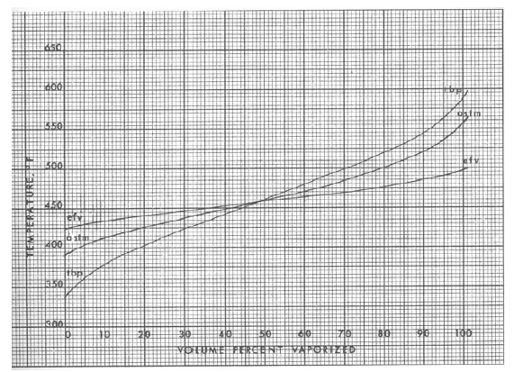
TBP, EFV and ASTM curves for a 39.7 degree API distillate

Slide 22
Calculation of (K) (Characterization Factor) for The Whole Crude
1. Calculate the TVABP using 20, 50, and 80 volume % TBP temperature.
2. Calculate the 10 to 70% slope of the whole curve.
3. Using a proper correction factor, convert TVABP to TMABP. (or some time given ):
(TMABP=TVABP-ΔT)
4. Constract a spg mid percent curve and evaluate the spg for the whole crude.
5. K is found as a function of TMABP and sp. gr.

Slide 24

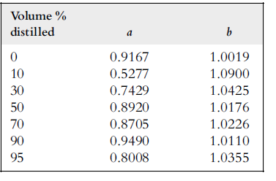
Conversion between ASTM and TBP Distillation
The following equation suggested by Riazi and Daubert
where a and b are constants varying with percent of liquid sample distilled as
given in Table 3
TBP is true boiling point temperatures at 0, 10, 30, 50, 70, 90, and 95 volume percent distilled, in degrees Rankin.
ASTM D86 isthe observed ASTM D86 temperatures at corresponding volume percent
distilled, in degrees Rankin.
Table 3

Slide 25
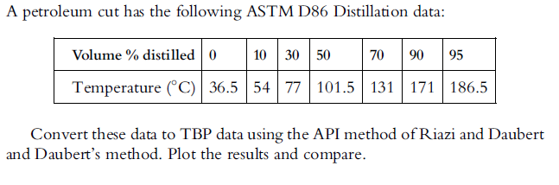
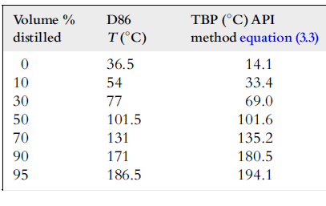
Example
Solution
Application of the API method is straightforward using equation (3) and the
constants in Table 3

Slide 26
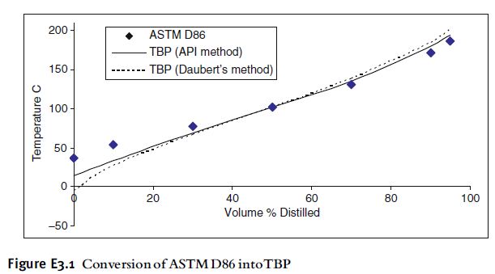
As can be seen from Figure E3.1, the TBP distillation curve is below the ASTM curve at volume distilled below 50% and above it for volume distilled above 50%.

Slide 27
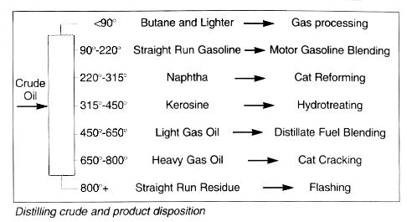
Distillation Fractions: All the components that boil between the two specified temperature which called the cut point
Cut Point
Each fraction has an IBP and EP on ASTM curve because of un efficient fractionation the IBP of heavier fraction is interrelated with the EP of lighter fraction.

Slide 28
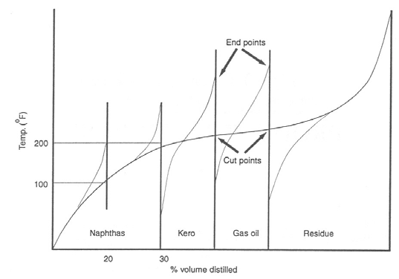
Figure 4: Cut points and end points.

Slide 29
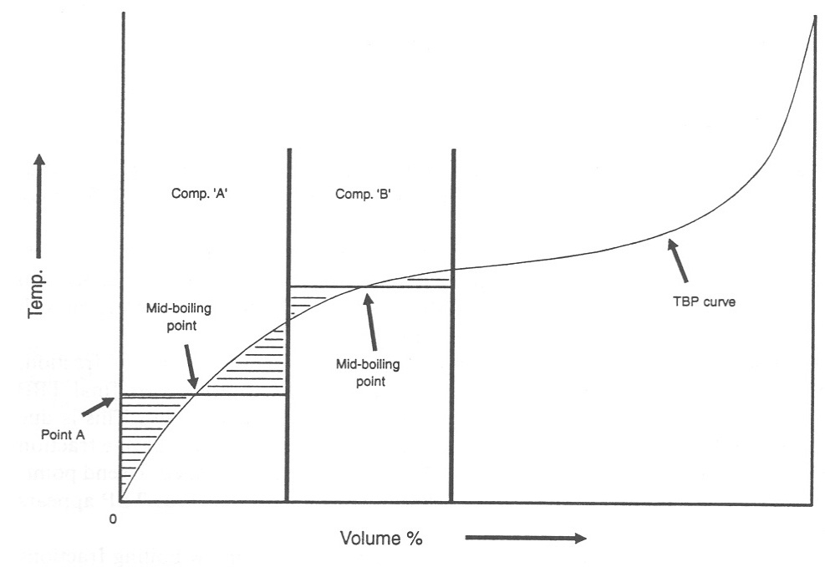

Slide 30
H.W (1): 4000 BPD of (35 ⁰ API) crude oil having the given TBP data is available.
a) Draw an assay curve.
b) Evaluate the given crude ; TMABP=TVABP- 120 ( ⁰ F )
c) Select TBP cut temperature for the products to be obtained from distilling this crude and estimate their yields.
% Sulfur | ⁰API | % vol. Distilled | TBP ⁰F
- | 110 | 1 | 85
- | 63 | 13 | 180
0.1 | 49 | 30 | 385
0.3 | 38 | 50 | 510
0.5 | 23 | 63 | 620
0.8 | 20 | 73 | 750
1.5 | 17 | 84 | 1000
2.3 | 11 | 100 | 1000⁺

Slide 31
H.W (2) : For the given crude oil (35.5 ⁰ API) ;
a) Evaluate the given oil.
b) Select TBP cut points for the products to be obtained from processing this crude in an atmospheric distillation unit and estimate the %yield for each cut.
% S | API | TBP (⁰F ) | % vol. Distilled
--- | --- | 40 | 0
0.1 | 40 | 200 | 20
0.18 | 35 | 280 | 40
0.25 | 30 | 330 | 60
0.42 | 26 | 410 | 80
0.68 | 25 | 500 | 90
0.8 | 20 | 520 | 95

Slide 32
H.W (3) : For the given crude oil (31.7 0 API ),sulfur percent 0.15 ;
a) Evaluate the given oil.
b) Select TBP cut points for the products to be obtained from processing this crude in an atmospheric distillation unit and estimate the %yield for each cut.
Stage 1- Distillation at atmospheric pressure 751 mm Hg
⁰ API 60 ⁰F | Sp. gr. 60/60 ⁰F | Sum. Percent | Percent Distilled | Cut Temp. ⁰F | Fraction No.
78.8 | 0.673 | 0.8 | 0.8 | 122 | 1
75.1 | 0.685 | 1.8 | 1.0 | 167 | 2
63.7 | 0.725 | 4.8 | 3 | 212 | 3
55.9 | 0.755 | 8.2 | 3.4 | 257 | 4
50.6 | 0.777 | 11.3 | 3.1 | 302 | 5
45.8 | 0.798 | 15.2 | 3.9 | 347 | 6
41.7 | 0.817 | 20.1 | 4.9 | 392 | 7
38.4 | 0.833 | 26.9 | 6.8 | 437 | 8
35.4 | 0.848 | 34.9 | 8.0 | 482 | 9
32.3 | 0.864 | 45.8 | 10.9 | 527 | 10

Slide 33
Stage 2- Distillation at atmospheric pressure 40 mm Hg
⁰ API 60 ⁰F | Sp. gr. 60/60 ⁰F | Sum. Percent | Percent Distilled | Cut Temp. ⁰F | Fraction No.
30.6 | 0.873 | 53.1 | 7.3 | 392 | 11
29.5 | 0.879 | 60.9 | 7.8 | 437 | 12
27.7 | 0.889 | 67.1 | 6.2 | 482 | 13
25.6 | 0.901 | 72.8 | 5.7 | 527 | 14
22.94 | 0.916 | 79.7 | 6.9 | 572 | 15
18.2 | 0.945 | 100.0 | 20.3 | ------- | 16

