Slide 1
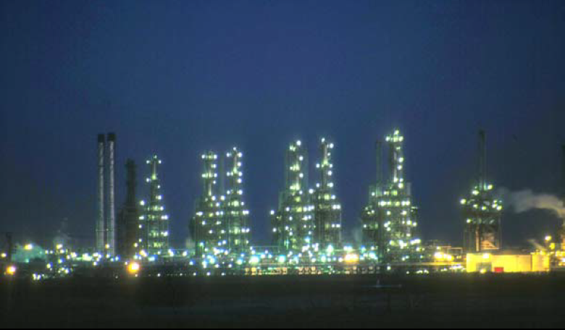
Fourth Year - Chemical Process Eng. Branch
Petroleum Refinery Eng. Lectures
By
Dr. Adnan A. Abdul Razak

Slide 2
Lect./4 Petroleum refinery
Degassing and Dehydration

Slide 3
Degassing and Dehydration
In a producing oilfield the fluid obtained at the wellhead is submitted to :
1- Dehydration
operation
2- Degassing
operation

Slide 4
Degassing and Dehydration
1- Degassing: -
At the high pressure existing at the bottom of the producing well, crude oil contains great quantities of dissolved gases. When crude oil is brought to the surface, it is at a much lower pressure. Consequently, the gases that were dissolved in it at the higher pressure tend to come out from the liquid.

Slide 5
Degassing and Dehydration
Two-Phase Gas–Oil Separation
High-pressure crude oils containing large amount of free and dissolved gas flow from the wellhead into the flow line, which routes the mixture to the GOSP. (This is usually done by admitting the well fluid into a gas–oil separator plant (GOSP) through which the pressure of the gas–oil mixture is successively reduced to atmospheric pressure in a few stages). In the separator, crude oil separates out, settles, and collects in the lower part of the vessel.

Slide 6
Degassing and Dehydration
Gas goes out the top of the separators to a gas collection system, a vapor recovery unit (VRU), or a gas flow line. Crude oil, on the other hand, goes out the bottom and is routed to other stages of separation, if necessary, and then to the stock tank (Fig. 1).

Slide 7
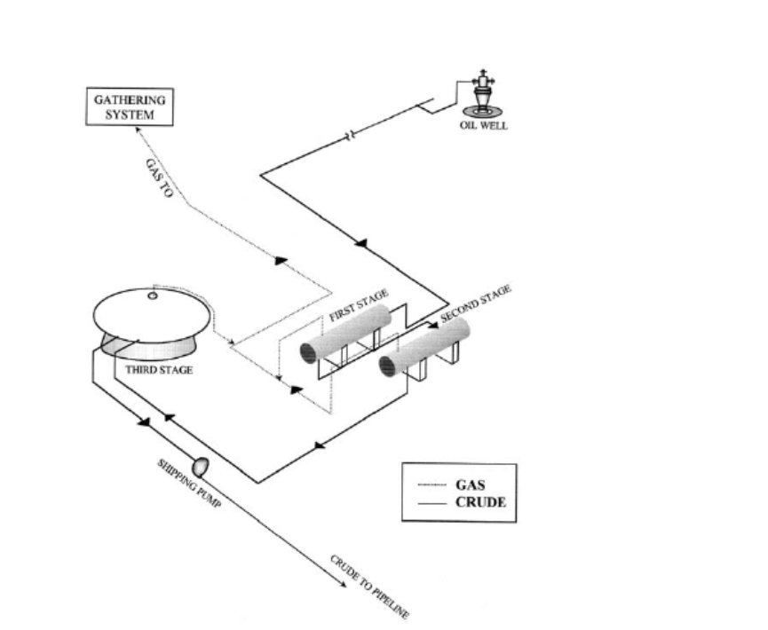
Degassing and Dehydration

Slide 8
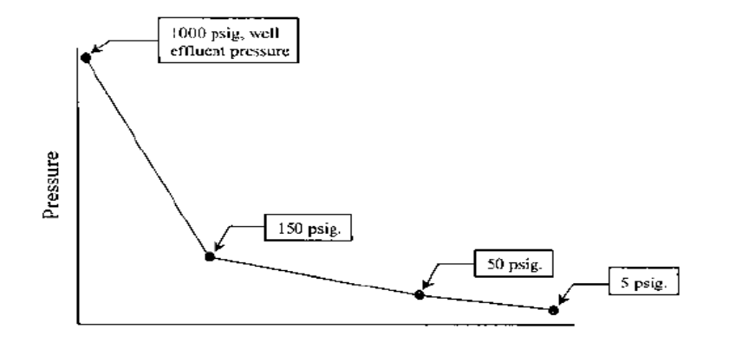
Degassing and Dehydration
Figure 2 : Pressure-drop profile for a typical GOSP in the Middle East.
- Volatile components either sent to consumer centers as natural gas or used to repressurize the oilfield.
The stripped liquid components are marketed as stabilized natural gasoline.

Slide 9
CRUDE OIL (DESALTING)
The fluid produced at the wellhead consists usually gas, oil, free water, and emulsified water (water–oil emulsion).
The gas remove by degassing process
First step in the refining process is to remove salt and solids to reduce corrosion, plugging, and fouling of equipment and to prevent poisoning of the catalysts in processing units.
contaminants must be removed by desalting (dehydration).
If the salt content of the crude is greater than 10 lb/1000 bbl (expressed as NaCl), the crude requires desalting to minimize fouling and corrosion caused by salt deposition on heat transfer surfaces and acids formed by decomposition of chloride salts.(<1000 lb/bbl).

Slide 10
Typical Configuration Atmospheric Column w/o Preflash

Slide 11
Degassing and Dehydration
The basic principles for the treating process are as follows:
1. Removal of free water.
2. Resolution of Emulsified Oil.

Slide 12
Degassing and Dehydration
Removal of free water:-
Free water is simply defined as that water produced with crude oil and will settle out of the oil phase if given little time.
There are several good reasons for separating the free water first:
3. Minimization of corrosion because free water comes into direct contact with the metal surface, whereas emulsified water does not.
2. Reduction of heat input when heating the emulsion (water takes about twice as much heat as oil).
1. Reduction of the size of flow pipes and treating equipment.

Slide 13
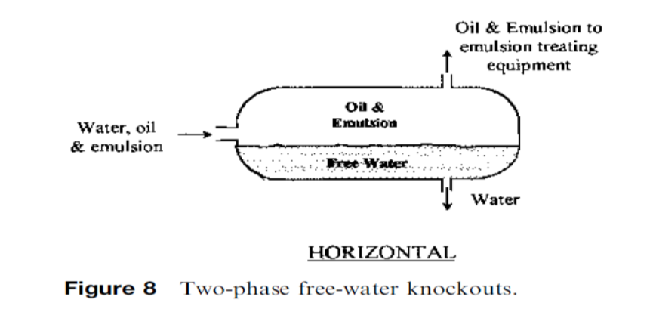
Degassing and Dehydration

Slide 14
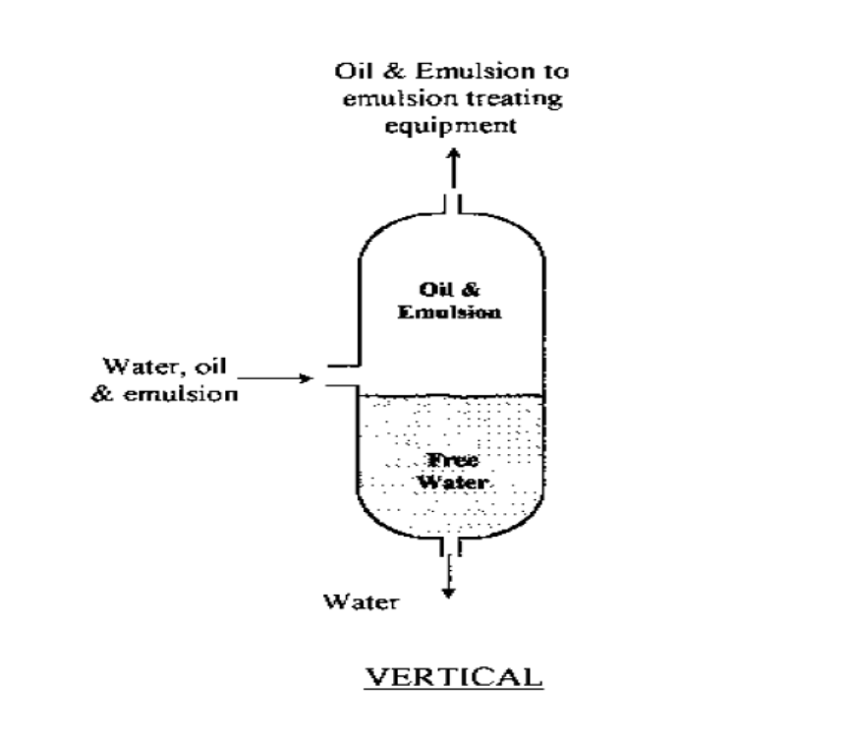
Degassing and Dehydration

Slide 15
Degassing and Dehydration
2. Resolution of Emulsified Oil:
Oil emulsions are mixtures of oil and water. In general, an emulsion can be defined as a mixture of two immiscible liquids, one of which is dispersed as droplets in the other (the continuous phase), and is stabilized by an emulsifying agent.

Slide 16
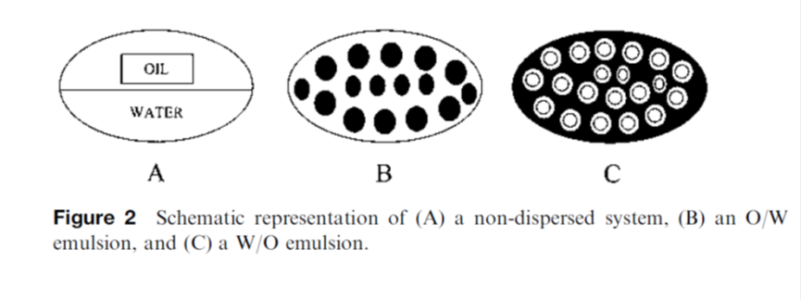
Degassing and Dehydration
In the oil field, crude oil and water are encountered as the two immiscible phases together. They normally form water-in-oil emulsion (W/O emulsion), in which water is dispersed as fine droplets in the bulk of oil. This is identified as type C in Figure 2.

Slide 17
Degassing and Dehydration
2. There must be sufficient energy of agitation to disperse one phase into the other.
3. There must be the presence of an emulsifying agent.
1. The two liquids must be immiscible.
For two liquids to form a stable emulsion, three conditions must exist:

Slide 18
Degassing and Dehydration
Some of the common emulsifiers are as follows:
1. Asphaltic materials
2. Resinous substances
3. Oil-soluble organic acids
4. Finely dispersed solid materials such as sand, carbon, calcium, silica, iron, zinc, aluminum sulfate, iron sulfide, and so on.

Slide 19
Crude possessing emulsifying
To increase the coalescence of water drops. (Soda ash, sodium hydroxide, salt of fatty acids petroleum sulfonates which assist coalescence of water droplets).

Slide 20
Resolution of Emulsified Oil consists of three consecutive steps:
A. Breaking the emulsion:
Using chemicals followed by settling can break some emulsions.
Other emulsions require heating and allowing the water to settle out of the bulk of oil.
More difficult (tight) emulsions require, however, both chemicals and heat, followed by coalescence and gravitational settling.
Basically, a dehydration process that utilizes any or a combination of two or more of the treatment aids mentioned earlier (heating, adding chemicals) is used to resolve water-oil emulsions.

Slide 21
B. Coalescence: This involves the combination of water particles that became free after breaking the emulsion, forming larger drops.
C. Gravitational settling and separation of water drops:
The larger water droplets resulting from the coalescence step will settle out of the oil by gravity and be collected and removed.

