Slide 1
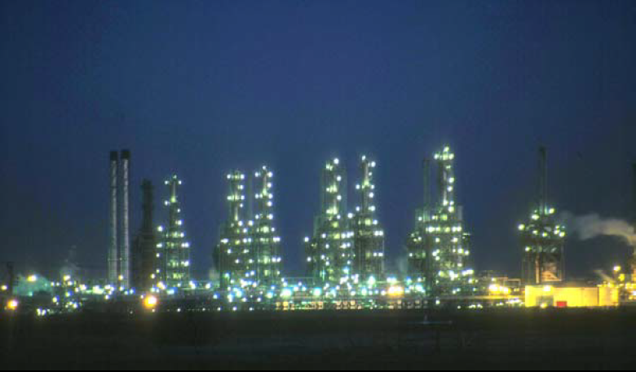
Fourth Year - Chemical Process Eng. Branch
Petroleum Refinery Eng. Lectures
By
Dr. Adnan A. Abdul Razak

Slide 2
Lect./5 Petroleum refinery
Heating of Crude Oil

Slide 3
1.Introduction:
Furnaces are used throughout the industry to provide the heat, using the combustion of fuels.
These fuels are solid, liquid or gaseous.
Furnaces consist essentially of an insulated, refractory lined chamber containing tubes.
Tubes carry the process fluid to be heated, and sizes are device for burning the fuel in air to generate hot gases. A great variety of geometries and sizes are used.
However, all furnaces have in common the general feature of heat transfer from hot gas source to a cold sink.

Slide 4
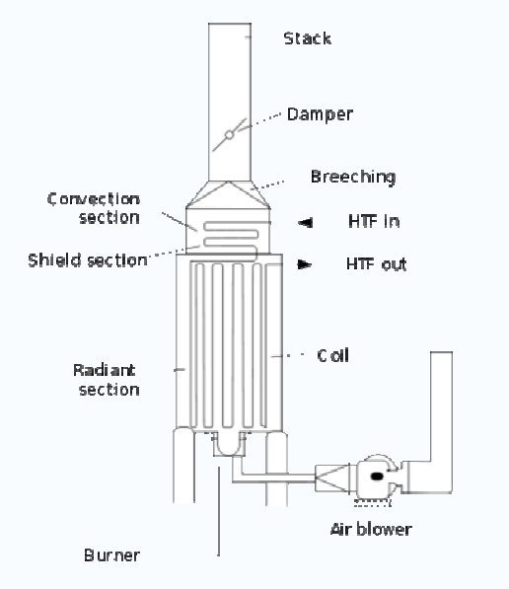
2.Types of furnaces used in process plant
An industrial furnace or direct fired heater, Fig.(1), is an equipment used to provide heat for a process or can serve as reactor which provides heats of reaction.
Furnace designs vary as to its function, heating duty, type of
fuel and method of introducing combustion air. However, most process furnaces have some common features.

Slide 5
Fuel flows into the burner and is burnt with air provided from an air blower.
There can be more than one burner in a particular furnace which can be arranged in cells which heat a particular set of tubes.
The flames heat up the tubes, which in turn heat the fluid inside in the first part of the furnace known as the radiant section or firebox.
In this chamber where combustion takes place, the heat is transferred mainly by radiation to tubes around the fire in the chamber.
The heating fluid passes through the tubes and is thus heated to the desired temperature.
The gases from the combustion are known as flue gas.
After the flue gas leaves the firebox, most furnace designs include a convection section where more heat is recovered before venting to the atmosphere through the flue gas stack.

Slide 6
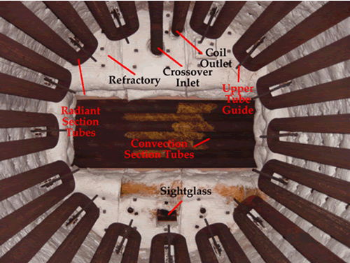
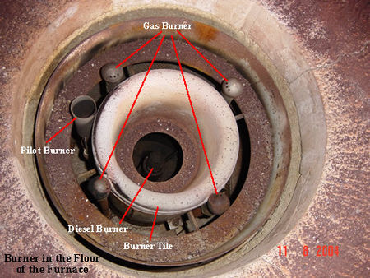
Middle of radiant section
Convection section
Furnace burner

Slide 9
Heating of Crude Oil
Pipe Still Heater
Pipe heaters can be categorized into three types:
3) Radiant Wall
2) Cylindrical.
1) Box/ Rectangular.
All these furnaces have got separate radiation section and convection section. The most universal classification is based on direction of tubes as well as shape of furnace and mode of application of heat.

Slide 10
Heating of Crude Oil
In most of the furnaces, the direction of tubes is horizontal as in all box type heaters and vertical in cylindrical stills. Radiant walls also use horizontal tubes; however tubes can be placed vertically also.
The radiant section design is based on Stefan's law of radiation:
A: area of radiating surface, ft²
b : 1.72x10⁹ Btu/ ºF ft² hr. at black bod conditions.
T: absolute temperature of the surface,ºF

Slide 11
Heating of Crude Oil
For a satisfactory design, the following schedule of heat distribution may be employed:
Type of heat | Percent
Convection heat transfer | 30-50%
Radiant heat transfer | 45-60%
Losses (Furnace) | 5%
Stack losses | 12%
Design of a furnace radiation section is based on Hottle, Wilson method and radiant heat absorption is given as:-

Slide 12
R= % heat absorbed in radiant section.
Q = Total heat developed by flame
G= Air /fuel ratio (wt. basis).
α = Factor to convert actual exposed surface to cold surface:
0.986 for two rows at spacing 2 OD.
0.88 for one rows at spacing 2 OD.
If
Q in Kj / hr S=14200 Area in m²
Q in Btu/hr S=4200 Area in ft²
Q in Kcal/hr S=6930 Area in m²

Slide 13
Heating of Crude Oil
A_{cp} = area of furnace wall that has tube mounted on it (ft²).
α A_{cp}= equivalent cold plane surface (ft²)
L= length.
C= Center to center spacing.
N= Number of tube per row.
A= Projected area
D= Tube diameter ( in )

Slide 14
Heating of Crude Oil
n= no. of rows
RQ = Aq
q= rate of heat absorption per square foot of projected tube area

Slide 15
Heating of Crude Oil
For a most commercial case D/C= 0.5 , n=2

Slide 16
Heating of Crude Oil
Example:-
A petroleum stock at a rate of 1200 bbl/hr. of sp. gr. 0.8524 is passed through a train of heat exchangers and is allowed to enter directly the radiant section of box type heater at 220 º C . The heater is designed to burn 3500 kgs per hour of refinery off gases as fuel.
The net heating value of fuel is 47.46x10³ Kj per kg.
The radiant section contains 150 sq. meters of projected area of one row of tubes (10.5 cm, 12 m long and spaced at 2 OD).
>> Find the outlet temperature of the petroleum stock?
Where,
α=0.88
Air fuel ratio= 25
Average Specific heat of stock=2.268 Kj/Kg º C.

Slide 17
Heating of Crude Oil
Solution
Total heat liberated (Q) = m _{fuel} * NHV
= 47.46*10³ * 3500 = 1.66*10⁸ Kj/hr.
Projected area of one tube (L * D) = 12 * 0.105
No. of tubes = 150 / ( 12 * 0.105 ) = 120 tubes
α A _{cp}= 0.88 * 120 * 0.105 * 2 * 12 = 266 Sq. m.
Heat absorption %(R)

Slide 18
Heating of Crude Oil
Outlet temperature of the stock:-
Q = m Cp Δt
0.44*1.66*10⁸ = 1200 * 200 * 0.8524* 2.268 * Δt
؞Δt =157 º C
So the outlet temperature is equal to 157 + 220 = 377 º C

Slide 19
Heating of Crude Oil
Example
A pipe still uses 7110 lb/hr of a cracked gas (Net Heating Value (NHV) 20560 Btu/lb). The radiant section contains 1500 sq ft of projected area, and the tube (5 in. outside diameter) are spaced at a center-to-center distance of 10 in. there is only one row of radiant tubes, and they are 40 ft long. The ratio of air to fuel is (21 - 30 percent excess air).
a) What percentage of the heat liberation is absorbed in the radiant section?
b) How many Btu are absorbed per hour through each square foot of projected area?

Slide 20
Heating of Crude Oil
Solution
Total heat liberated(Q)= m _{fuel} * NHV
= 7110 * 20560
=146000000 Btu/hr
A = 1500
N = number of tubes
= 90
= 40 * 90 *10 / 12 = 3000
α A _{cp}= 0.88 * 3000 = 2640 sq ft

Slide 21
Heating of Crude Oil
Heat absorption %(R)
Heat absorption in radiant section = 0.458 *146 *10⁶
= 66900000 Btu/hr
Heat absorbed / sq ft projected area = q = 66900000/1500
= 44500 Btu/hr.ft²

Slide 22
Heating of Crude Oil
H.W (1)
A furnace is to be designed for a heat duty of 30 x 10⁶ Btu/hr and efficiency of 75%.
The furnace is fired with gaseous fuel at a rate of 17 lb air/lb fuel (NHV = 17000 Btu/lb).
The tube are arranged in two rows and are of 5 in OD., 40 ft length and 2x OD.
Spacing, heat rate of 35000 Btu/hr of projected area is recommended.
calculate:
1) % heat absorbed in radiation section (R %).
2) Heat absorbed in the convection section.
(State any assumptions used).
3) The number of tubes in the radiation section.

Slide 23
Solution
a)
0.581= (1-R)²
R= 47.55%
Heat absorbed in radiation zone = R x Q= 0.4755X 40x10⁶ = 19020000 Btu
b)
q x A = R x Q
35000 x A= 19020000
A= 543.42 ft ²
A= L n N D/12
N= 543.42 x12/( 40x2x5)
N= 16
C)
% Heat absorbed in the convection section= 100%- (Heat absorbed in radiation zone+ Losses (Furnace)+ Stack losses)
% Heat absorbed in the convection section= 100%- (47.55+ 5+12)%
%Heat absorbed in the convection section =32.45%
Heat absorbed in the convection section=0 .3275 X 40x10⁶ = 13.1x10⁶ Btu

Slide 24
Heating of Crude Oil
H.W (2)
7000 lb/hr of cracked gas of 20560 Btu/lb NHV is used as a fuel in a furnace.
The radiant section absorbed 44500 Btu/hr ft² of projected area. The tubes are 5 in. OD. , 10 in. spacing, and 20 ft long.
They arranged in two rows. The air to fuel ratio is 21- 0. Calculate :
the number of tubes in the radiation section.
2) the amount of heat absorbed in this section.

