Slide 1
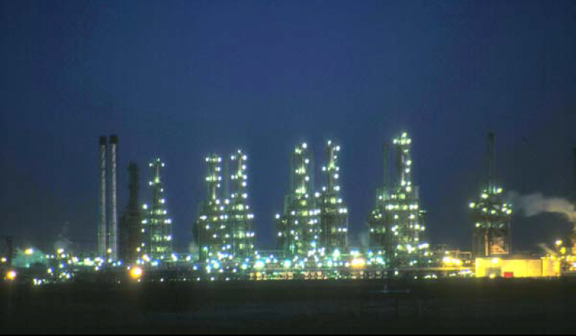
Fourth Year - Chemical Process Eng. Branch
Petroleum Refinery Eng. Lectures
By
Dr. Adnan A. Abdul Razak

Slide 2
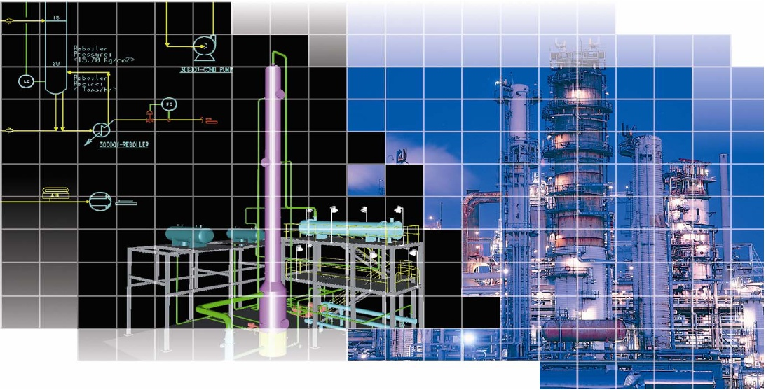

Lect./7
Conversion Processes

Slide 3
A) Thermal cracking

Slide 4
Thermal cracking:
Is defined as the thermal decomposition, under pressure, of large HC molecules to form smaller molecules. Lighter, more valuable HC may be obtained from such relatively low value stocks as heavy gas oils (boiling up to 540 ºC (1005 ºF)) and residues.
These processes are considered as upgrading processes for vacuum residue.

Slide 5
Requirements of Thermal cracking:
Residual fractions (bottom of barrel) are the least valuable streams of a refinery.
Nearly 30-40 % of the typical C.O in Iraq contains 370 ⁺ ⁰C fractions.
Worldwide limited reserve of sweet crude oil.
Disposal problems due to stringent environmental regulations.
Decreasing demand of fuel oil.
Gradually increasing demand of middle distillates.

Slide 6
Advantages of Thermal cracking:
It is simple and cost effective process. However rapid uncontrolled thermal cracking produces undesirable products like gas and coke.
Limitation of catalytic cracking for resid processing :
In resid feed stock presence of high molecular weight compounds like resins, asphaltenes and metals it unsuitable for catalytic cracking, FCC can process resid feed only to certain limit.
Metal and sulfur compounds in resid feedstock as catalyst poison.

Slide 7
Coking:
Coking are severe thermal cracking operations, most commonly used carbon rejection process that upgrades residues to a wide range of lighter H.C gases and distillates through thermal cracking.
The byproduct of coking process is petroleum coke.
The goal of coker operation is to maximize the yield of clean distillates and minimize the yield of coke.

Slide 8
Feed stock of coking process:
Wide variety of feed stocks ( can have considerable metals (nickel &vanadium) , sulfur, resin and asphaltens.
Most contaminants exit with coke.
Typical feed is vacuum resid.

Slide 9
The main produts:
Off-gas from which LPG is recovered.
Naphtha may be used as gasoline blending agent although its O.N =65-80 RON.
Gasoil may be catalytic cracking
Coke the main uses of petroleum coke:
Fuel
Manufacture of anode for electrolytic cell reduction of alumina
Direct use as chemical carbon source for manufacture of elemental phosphorus, calcium carbide, and silicon carbide.
Manufacture of electrodes for use in electric furnace production of elemental phosphorus, titanium dioxide, calacium carbide, and silicon carbide.
Manufacture of graphite.

Slide 10
The major coking processes:
1) Delayed Coking
Semi-continuous process.
Feed :atm. Residue, cracked tar, and heavy cycle oil
Feed heated and transferred to large soaking (or coking drum).
Long residence time need to allow the cracking reactions to complete.
Moderate heating : 482-516 ºC (900-960) º F
Soak drum : 452-482 ºC (845-900) º F
Residence time : until they are fill of coke.
Coke is removed hydraulically
Coke yield = 30 %

Slide 11
Fig 1: Delayed coking unit

Slide 12
2) Fluid Coking or flexicoking
A continuous process which uses the fluidized- solids technique to convert residues to more valuable products.
The residue is coked by being sprayed into a fluidized bed of hot, fine coke particles.
The use of a fluid bed permits the coking reaction to be conducted at higher temperature and shorter contact times than those in delayed coking: Fluidized bed with steam.
Severe heating 482- 566 ºC (900-1050) º F at 10 psig.
Higher yields of light ends.
Less coke yields ( 20 % for fluid coking and 2 % for flexicoking)

Slide 13
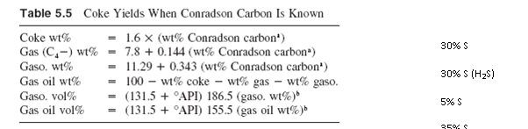
Coke & liquid yields may be estimated by simple equations:

Slide 14
Example ( 1 ) : Develop preliminary estimate of product yields on the processing of 1000⁺ Rc of 23760 BPD capacity. Conrad son carbon = 19%, 2.3% S, API = 10.7.
Solution :
(lb/bbl)
Feed BPD API lb/ hr lb/ hr wt% S lb/hr
(348.56)
1000⁺ RC 23700 10.7 14.52 345080 2.3 7940
Products wt% lb/ hr lb/ hr S
Coke wt % 30.4 104900 2382
Gas (C4 - ) wt% 10.5 36230 2382
Gasoline wt% 17.8 61450 397
Gas oil wt% 41.3 142500 2779
----- -------- -------
100 345080 7940

Slide 15
Visbreaking:
Visbreaking is a relatively mild thermal cracking operation mainly used to reduce the viscosities and pour points of vacuum tower bottoms to meet the requirements of fuel oil
reduce the amount of cutting stock required to dilute the residue to meet the specifications.
It is also used to increase catalyst cracker feed stocks and gasoline yields.

Slide 16
Visbreaking:
The principal reactions which occur during the visbreaking operation are :
1) Cracking of the side- chains attached to cyclo-paraffin and aromatic rings.
2) Cracking of resins to light HC (primarily olefins) and compounds which convert to asphaltenes.
3) At temperature above 900 ºF some cracking of naphthene rings.

Slide 17
Visbreaking:
There are two types of visbreaker operation
1) Coil or furnace cracker
Uses high furnace outlet temperature (885-930 ºF), and reaction time from 1-3 minutes. The feed is heated in a furnace or coil and quenched as it exits the furnace with gas oil or tower bottoms to slop the cracking reaction.
2) Soaker
The feed leaves the furnace at (800- 820) ºF and pass through a soaking drum which provides an additional reaction time, before it is quenched.

Slide 18
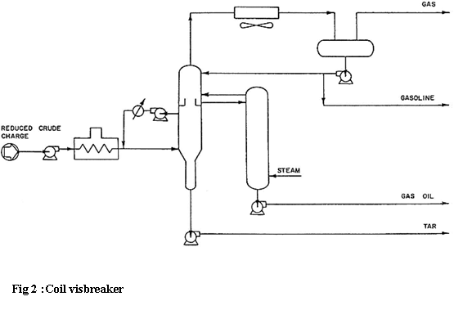

Slide 19
B) Catalytic cracking

Slide 20
Catalytic cracking is the most important and widely used refinery process for converting heavy oils into more valuable gasoline and lighter products.
Catalytic cracking breaks complex hydrocarbons into simpler molecules in order to increase the quality and quantity of lighter, more desirable products and decrease the amount of residuals.
This process rearranges the molecular structure of hydrocarbon compounds to convert heavy hydrocarbon feedstock into lighter fractions such as kerosene, gasoline, LPG, heating oil, and petrochemical feedstock.
Catalytic cracking is similar to thermal cracking except that catalysts facilitate the conversion of the heavier molecules into lighter products.
Use of a catalyst (a material that assists a chemical reaction but does not take part in it) in the cracking reaction increases the yield of improved-quality products under much less severe operating conditions than in thermal cracking.

Slide 21
There are three basic functions in the catalytic cracking process:
Reaction: Feedstock reacts with catalyst and cracks into different hydrocarbons;
Regeneration: Catalyst is reactivated by burning off coke; and
Fractionation: Cracked hydrocarbon stream is separated into various products.

Slide 22
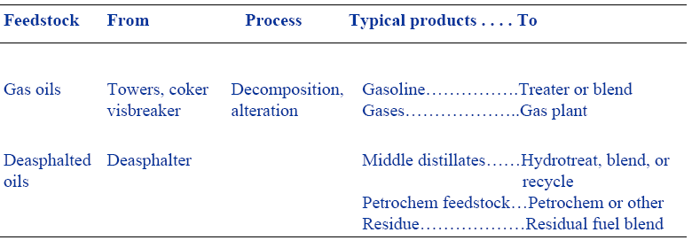
Catalytic Cracking

Slide 23
Fluid Catalytic Cracking (FCC)
• The most common process is FCC, in which the oil is cracked in the presence of a finely divided catalyst which is maintained in an aerated or fluidized state by the oil vapors.
• The fluid cracker consists of a catalyst section and a fractionating section that operate together as an integrated processing unit.
• The catalyst section contains the reactor and regenerator, which, with the standpipe and riser, forms the catalyst circulation unit.
• The fluid catalyst is continuously circulated between the reactor and the regenerator using air, oil vapors, and steam as the conveying media.
• A typical FCC process involves mixing a preheated hydrocarbon charge with hot, regenerated catalyst as it enters the riser leading to the reactor.

Slide 24
•The charge is combined with a recycle stream within the riser,
vaporized, and raised to reactor temperature (900°-1,000° F) by the hot catalyst.
• As the mixture travels up the riser, the charge is cracked at 10-30 psi. In the more modern FCC units, all cracking takes place in the riser.
• The "reactor" no longer functions as a reactor; it merely serves as a holding vessel for the cyclones.
• This cracking continues until the oil vapors are separated from the catalyst in the reactor cyclones.
• The resultant product stream (cracked product) is then charged to a fractionating column where it is separated into fractions, and some of the heavy oil is recycled to the riser.
• Spent catalyst is regenerated to get rid of coke that collects on the catalyst during the process.
• Spent catalyst flows through the catalyst stripper to the regenerator, where most of the coke deposits burn off at the bottom where preheated air and spent catalyst are mixed.
• Fresh catalyst is added and worn-out catalyst removed to optimize the cracking process.

Slide 25
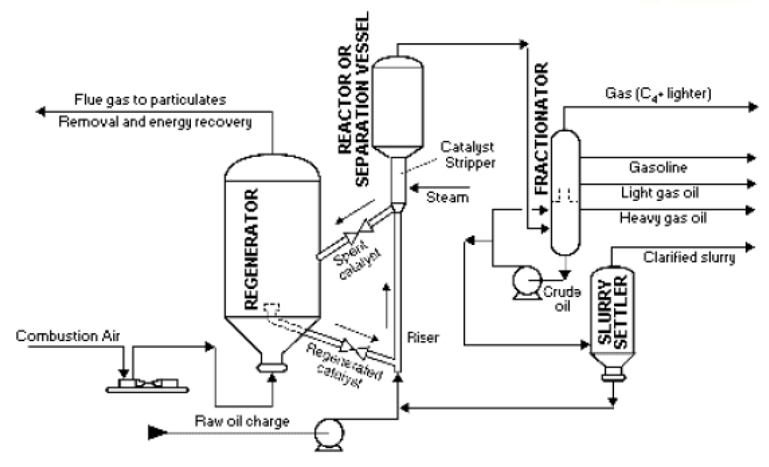
Fluid Catalytic Cracking

Slide 26
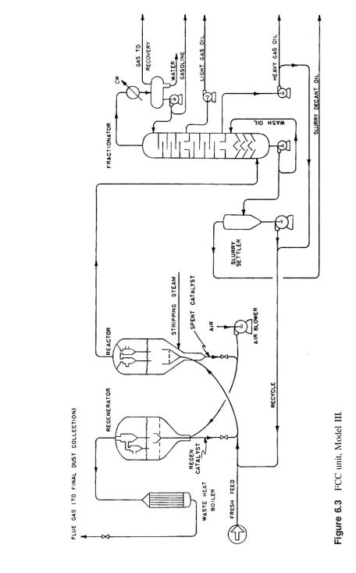

Slide 27
Moving-Bed Catalytic Cracking
• The moving-bed catalytic cracking process is similar to the FCC process.
• The catalyst is in the form of pellets that are moved continuously to the top of the unit by conveyor or pneumatic lift tubes to a storage hopper, then flow downward by gravity through the reactor, and finally to a regenerator.
• The regenerator and hopper are isolated from the reactor by steam seals.
• The cracked product is separated into recycle gas, oil, clarified oil , distillate, naphtha, and wet gas.

Slide 28
Catalyst
Both systems use basically similar catalysts but produced in a different form, in the shape of beds for moving bed and fine powder for fluidized bed.
Acid treated clays ground to a powder
Synthetic silica- alumina catalysts of higher activity (amorphous)
Crystalline synthetic silica – alumina catalyst called zealots or molecular sieves.
The advantages of zealots over the natural and synthesis amorphous catalyst are
1) Higher activity.
2) Higher gasoline yields at a given conversion.
3) Production of gasoline containing a larger % of paraffinic and aromatic HC.
4) Lower coke yield.
5) Increased iso-butane production.
6) Ability to go for higher conversion per pass without over cracking.

Slide 29
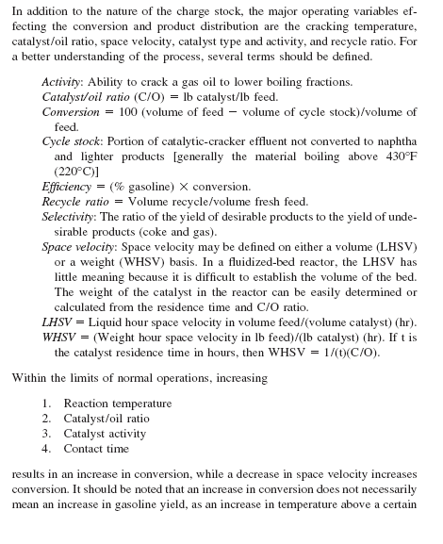
PROCESS VARIABLES

Slide 30
Comparison between thermal and catalytic cracking
Catalytic cracking is differences with respect Thermal Cracking
uses a catalyst
lower temperature
lower pressure
more flexible
different reaction mechanisms : ionic vs. free radical
High thermal efficiency
Good integration of cracking and regeneration
High yields of gasoline and other distillates
Low gas yields
High product selectivity
Low n-alkane yields
High octane number
Chain-branching and high yield of C4 olefins
High yields of aromatics

