Slide 1
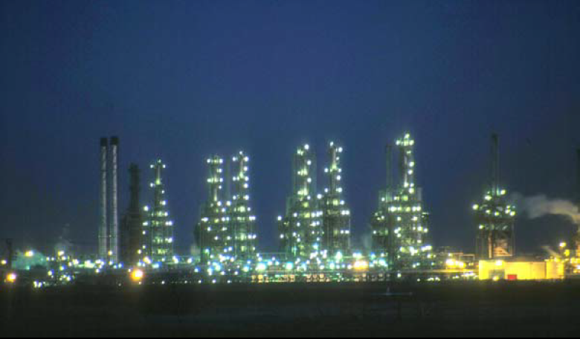
Fourth Year - Chemical Process Eng. Branch
Petroleum Refinery Eng. Lectures
By
Dr. Adnan A. Abdul Razak

Slide 2
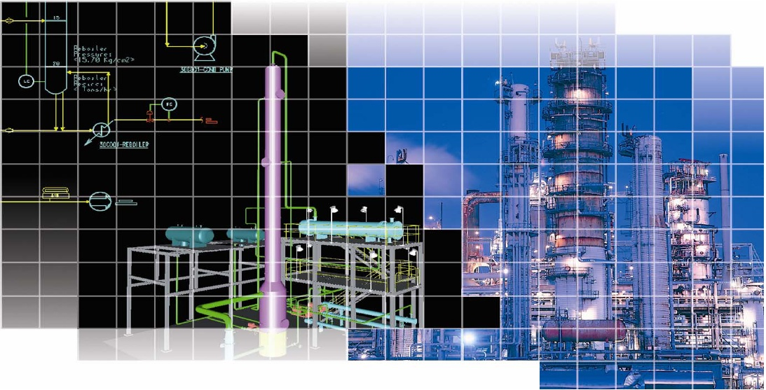
Lect./8
Upgrading Naphtha

Slide 3
A) Catalytic Reforming

Slide 4
Catalytic Reforming
Catalytic reforming is the process of transforming C7–C10 hydrocarbons with low octane numbers to aromatics and iso-paraffins which have high octane numbers. It is a highly endothermic process requiring large amounts of energy.
Depending on the properties of the naphtha feedstock (as measured by the paraffin, olefin, naphthene, and aromatic content) and catalysts used, reformates can be produced with very high concentrations of toluene, benzene, xylene, and other aromatics useful in gasoline blending and petrochemical processing.
Hydrogen, a significant by-product, is separated from the reformate for recycling and use in other processes.
A catalytic reformer comprises a reactor section and a product recovery section.

Slide 5
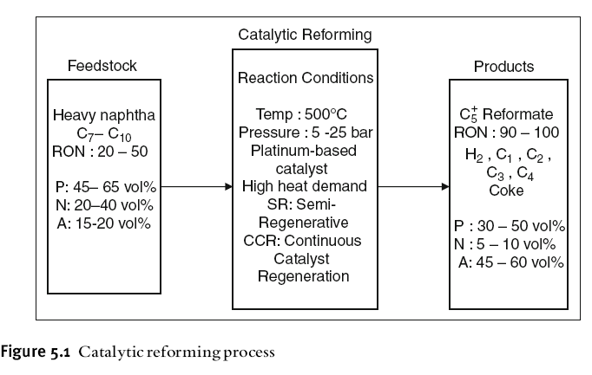

Slide 6
Role of Reformer in the Refinery and Feed Preparation
The catalytic reformer is one of the major units for gasoline production in refineries. It an produce 37 wt% of the total gasoline pool. Other units such as the fluid catalytic cracker (FCC), the methyl ter-butyl ether (MTBE) production unit, alkylation unit and isomerization unit, also contribute to this pool.
The straight run naphtha from the crude distillation unit is hydrotreated
to remove sulphur, nitrogen and oxygen which can all deactivate the reforming
catalyst.
The hydrotreated naphtha (HTN) is fractionated into light naphtha (LN), which is mainly C5–C6, and heavy naphtha (HN) which is mainly C7–C10 hydrocarbons.
Light naphtha (LN) is isomerized in the isomerization unit (I). Light naphtha can be cracked if introduced to the reformer.
The role of the heavy naphtha (HN) reformer in the refinery is shown in Figure 5.2.
Hydrogen, produced in the reformer can be recycled to the naphtha hydrotreater, and the rest is sent to other units demanding hydrogen.

Slide 7
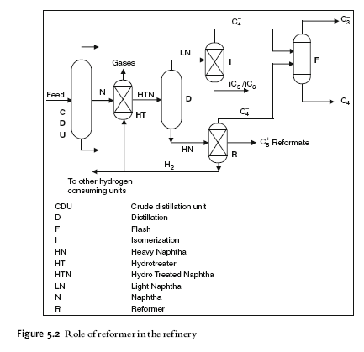

Slide 8
Reforming Reactions
(PONA) {Paraffin, Olefin, Naphthene, Aromatic}
1) P → isomerizes to some extent converted to N, and N subsequently converted to aromatics.
2) O → saturated to form P which then react as in (1) {hydro-cracking}.
3) N → converted to aromatics. {dehydrogenation}.
4) A→ unchanged.

Slide 9
Process Technology
There are several commercial processes available for reforming.
Semi-regenerative Fixed Bed Process :The name semi-regenerative comes from regeneration of the catalyst in the fixed bed reactors after shut down by burning off the carbon formed on the catalyst surface. (Low capital cost).
Continuous Regenerative (moving bed) CCR Platforming :Catalyst can be regenerated continuously and maintained at a high activity . (Higher capital cost).
Cyclic :compromise between the two extremes having a swing reactor for regeneration.

Slide 10
Catalyst
All of the reforming catalyst contains platinum supported on a silica alumina base.
In most cases rhenium is combined with platinum to form a more stable catalyst which permits operation at lower pressure.
Platinum serve as a catalytic site for hydrogenation and dehydrogenation reactions.
Chlorinated alumina provides an acids site for isomerization and hydro- cracking reactions and cyclization.

Slide 11
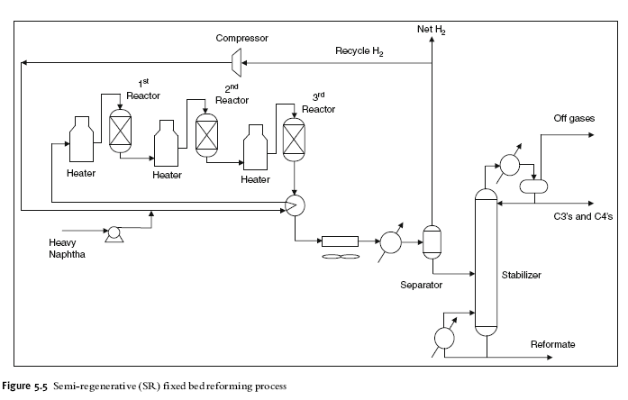

Slide 12
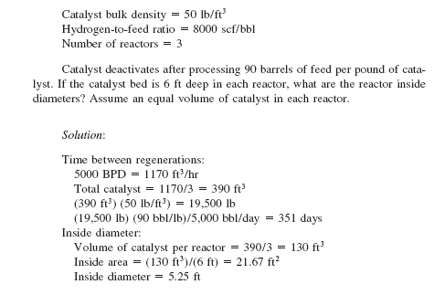
Example (2)

Slide 13
Example (3)
On processing 1200 ton / day of 27 API catalyst crackers feed stock at a temperature of 450 ºC, pressure =1050 mm Hg the following products were obtained:
Products wt % API Mw
Gases 15 -- 32
C₅⁺ gasoline 55 63 110
TCGO 26 5 260
Coke 4 -- 12
Given that: WHSV = 0.7 hr ⁻¹, Linear velocity of vapor (U) = 0.3 m/s,
ρ _{catalyst} = 420 Kg /m³
Calculate: a) diameter of the cracker, b) weight of catalyst needed, c) conversion, and d) efficiency.
Solution :
1200 ton/day * 1000 Kg/ton
m _{feed} = -------------------------- = 50000 Kg /hr
24 hr/day
m _{gases} = 0.15 * 50000 / 3600 =2.08 Kg/s
m _{C5}⁺ _{gasoline} = 0.55 * 50000/ 3600 =7.64 Kg/s
m _{TCGO} = 0.26 * 50000/ 3600 = 3.61 Kg/s
Total moles of vapor = (2.08/ 32) + (7.64/ 110) + (3.61/ 260 )
n = 0.1479 Kg mole / s

Slide 14
22.4 (m³/ kg mole) * 760 mm Hg
R = --------------------------------- = 62.359
1 Kg mole * 273
n R T 0.1479* 62.359 *(450+273)
V= -------- = ------------------------= 6.35 m³/s
P 1050
П V 6.35 m³/s
A =----- D² = ----- = ------- = 21.17 m²
4 U 0.3 m/s
m _{catalyst} = 50000/0.7 = 71428 Kg
V _{catalyst} = m/ ρ = 170 m³
4* 170
H= ---------------- = 8 m
3.14 * (5.19)²

Slide 15
B) Alkylation

Slide 16
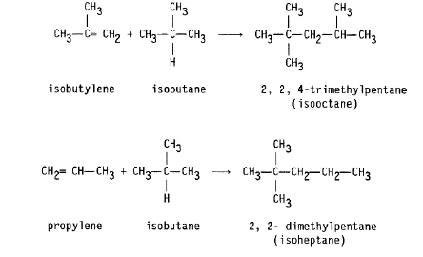
Alkylation combines low-molecular-weight olefins (primarily a mixture of propylene and butylene) with isobutane in the presence of a catalyst, either sulfuric acid or hydrofluoric acid.
The product is called alkylate and is composed of a mixture of high octane,
branched-chain paraffinic hydrocarbons.
Alkylate is a premium blending stock because it has exceptional antiknock properties and is clean burning.
The octane number of the alkylate depends mainly upon the kind of olefins used and upon operating conditions.

Slide 17
C) Isomerization

Slide 18
Isomerization is the process in which light straight chain paraffins of low RON (C6, C5 and C4) are transformed with proper catalyst into branched chains with the same carbon number and high octane numbers.
The hydrotreated naphtha (HTN) is fractionated into heavy naphtha between 90–190 C (190–380 F) which is used as a feed to the reforming unit. Light naphtha C5 - 80 C (C5 - 180 F) is used as a feed to the isomerization unit.
Isomerization Reactions:
Isomerization is a reversible and slightly exothermic reaction:
n-paraffin i-paraffin
The isomerization reactions are slightly exothermic and the reactor works in
the equilibrium mode. There is no change in the number of moles and thus
the reaction is not affected by pressure change. Better conversions are achieved at lower temperature
The conversion to iso-paraffin is not complete since the reaction is equilibrium conversion limited. It does not depend on pressure, but it can be increased by lowering the temperature. However operating at low temperatures will decrease the reaction rate. For this reason a very active catalyst must be used.

Slide 19
Isomerization Catalysts
There are two types of isomerization catalysts:
The standard Pt/chlorinated alumina with high chlorine content, which is considered quite active,
and the Pt/zeolite catalyst.

