Slide 1
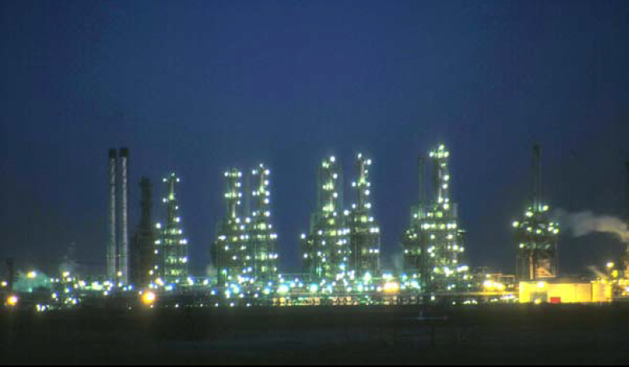
Fourth Year - Chemical Process Eng. Branch
Petroleum Refinery Eng. Lectures
By
Dr. Adnan A. Abdul Razak

Slide 2
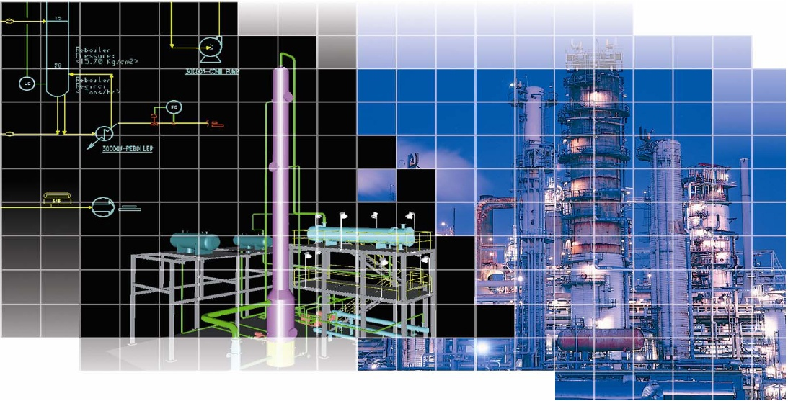

Lect./9
Product Blending

Slide 3
Product Blending
Blending purpose is to allocate the available blending components in such a way to meet product demands and specification at the least cost. We now review how the properties of mixtures are estimated based on the properties of the components.
Octane Blending:
True octane numbers do not blend linearly. It is therefore necessary to use especial “blending” octane numbers to obtain linear expressions. The blending is performed on a volumetric average basis.
The formula used for calculation is:
where
B_{t} = total amount of blended gasoline , bbl
ON_{t} = desired octane of blend
B_{i} = bbl of component i
ON_{i} = blending octane number of component i.
……………………………….. 1

Slide 4
contributing to product t and blending octane numbers, respectively. The practice has been to use the following expression for the “blending” octane number:
where MON and RON are the motor and research octane numbers, respectively. Note that the true octane number is the one obtained using a CFR test engine. For example, consider a 30% isomerate and 70% reformate blend. Isomerate has the following octane values: MON=81.1, RON=83.0, whereas reformat has the following octane numbers: MON=86.9 and RON=98.5. When blended in the proportion given above, the blended pool has ON=89.505.
Pool Octane : is the average octane of the total gasoline production of the refinery, if the regular, mid- premium, and super- premium gasolines are blended together.
Posted Octane numbers (PON): are the arithmetic average of the motor octane number (MON) and research octane number (RON).
……………………………….. 2

Slide 5
Reid vapor pressure:
The desired RVP of a gasoline is obtained by blending n-butane with C₅ (380 ºF) with C₅ (193 ºF) naphtha. The amount of n-butane required to give the needed RVP is calculated by:
Where:
M _{t} = total moles blended product
(RVP) _{t} = specification RVP for product, psi
M _{i} = moles of component i
(RVP) _{i} = RVP of component i, psi or kPa
The desired RVP for a blended gasoline is obtained by adding n-butane to reach the desired value.
……………………………….. 3

Slide 6
Example (1): calculate the amount of n-butane to be added to following base stock to achieve an RVP of 10 psi( n- butane: MW=58, RVP=52).
Solution:
RVP (psi) | MW | Lb/hr | BPD | Base stock
11.1 | 86 | 39320 | 4000 | LSR gasoline
2.8 | 115 | 69900 | 6000 | Reformate
4.6 | 104 | 30690 | 3000 | Alkylate
4.4 | 108 | 87520 | 8000 | FCC gasoline
5.38 |  |  | 21000 | Total
PVP | RVP | mol% | mol/hr | MW | Lb/hr | BPD | Base stock
2.32 | 11.1 | 21 | 457 | 86 | 39320 | 4000 | LSR gasoline
0.80 | 2.8 | 28.4 | 617 | 115 | 69900 | 6000 | Reformate
0.62 | 4.6 | 13.4 | 295 | 104 | 30690 | 3000 | Alkylate
1.64 | 4.4 | 37.2 | 810 | 108 | 87520 | 8000 | FCC gasoline
 |  | 100 | 2179 |  |  | 21000 | Total

Slide 7
Butane requirement : (use Eq. (3) )
(2179) (5.38) + M (52) = (2179+ M) (10)
11732+52 M=21790 +10 M
M= 240 moles n-butane required.
The above method requires obtaining the molecular weight of each of the streams involved, which could be a problem sometimes, although there are good ways of estimating such molecular weights. To makes matter simpler, one can use the method developed at Chevron. In this method “Vapor blending indices” (VPBI), which work well. The RVP of a blend is then calculated using the following volume averaging formula:
In the case where the volume of the butane to be blended for a given RVP is desired :
where
A= bbl of component a, etc
W= bbl of n- butane (w)
Y= A+B+C+ ----------- ( all component except n- butane )
(VPBI)_{m} = VPBI corresponding to the desired RVP of the mixture
w= subscript indicating n- butane.
……………………………….. 4
A(VPBI)_{a} + B(VPBI)_{b}+ C(VPBI)_{c}+ - - - - + W(VPBI)_{w}= (Y+W) (VPBI)_{m}
…………... 5

Slide 8
Table 11-1 and 11-2 show the blending component values for different blending streams and the blending indexes as a function of RVP values.
Table 11-1: Blending Component values (Gary and Handwerk, 2001)

Slide 9
Table 11-2: Blending Component values (Gary and Handwerk, 2001)

Slide 10
Example (2): Repeat Example (1) use vapor blending indices (VPBI) method.
Given : VPBI of n- butane =138
For 10 psi RVP, (VPBI)_{m} = 17.8
Solution
17.8 (21000 + W) =174070 +138 W
(138-17.8) W =373800-174070
W= 1660 bbl n-butane required
Total 10 psi RVP gasoline =21000 + 1660 = 22660 BPCD
Although this differs slightly from the result in Example (1)
Vol x VPBI | VPBI | RVP | BPCD | Component
138 W | 138 | 51.6 | W | n-Butane
81200 | 20.3 | 11.1 | 4000 | LSR gasoline
21720 | 3.62 | 2.8 | 6000 | Reformat
20190 | 6.73 | 4.6 | 3000 | Alkylate
50960 | 6.37 | 4.4 | 8000 | FCC gasoline
174070 + 138 W |  |  | 21000 + W | Total

Slide 11
Example (3): Consider the following gasoline blending streams are available from the various units. It is desired to produce a 50-50 split of premium and regular gasoline having 91 and 87 posted octane numbers respectively, with both having an RVP= to 10.2 psi . calculate the quantity of n- butane required to give the desired vapor pressure.
Given : VPBI of n- butane =138
For 10.2 psi RVP, (VPBI)_{m} = 18.2
Solution
Starting with the given flow for all of the above streams and calculating the amount of n-butane to add to fix the RVP.
VPBI | RON | MON | Volume | Component
25.9 | 83 | 81.1 | 5735 | Isomerate
2.7 | 98.5 | 86.9 | 14749 | Reformat
6.4 | 92.3 | 76.8 | 20117 | FCC gasoline
24.4 | 82.8 | 82.4 | 814 | Light hydrocrackate
6.7 | 97.3 | 95.9 | 4117 | Alkylate
14.9 | 96.9 | 84 | 2071 | Polymer
 |  |  | 47603 | Total

Slide 12
Vol (VPBI) | VPBI | RVP | Vol. | Component
138 W | 138 | 51.6 | W | n- butane
148395 | 25.9 | 13.5 | 5735 | Isomerate
39517 | 2.7 | 2.2 | 14749 | Reformate
128199 | 6.4 | 4.4 | 20117 | FCC gasoline
19895 | 24.4 | 12.9 | 814 | Light hydrocrackate
27732 | 6.7 | 4.6 | 4117 | Alkylate
30950 | 14.9 | 8.7 | 2071 | Polymer
394688+138W |  |  | 47603 +W | Total
18.2 (47603 + W )= 394688 + 138 W
W = 3937 bbl n- butane
The total volume of 10.2 psi RVP premium gasoline = 47603 + 3937 = 51540 BPCD

Slide 13
Octane calculations for pool Gasoline
Pool octane [ (∑ MON + ∑ RON ) / 2 )] = 88.38 PON
This is not acceptable, as the octane requirement for pool gasoline is 89 PON.
There are several ways of correcting this. Among the possibilities are :
Increase severity of reforming to produce a 98.8 to 100 RON clear reformate.
Use an octane blending agent, such as MTBE ( methyl tertiary butyl ether ) and ETBE ( ethyl tertiary butyl ether ).
∑ RON | RON | ∑ MON | MON | Vol. fract. | Volume | Component
7.12 | 93.0 | 7.05 | 92.0 | 0.077 | 3937 | n- butane
9.23 | 83.0 | 9.02 | 81.1 | 0.111 | 5735 | Isomerate
28.18 | 98.5 | 24.85 | 86.9 | 0.286 | 14749 | Reformate
36.02 | 92.3 | 29.97 | 76.8 | 0.390 | 20117 | FCC gasoline
1.31 | 82.8 | 1.30 | 82.4 | 0.016 | 814 | Light hydrocrackate
7.77 | 97.3 | 7.66 | 95.9 | 0.080 | 4117 | Alkylate
3.89 | 96.9 | 3.38 | 84.0 | 0.040 | 2071 | Polymer
95.53 |  | 83.23 |  | 1.000 | 51540 | Total

Slide 14
Recalculating pool gasoline RVP and PON after adding sufficient MTBE to increase the PON to 89.0 gives the following .
49195 +W=18.2 (419520+138W)
119.8W=895349-419520=475829
W=3984 bbl
Total pool 10.2 RVP, 89.0 PON gasoline= 53179 BPCD
Vol (VPBI) | VPBI | RVP | Vol. | Component
138 W | 138 | 51.6 | W | n- butane
148395 | 25.9 | 13.5 | 5735 | Isomerate
39517 | 2.7 | 2.2 | 14749 | Reformate
128199 | 6.4 | 4.4 | 20117 | FCC gasoline
19895 | 24.4 | 12.9 | 814 | Light hydrocrackate
27732 | 6.7 | 4.6 | 4117 | Alkylate
30950 | 14.9 | 8.7 | 2071 | Polymer
24832 | 15.6 | 9.0 | 1593 | MTBE
419520+138W |  |  | 49195 +W | Total

Slide 15
Other properties:
Several other properties of blend pools (viscosities, aniline point, pour points, flash points) can be estimated using a technique similar to that of the Chevron Method for RVP, that is:
where v_{i} is the volume fraction of blending stream i as above, and P_{t} as well as P_{i} are the “blending” properties of the product and the blending streams, respectively. The blending properties are, of course, compiled in tables much in the same way as in the case of RVP. These additional properties are important for Diesel blending. Finally, properties like sulfur or nitrogen content are monitored and blended linearly with percentages.
……………………………….. 6

Slide 16
Home work (1) :
Using the value from the following table, calculate the number of barrels of n- butane that have to be added to a mixture of 1250 barrels of HSR gasoline, 750 barrels of LSR gasoline, and 620 barrels of C₅ FCC gasoline to produce a 9.0 psi Reid vapor pressure . What are the research and motor octane number of the blend?
Given : VPBI of n- butane =138 , MON=92.0 , RON=93
For 8 psi RVP, (VPBI)_{m} = 13.4
VPBI | RVP | RON | MON | Volume | Component
1.0 | 1.0 | 62.3 | 58.7 | 1250 | HSR gasoline
20.3 | 11.1 | 66.40 | 61.6 | 750 | LSR gasoline
6.4 | 4.4 | 92.1 | 77.1 | 620 | C₅ FCC gasoline

Slide 17
Home work (2) :
Calculate the octane number of the final blend and amount of n- butane needed for producing a 9.5 psi RVP gasoline from 5100 BPSD of LSR gasoline, 3000 BPSD light hydrocrackate,4250 BPSD alkylate, 10280 BPSD heavy hydrocrackate, 14500 BPSD C₅ FCC gasoline,14200 BPSD of 96 RON reformat, and 2500 BPSD of polymer gasoline.
Given : VPBI of n- butane =138
For 9.5 psi RVP, (VPBI)_{m} = 17.6
VPBI | RVP | RON | MON | Volume | Component
20.3 | 11.1 | 66.4 | 61.6 | 5100 | LSR gasoline
24.4 | 12.9 | 82.8 | 82.4 | 3000 | light hydrocrackate
6.7 | 4.6 | 97.3 | 95.9 | 4250 | alkylate
1.24 | 1.1 | 67.6 | 67.3 | 10280 | heavy hydrocrackate
6.4 | 4.4 | 92.1 | 77.1 | 14500 | C₅ FCC gasoline
2.7 | 2.2 | 98.0 | 86.5 | 14500 | Reformate RON 96
14.9 | 8.7 | 96.9 | 84 | 2500 | Polymer

Slide 18
Home work (3) : A regular gasoline is to be blended using the components listed in the table below. The target (ON) specification is 90. Using the information provided, determine the volume of Reformate required meeting the blending specification.
MON | RON | Volume (barrels) | Component
82.4 | 82.8 | 3000 | Hydrocracate
89 | 89.7 | 1000 | Alkylate
91 | 98 | ------- | Reformate
78 | 79 | 1000 | Straight run naphtha

