Slide 1
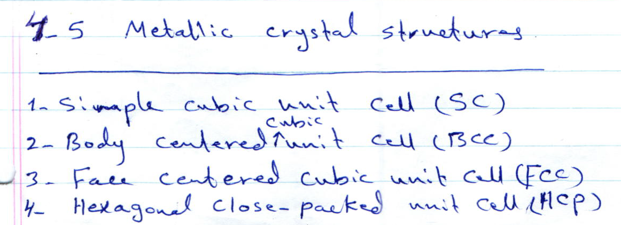
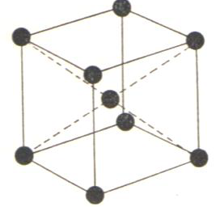
1. Body-Centered-Cubic [BCC]
As an example of the materials for this
type :
Chromium, Molybdenum, Niobium, Tungsten, Iron

