Slide 1
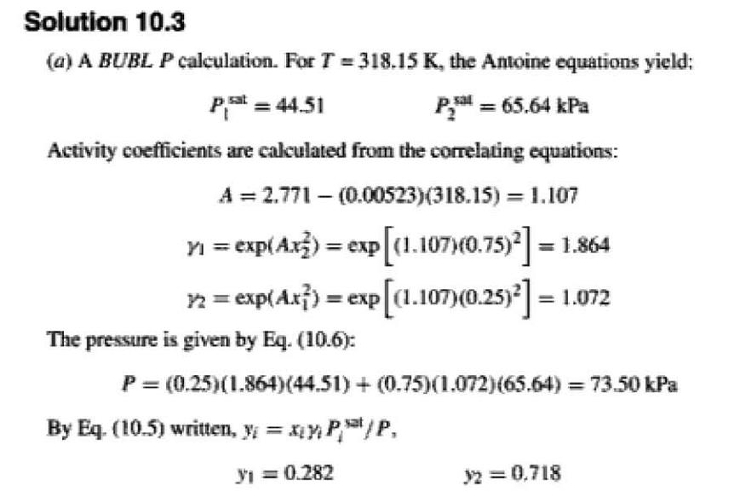

Slide 2
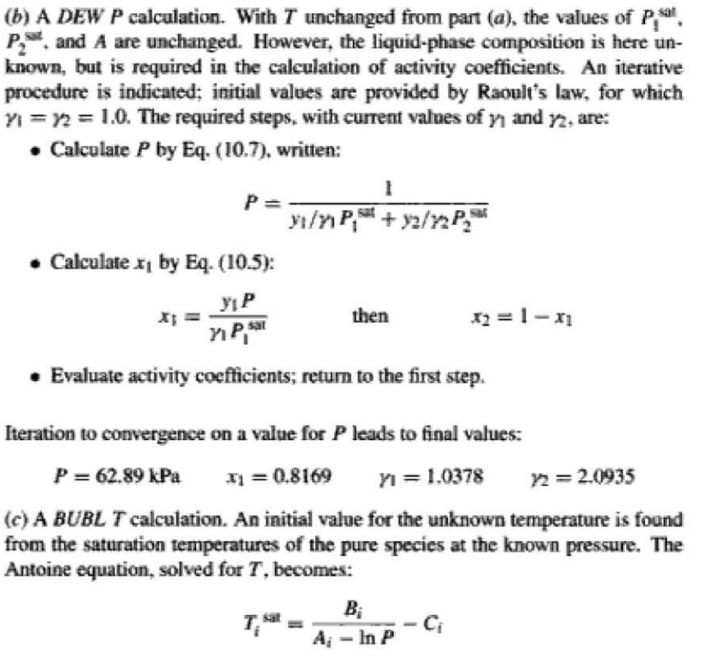

Slide 3
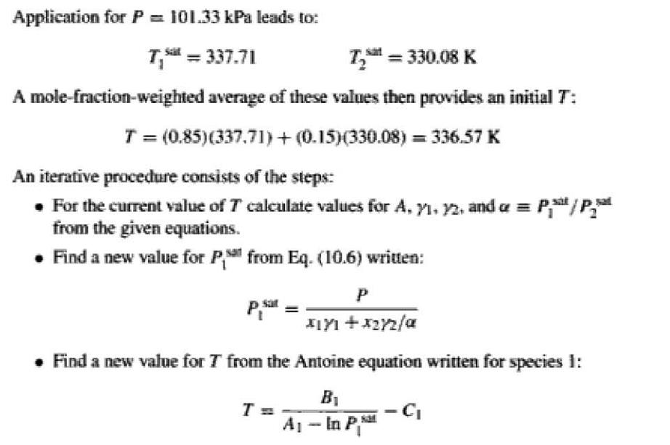

Slide 4
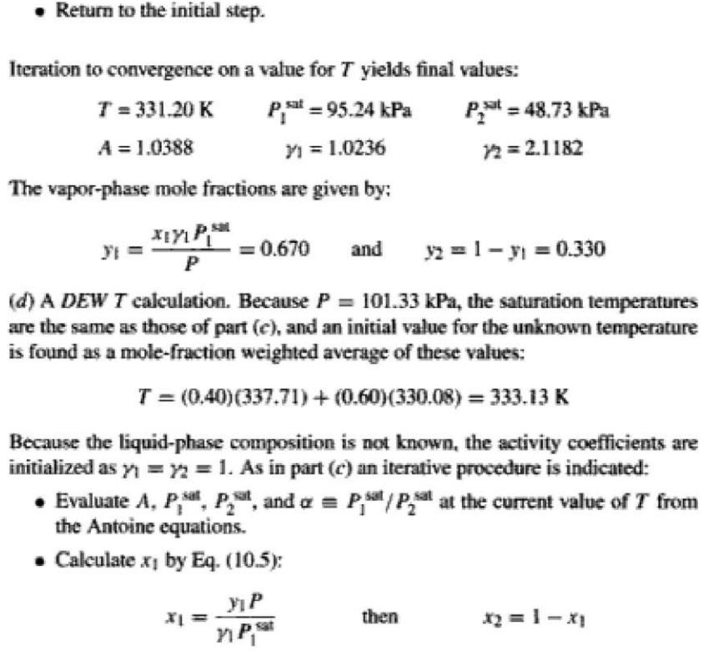

Slide 5
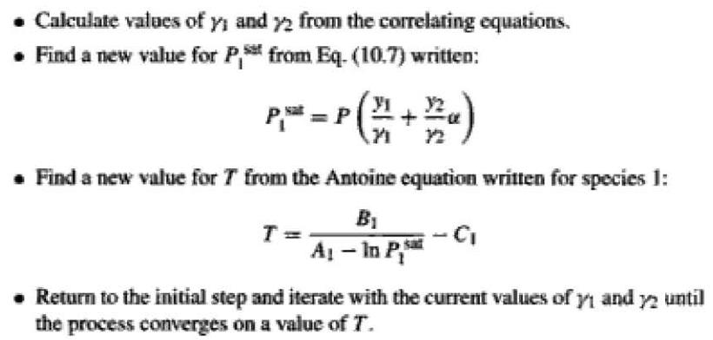

Slide 6
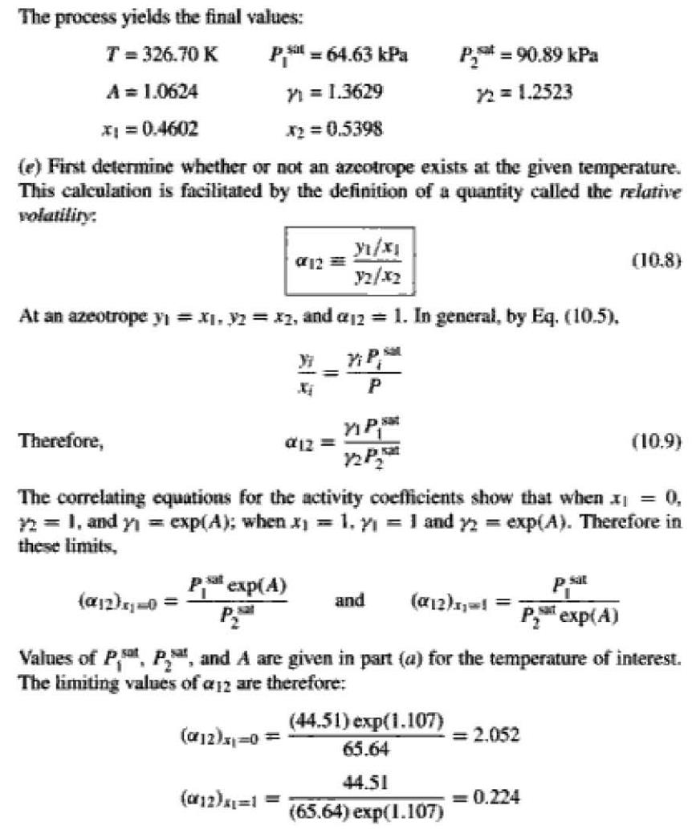

Slide 7
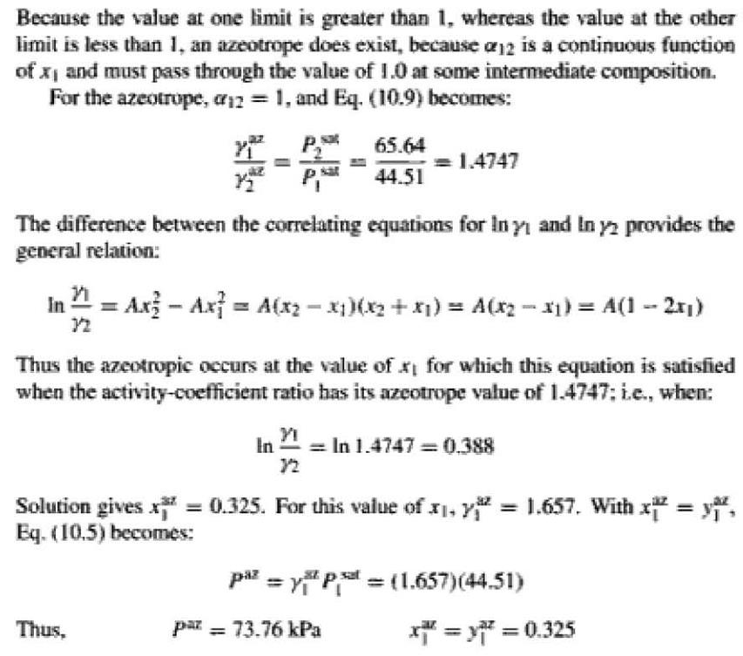

Slide 8
VLE FROM K-VALUE CORRELATIONS
A convenient measure of the tendency of a given chemical species to partition itself preferentially between liquid and vapor phases is the equilibrium ratio Ki, defined as:
ki=yi/xi (10.10)
This quantity is usually called simply a K-value. Although it adds nothing to thermodynamic knowledge of VLE, it does serve as a measure of the "lightness" of a .

Slide 9
constituent species, i.e., of its tendency to favour the vapour phase. When Ki is greater than unity, species i exhibits a higher concentration in the vapour phase; when less, a higher concentration in the liquid phase, and is considered a "heavy" constituent. Moreover, the use of K-values makes for computational convenience, allowing elimination of one set of mole fractions.{yi} or {xi) in favour of the other.
Reference to Eq. (10.1) shows that the K-value for Raoult's law is:

Slide 10



and reference to Eq. (10.5) shows that for modified Raoult's law it is:
According to Eq. (10.10), yi = Kixi; because ∑yi= 1, then

Slide 11

Thus for bubble point calculations, where the xi are known, the problem is to find the set of K- values that satisfies Eq. (10.13). Alternatively, Eq. (10.10) can be written, xi =yi/Ki; because ∑xi= 1, then

