Slide 1
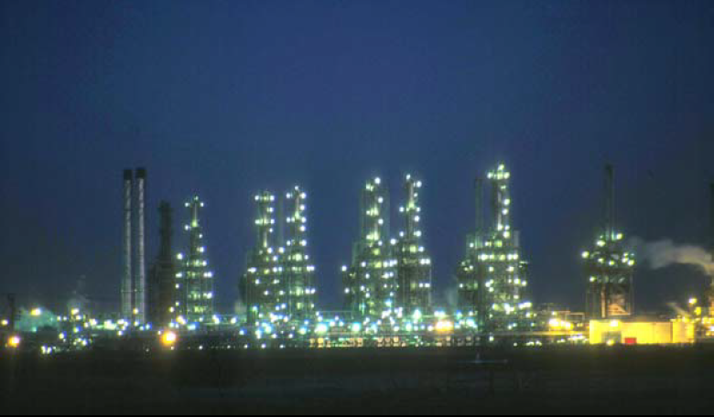
Fourth Year - Chemical Process Eng. Branch
Petroleum Refinery Eng. Lectures
By
Dr. Adnan A. Abdul Razak

Slide 2
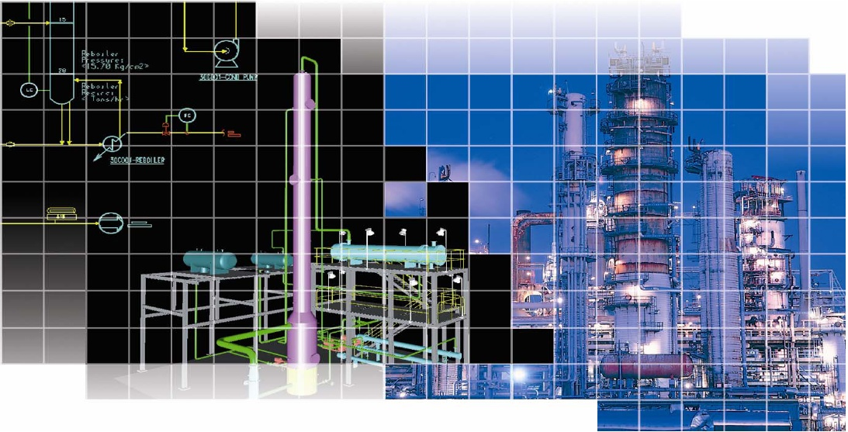
Lect./10
Supporting Processes

Slide 3
Supporting Processes
Not directly involved in the processing of petroleum based fuels Processes » Hydrogen production & purification » Acid gas treating » Sulfur recovery
» Gas processing units » Water treatment

Slide 4
Hydrogen Production & Purification
Many refineries produce sufficient quantities of hydrogen for hydro treating from their naphtha-fed platinum catalyst reforming operations.
however, require more hydrogen than is produced by their catalytic reforming units
This supplemental hydrogen requirement can be Provided by one of two processes:
Steam reforming of light ends such as methane (natural gas), ethane, or propane
Partial oxidation of heavy hydrocarbons such as fuel oil

Slide 5
Steam reforming Steam reforming for hydrogen production is accomplished in four steps: 1. Reforming. This involves the catalytic reaction of methane with steam at temperatures in the range of 1400 to 1500°F (760–816°C), according to the following equation: CH4 + H2O → CO + 3H2 (1) This reaction is endothermic and is carried out by passing the gas through catalyst-filled tubes in a furnace. The catalyst usually is in the form of hollow cylindrical rings ranging up to 3/4 inch in diameter. It consists of 25 to 40% nickel oxide deposited on a low-silica refractory base. 2. Shift conversion. More steam is added to convert the CO from step 1 to an equivalent amount of hydrogen by the following reaction: CO + H2O → CO 2 + H2 (2) This is an exothermic reaction and is conducted in a fixed-bed catalytic reactor at about 650°F (343°C). Multiple catalyst beds in one reactor with external cooling between beds are commonly employed to prevent the temperature from getting too high. The catalyst used is a mixture of chromium and iron oxide.

Slide 6
3. Gas purification. The third step is removal of carbon dioxide by absorption in a circulating amine or hot potassium carbonate solution. Several other treating solutions are in use. The treating solution contacts the hydrogen and carbon dioxide gas in an absorber containing about 24 trays, or the equivalent amount of packing. Carbon dioxide is absorbed in the solution, which is then sent to a still for regeneration. 4. Methanation. In this step, the remaining small quantities of carbon monoxide and carbon dioxide are converted to methane by the following reactions: CO + 3H 2 → CH4 + H2O CO 2 + 4H 2 → CH4 + 2H2O (3) This step is also conducted in a fixed-bed catalytic reactor at temperatures of about 700 to 800°F (427°C). Both reactions are exothermic and, if the feed concentration of CO and CO 2 is more than 3%, it is necessary to recycle some of the cooled exit gas to dissipate the heat of reaction. The catalyst contains 10 to 20% nickel on a refractory base.

Slide 7
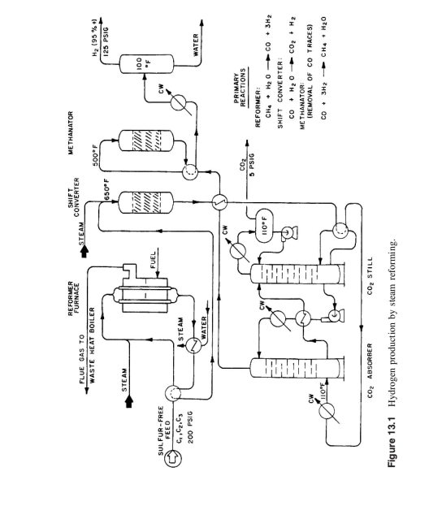

Slide 8
Partial oxidation of fuel oils
Partial oxidation of fuel oils is accomplished by burning the fuel at high pressures (800 to 1300 psig) with an amount of pure oxygen which is limited to that required to convert the fuel oil to carbon monoxide and hydrogen.
Enough water (steam) is added to shift the carbon monoxide to hydrogen in a catalytic shift conversion step.
The resulting carbon dioxide is removed by absorption in hot potassium carbonate or other solvents.
Ideally the partial oxidation reactions are as follows: 2CnHm + nO 2 → 2nCO + mH2 2nCO + 2nH 2O → 2nCO 2 + 2nH2

Slide 9
ACID GAS REMOVAL
Gases from various operations in a refinery processing sour crudes contain hydrogen sulfide and occasionally carbonyl sulfide.
Some hydrogen sulfide in refinery gases is formed as a result of conversion of sulfur compounds in processes such as hydrotreating, cracking, and coking. Recent air pollution regulations, however, require that most of the hydrogen sulfide be removed from refinery fuel gas and converted to elemental sulfur.
In addition to hydrogen sulfide many crudes contain some dissolved carbon dioxide which through distillation finds its way into the refinery fuel gas.
These components—hydrogen sulfide and carbon dioxide—are generally termed acid gases.
They are removed simultaneously from the fuel gas by a number of different processes, some of which are:

Slide 11
Amine Treating Unit
Hydrogen sulphide and carbon dioxide readily combine with aqueous solutions of certain alkanol amines at temperatures usually close to ambient ,
and may be driven off from the fat solutions by heating to about 100 ºC .
The reaction with hydrogen sulphide is :
2 RNH₂+ H₂S (RNH₃)₂S
Amine (mono- di and tri ethanol amines and methyl di ethanol amine)

Slide 12
The conventional equipment , comprising a bubble- cup tower together with a bubble cup tower for regeneration.
The treating temperature is 5 to 10 ºC above the dew point of the gas to ensure that no hydrocarbons liquid condenses out of the plant.
This process is the most widely used method for the regenerative removal of H₂S from both gases and liquids.
Its use is not only in refineries but also for oilfield treatment of natural gases and LPG.
The choice of the proper amine and solution depends on the composition of the gas to be treated and the final purity desired.

Slide 13
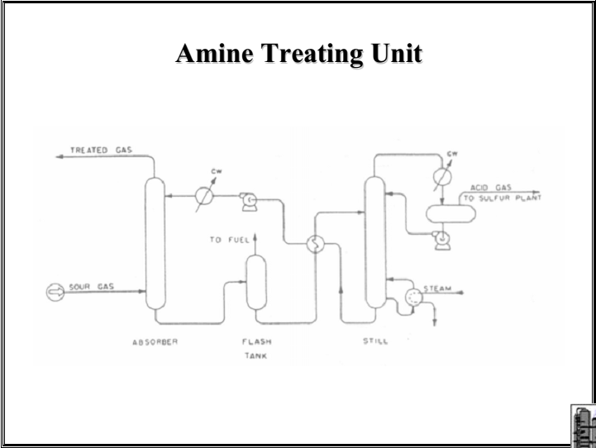

Slide 14
Sulphur Recovery
Acid gas streams from hydrodesulphurization containing H2S are sent to sulphur recovery unit (Claus unit).
Furthermore, sulphur removal is carried out by tail gas clean up schemes.
The purpose of removing the sulphur is to reduce the sulphur dioxide (SO2) emissions in order to meet environmental guidelines.

Slide 15
Claus Process
The Claus process is the most significant elemental sulphur recovery process from gaseous hydrogen sulphide.
Gases with an H2S content of over 25% are suitable for the recovery of sulphur in the Claus process.
Hydrogen sulphide produced, for example, in the hydrodesulphurization of refinery products is converted to sulphur in Claus plants .
The main reaction is 2H2S + O2 2S + 2H2O
The Claus technology can be divided into two process stages : thermal and catalytic.
In the thermal stage, hydrogen sulphide partially oxidized at temperatures above 850 0C (1562 F) in the combustion chamber.
This causes elemental sulphur to precipitate in the downstream process gas cooler. If more oxygen is added, the following reaction occurs: 2H2S + 3O2 2SO2 + 2H2O
This gas contains 20–30% of the sulphur content in the feed stream. Activated alumina or titanium dioxide is used. The H2S reacts with the SO2 and results in gaseous, elemental sulphur. This is called the Claus reaction: 2H2S + SO2 3S + 2H2O

Slide 16
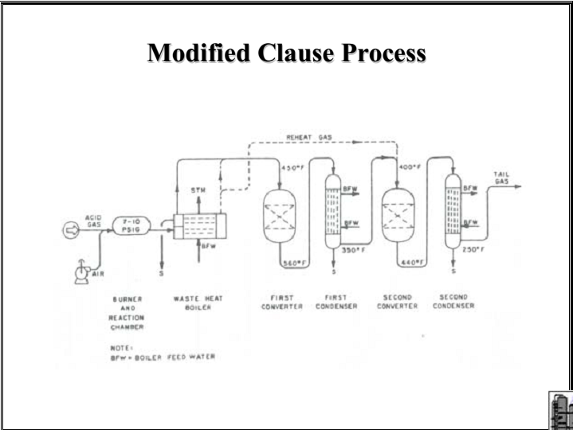

Slide 17
GAS PROCESSING UNIT

Slide 18
Gaseous Fuels The Importance of Gaseous Fuel - Generally very clean burning. Little soot. - Easy to burn - No grinding or atomisation. Excellent mixing - No problems with erosion or corrosion - No ash - The gas is easy to clean. E.g. if sulphur is present, it may be easily removed prior to combustion. - Simplest combustion plant of all - Burners - Problems with distribution and storage - Explosion risk - very volatile. - Relatively costly. Offset by cheaper and more efficient plant.

Slide 19
Classification of Gaseous Fuels (A) Fuels naturally found in nature: Natural gas Methane from coal mines (B) Fuel gases made from solid fuel Gases derived from Coal Gases derived from waste and Biomass From other industrial processes (Blast furnace gas) (C) Gases made from petroleum Liquefied Petroleum gas (LPG) Refinery gases Gases from oil gasification (D) Gases from some fermentation process

Slide 20
Natural Gas Natural gas is a gaseous fossil fuel consisting primarily of methane but including significant quantities of ethane, butane, propane, carbon dioxide, nitrogen, helium and hydrogen sulfide. It is found in oil fields and natural gas fields, and in coal beds. When methane-rich gases are produced by the anaerobic decay of non-fossil organic material, these are referred to as biogas. Natural gas is often informally referred to as simply gas, especially when compared to other energy sources such as electricity. Before natural gas can be used as a fuel, it must undergo extensive processing to remove almost all materials other than methane. The by-products of that processing include ethane, propane, butanes, pentanes and higher molecular weight hydrocarbons, elemental sulfur, and sometimes helium and nitrogen.

Slide 21
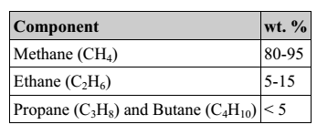
Chemical composition
The primary component of natural gas is methane (CH4), the shortest and lightest hydrocarbon molecule.
It also contains heavier gaseous hydrocarbons such as ethane (C2H6), propane (C3H8) and butane (C4H10). as well as other sulphur containing gases, in varying amounts.
Nitrogen, helium, carbon dioxide and trace amounts of hydrogen sulfide, water and odorants can also be present.
Mercury is also present in small amounts in natural gas extracted from some fields.
The exact composition of natural gas varies between gas fields.
Organosulfur compounds and hydrogen sulfide are common contaminants which must be removed prior to most uses.
Gas with a significant amount of sulfur impurities, such as hydrogen sulfide, is termed sour gas; gas with sulfur or carbon dioxide impurities is acid gas.

Slide 22
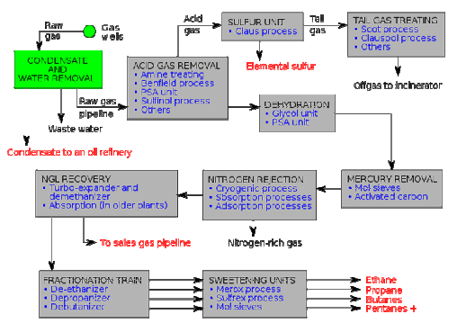
Natural gas processing plant There are a great many ways in which to configure the various unit processes used in the processing of raw natural gas.
The block flow diagram , Fig. (3), is a generalized, typical configuration for the processing of raw natural gas from non-associated gas wells.
Figure 3: Natural gas processing plant

Slide 23
It shows how raw natural gas is processed into sales gas pipelined to the end user markets.
It also shows how processing of the raw natural gas yields these byproducts:
• Natural gas condensate • Sulfur • Ethane • Natural gas liquids (NGL): propane, butanes and C5+ (which is the commonly used term for pentanes plus higher molecular weight hydrocarbons) .
1- Raw natural gas is commonly collected from a group of adjacent wells and is first processed at that collection point for removal of free liquid water and natural gas condensate. The condensate is usually then transported to an oil refinery and the water is disposed of as wastewater. 2- The raw gas is then pipelined to a gas processing plant where the initial purification is usually the removal of acid gases (hydrogen sulfide and carbon dioxide). There a many processes that are available for that purpose as shown in the flow diagram, but amine treating is the most widely used process.
3- The acid gases removed by amine treating are then routed into a sulfur recovery unit which converts the hydrogen sulfide in the acid gas into elemental sulfur. There are a number of processes available for that conversion, but the Claus process is by far the one usually selected. The residual gas from the Claus process is commonly called tail gas and that gas is then processed in a tail gas treating unit (TGTU) to recover and recycle residual sulfur-containing compounds back into the Claus unit. Again, as shown in the flow diagram, there are a number of processes available for treating the Claus unit tail gas. The final residual gas from the TGTU is incinerated. Thus, the carbon dioxide in the raw natural gas ends up in the incinerator flue gas stack.

Slide 24
4- The next step in the gas processing plant is to remove water vapor from the gas using the either regenerable absorption in liquid triethylene glycol (TEG) or a Pressure Swing Adsorption (PSA) unit which is regenerable adsorption using a solid adsorbent. Another newer process using membranes may also be considered. 5- Mercury is then removed by using adsorption processes (as shown in the flow diagram) such as activated carbon or regenerable molecular sieves.
6- Nitrogen is next removed and rejected using one of the three processes indicated on the flow diagram: 7- The next step is to recover of the natural gas liquids (NGL) for which most large, modern gas processing plants use another cryogenic low temperature distillation process involving expansion of the gas through aturbo-expander followed by distillation in a demethanizing fractionating column. Some gas processing plants use lean oil absorption process rather than the cryogenic turbo-expander process. 8- The residue gas from the NGL recovery section is the final, purified sales gas which is pipelined to the end-user markets. 9- The recovered NGL stream is processes through a fractionation train consisting of three distillation towers in series: a dethanizer, adepropanizer and and a debutanizer. The overhead product from the deethanizer is ethane and the bottoms are fed to the depropanizer. The overhead product from the depropanizer is propane and the bottoms are fed to the debutanizer. The overhead product from the debutanizer is a mixture of normal and iso-butane, and the bottoms product is a C5+ mixture.

