Slide 1
Lubricating oils
The large number of natural lubricating and specialty oils today are produced by blending a small number of lubricating oil base stocks and additives.
The lube oil base stocks are prepared from selected crude oils by distillation and special processing to meet the desired qualifications.
The additives are chemicals used to give the base stocks desirable characteristics which they lack or to enhance and improve existing properties.
The properties that considered important
1) Viscosity,
2) Viscosity index,
3) Pour point,
4) Oxidation resistance,
5) Flash point,
6) Boiling temperature,
7) Acidity ( Neutralization number ).

Slide 2
Lubricating oil Processing
1) Separation of the individual fractions : according to viscosity and boiling range specifications in crude oil distillation units. The heavier lubricating oil row stocks are included in the vacuum fractionating tower bottoms with the asphaltenes resin, and other undesirable materials.
2) Removal of components which have undesirable characteristics
a) Reduce carbon- and sludge forming tendencies ( Solvent deasphalting )
b) Improve viscosity index ( Solvent extractions + Hydrocracking )
c) Lower Cloud and pour points ( Solvent De-waxing + Selective hydrocracking )
d) Improve color and oxygen stability (Hydrotreating )
e) Lower organic acidity (Hyrotreating )
Although the main effects of the processes are as discussed, there are also secondary effects which are not shown . For example, although the main result of solvent dewaxing is the lowering of the cloud and pour points of the oil, solvent dewaxing also slightly reduces the viscosity index of the oil.
For economic reasons as well as process ones, the process sequence is usually in the order of :1) deasphalting, 2) solvent extraction, 3) dewaxing, and 4)finishing.

Slide 3
Propane Deasphalting
The lighter feed stocks for producing lubricating oil stocks can be sent directly to the solvent extraction units.
The atmospheric and vacuum still residues require deasphalting to remove the asphaltenes and resins before undergoing solvent extraction.
In come cases highest boiling distillates also contain sufficient asphaltenes and resins and need deasphalting.
Propane :
is usually used as the solvent in deasphalting but it may be used with ethane and butane in order to obtain the desired solvent properties.
( 40- 60 ºC) paraffins are very soluble in propane (like dissolves like) (oil + solvent non-polar), the solubility decreases with increasing temperature, until the critical temperature ( 96.8 ºC ) all HC becomes insoluble.
(40 – 96.8 ºC ) the high molecular weight asphaltens and resins are largely insoluble in propane.
The feed stock is contacted with 4-8 volumes of liquid propane in a cylindrical tower, usually RDC (rotating disc contactor ).
The asphalt recovered from the raffinate can be blended with other asphalts , into heavy fuels, or used as a feed to the coking unit.
The heavy oil product from vacuum residuum is called bright stock.

Slide 4
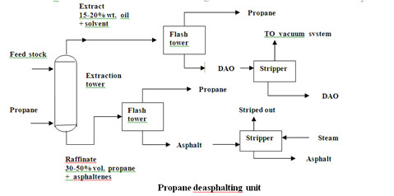

Slide 5
Solvent Extraction
There are three solvents used for the extraction of aromatics from lubricating oil feed stocks and the solvent recovery portions of the system are different for each.
The solvents are : 1)Furfural, 2) phenol, 3) N- methyl 2- pyrrolidone (NMP).
The purpose of solvent extraction is :
1. Improve VI.
2. Improve oxidation resistance and color.
3. Reduce carbon and sludge forming tendencies of the lubricants by separating the aromatic portion from the naphthenic and paraffinic portion of the feed stock.
Furfural Extraction The most important operating variables are :
1. Furfural / oil ratio ( F / O ratio ) :It has the greatest effect on the quality and yield of the raffinate. Range 2:1 for light stocks to 4.5 : 1 for heavy stocks.
2. Extraction temperature : Is selected as a function of the viscosity of the oil and the miscibility temperature.
3. Extracted recycle ratio : Determines to some extent the rejection point for the oil and the sharpness of separation between the aromatics and naphthenes and paraffins.

Slide 6
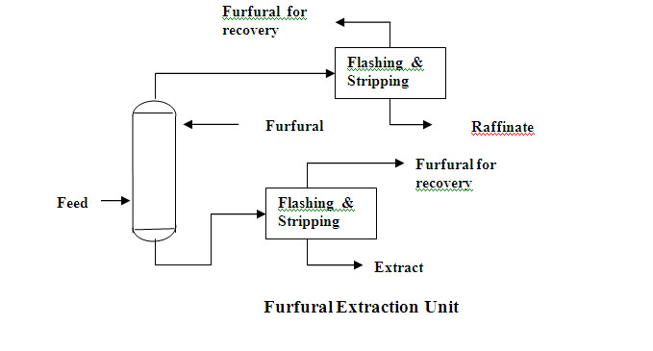

Slide 7
Dewaxing
All the lubricating oil except those from a relatively naphthenic crude oils, must be dewaxed or they will not flow properly at ambient temperature.
Dewaxing is one of the most important and most difficult processes in lubricating oil manufacturing.
There are two types of processes in use today :
1. Uses refrigeration to crystallize the wax and solvent to dilute the oil portion sufficiently to permit rapid filtration to separate the wax from the oil.
2. Uses selective hydrocracking process to crack the wax molecules to light HC.
Solvent dewaxing : The solvent used are
a) Propane
1) Readily available, less expensive and easier to recover
2) Direct chilling can be accomplished by vaporization of the solvent thus reducing the capital and maintenance costs of scraped- surface chiller.
3) High filtration rate can be obtained because of its low viscosity at very low temperature.
4) Requires use of a dewaxing aid.
5) Large difference between filtration temperature and pour point of finished oils (15 to 25 ºC)

Slide 8
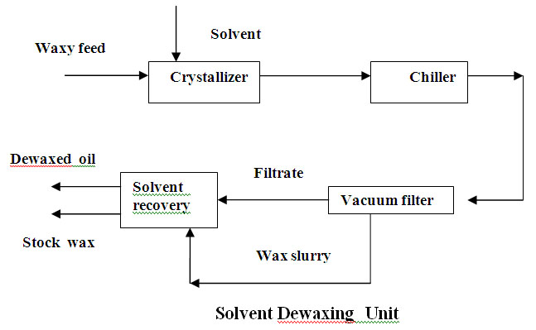
b) Ketone
1) Small differences between filtration temperature and pour point of dewaxing oil (5 to 10 ºC).
2) Fast chilling rate.
3) Good filtration rate but lower than propane.
Lower pour point capability : Greater recovery of heat by heat exchanger lower refrigeration requirements.

Slide 9
The dewaxed oil next must go through a finishing step to improve its color and color stability.
The stock wax is used either for catalytic cracker feed or undergoes a de-oiling operation before sold as industrial wax.
Selective hydrocracking :
The feed to selective hydrocracking unit is solvent extracted oil from aromatic extraction units.
The advantages over conventional solvent dewaxing unit
Production of very low pour and cloud oils from paraffinic stocks.
Lower capital investment.
Improved lubrication oils base stock yields.
A separate hydrofinishing operation is not necessary.
Hydrofinishing
This process is needed to remove chemically active compounds that affect the color stability of lubrication oils.
Most hyderotreating operation use cobalt- molybdate catalysts.
The removal of nitrogen compounds is a major requirement of the operation because it affect color, usually finished oil yields are approximately 98% of dewaxed oil feed.

Slide 10
Hyderotreating
Hydrotreating: It is a relatively mild operation whose primary purpose is to saturate olefins and/ or reduce the sulfur and/ or nitrogen content (and not to change the boiling range) of the feed.
Hydrocracking : Processes whose primary purpose is to reduce the boiling range in which 100% of the feed is converted to product with boiling ranges lower than that of the feed.
Hydrotreating and hydrocracking set the two ends of the spectrum and those processes with a substantial amount of sulfur and/ or nitrogen removal and a significant change in boiling range of the products versus the feed are called hydro- processing.
Hydrotreating is a process to catalytically stabilize petroleum products and/ or to remove objectionable from products or feeds stocks by reacting them with hydrogen.
Stabilization : Involves converting unsaturated hydrocarbons such as olefins and gum- forming unstable diolefines to paraffins, objectionable elements removed by hydrotreating include sulfur, nitrogen, oxygen , halides, and trace metals. Hydro treating is applied to wide range of feeds stocks from naphtha to reduce crude . When the process is applied specifically for sulfur removal it is usually called hydrodesulfurization or HDS.

Slide 11
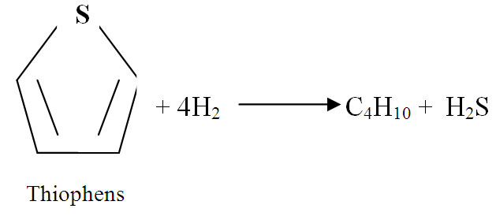
1) The oil feed is mixed with hydrogen- rich gas either before or after it is preheated to the proper reactor inlet temperature, below 800 ºF to minimize cracking in the presence of metal oxide catalyst.
Reaction
1) Desulfurization
RSH + H₂ → RH + H₂S
mercaptans
R₂S + 2H₂ → 2RH + H₂S
sulfides
(RS)₂ + 3H₂ → 2RH + 2H₂S
disulfides

Slide 12
2) Denitrogenation
C₄H₄NH + 4H₂ → C₄H₁₀ + NH₃
Pyrrole
C₅H₅N + 5H₂ → C₅H₁₂ + NH₃
Pyridine
3) Deoxidation
C₆H₅OH + H₂ → C₆H₆ + H₂O
Phenol
C₇H₁₃00H + 3H₂ → C₇H₁₆ + 2H₂O
Peroxides
4) Dehalogenation
RCl +H₂ → RH + HCl
5) Hydrogenation
C₅H₁₀ + H₂ → C₅H₁₂
6) Hydrocracking
C₁₀H₂₂ → C₄H₈ + C₆H₁₄
Nitrogen removal requires more severe operating conditions than does desulfurization. The ease of desulfurization is dependent upon the type of compound. Lower boiling compounds are desulfurized more easily than higher boiling ones.

