Slide 1
Lect./6 Petroleum refinery
Heating of Crude Oil

Slide 2
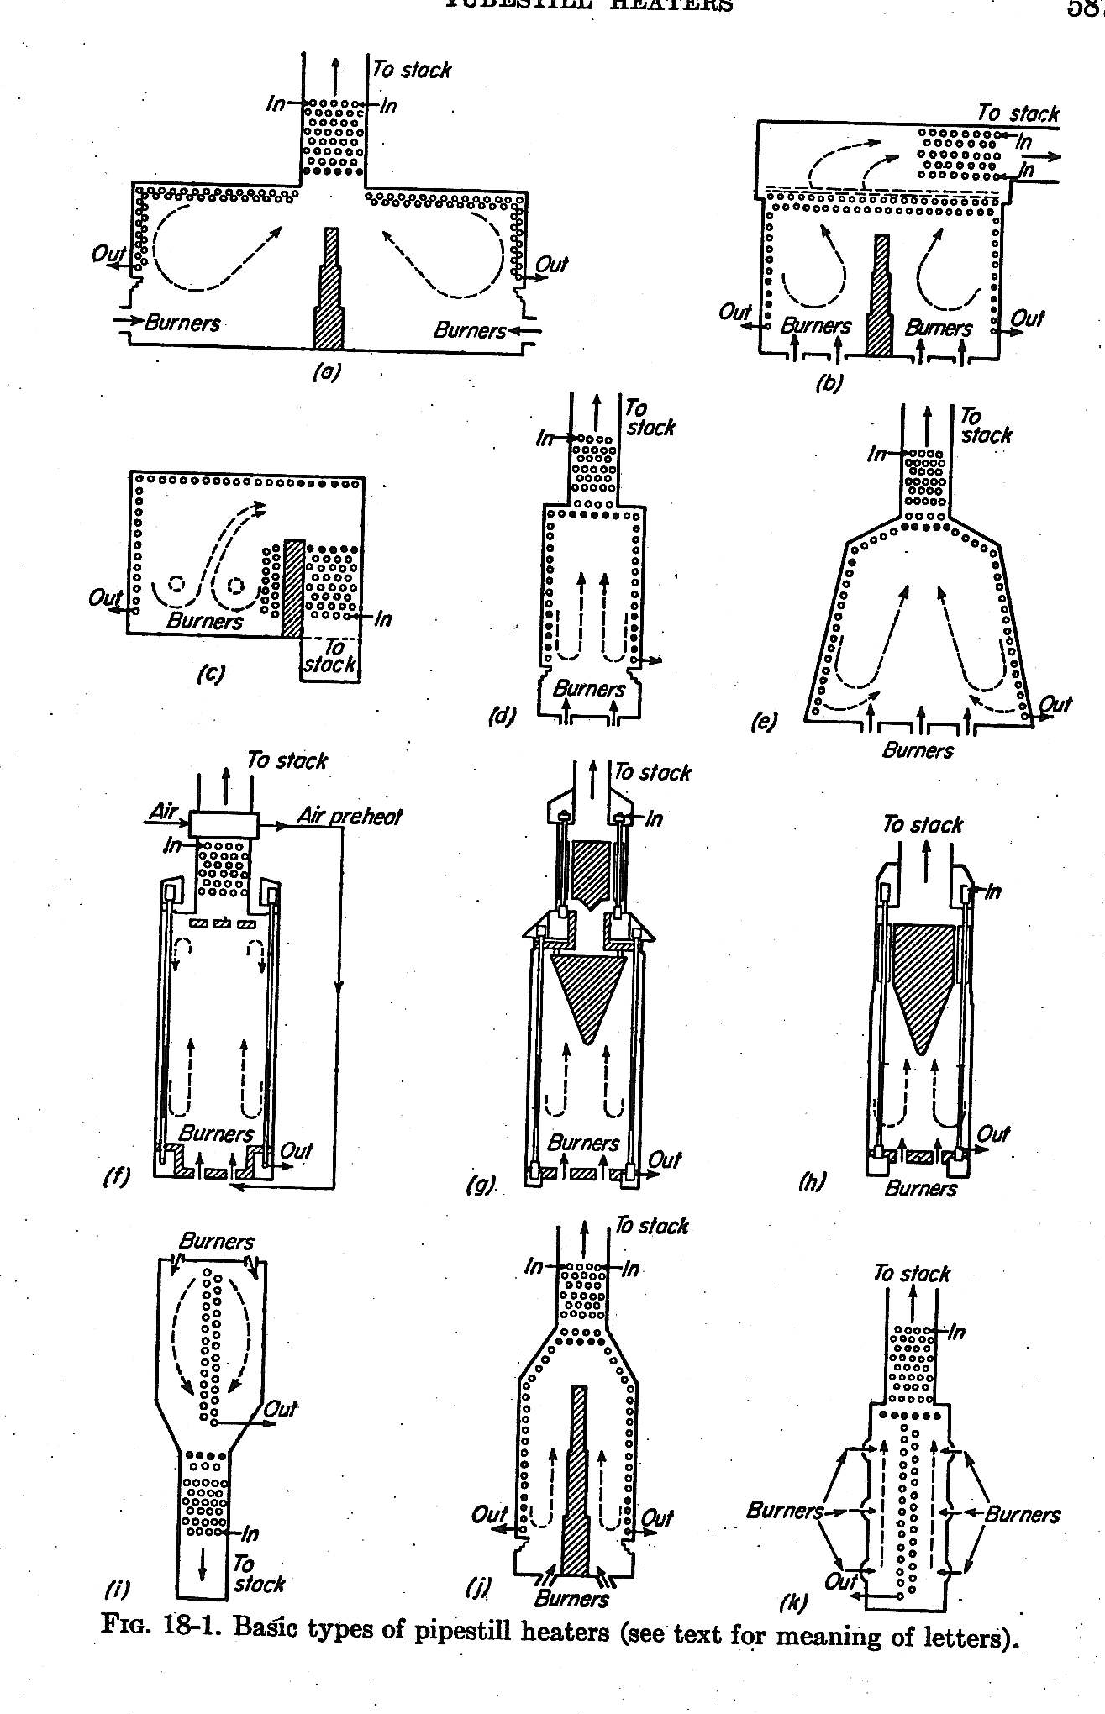

Slide 3
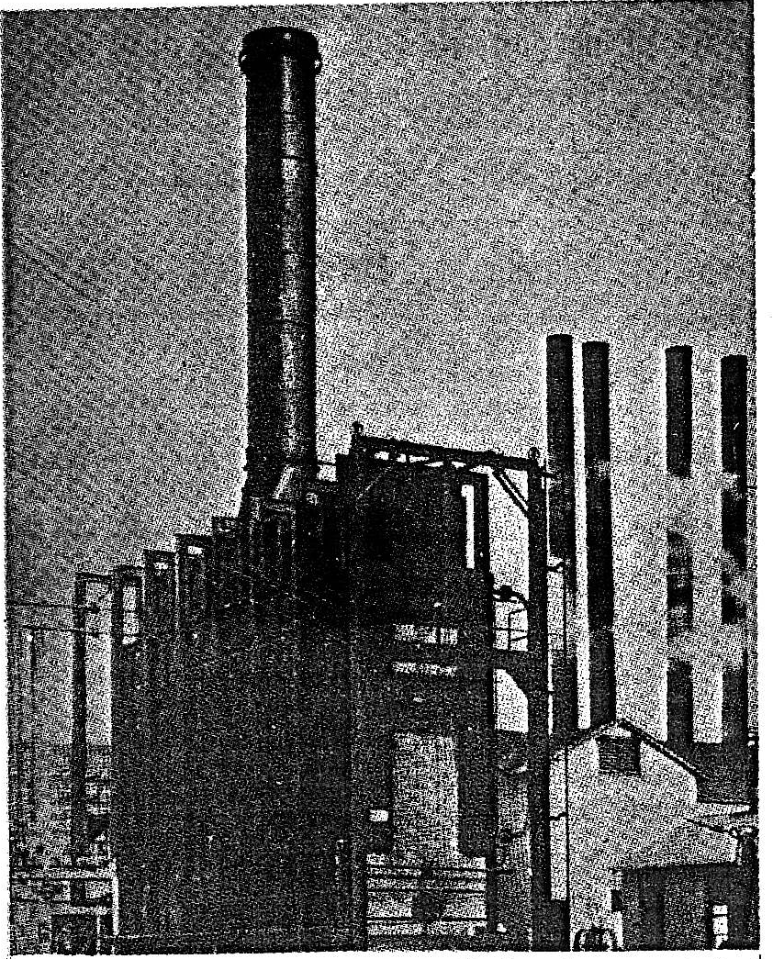

Slide 4

Heating of Crude Oil
Pipe Still Heater
Pipe heaters can be categorized into three types:
3) Radiant Wall
2) Cylindrical.
1) Box/ Rectangular.
All these furnaces have got separate radiation section and convection section. The most universal classification is based on direction of tubes as well as shape of furnace and mode of application of heat.

Slide 5
Heating of Crude Oil
In most of the furnaces, the direction of tubes is horizontal as in all box type heaters and vertical in cylindrical stills. Radiant walls also use horizontal tubes; however tubes can be placed vertically also.
The radiant section design is based on Stefan's law of radiation:
A: area of radiating surface, ft²
b : 1.72x10⁹ Btu/ ºF ft² hr. at black bod conditions.
T: absolute temperature of the surface,ºF

Slide 6
Heating of Crude Oil
For a satisfactory design, the following schedule of heat distribution may be employed:
Type of heat | Percent
Convection heat transfer | 30-50%
Radiant heat transfer | 45-60%
Losses (Furnace) | 5%
Stack losses | 12%
Design of a furnace radiation section is based on Hottle, Wilson method and radiant heat absorption is given as:-

Slide 7
R= % heat absorbed in radiant section.
G= Air /fuel ratio (wt. basis).
α = Factor to convert actual exposed surface to cold surface:
0.986 for two rows at spacing 2 OD.
0.88 for one rows at spacing 2 OD.
If
Q in Kj / hr S=14200 Area in m²
Q in Btu/hr S=4200 Area in ft²
Q in Kcal/hr S=6930 Area in m²

Slide 8
Heating of Crude Oil
A_{cp} = wall area.
α A_{cp}= equivalent cold plane surface ft²
L= length.
C= Center to center spacing.
N= Number of tube per row.
A= Projected area
D= Tube diameter ( in )

Slide 9
Heating of Crude Oil
n= no. of rows
RQ = Aq
q= rate of heat absorption per square foot of projected tube area

Slide 10
Heating of Crude Oil
For a most commercial case D/C= 0.5 , n=2

Slide 11
Heating of Crude Oil
Example:-
A petroleum stock at a rate of 1200 bbl/hr. of sp. gr. 0.8524 is passed through a train of heat exchangers and is allowed to enter directly the radiant section of box type heater at 220 º C . The heater is designed to burn 3500 kgs per hour of refinery off gases as fuel.
The net heating value of fuel is 47.46x10³ Kj per kg.
The radiant section contains 150 sq. meters of projected area of one row of tubes (10.5 cm, 12 m long and spaced at 2 OD).
>> Find the outlet temperature of the petroleum stock?
Where,
α=0.88
Air fuel ratio= 25
Average Specific heat of stock=2.268 Kj/Kg º C.

Slide 12
Heating of Crude Oil
Solution
Total heat liberated (Q) = m _{fuel} * NHV
= 47.46*10³ * 3500 = 1.66*10⁸ Kj/hr.
Projected area of one tube (L * D) = 12 * 0.105
No. of tubes = 150 / ( 12 * 0.105 ) = 120 tubes
α A _{cp}= 0.88 * 120 * 0.105 * 2 * 12 = 266 Sq. m.
Heat absorption %(R)

Slide 13
Heating of Crude Oil
Outlet temperature of the stock:-
Q = m Cp Δt
0.44*1.66*10⁸ = 1200 * 200 * 0.8524* 2.268 * Δt
؞Δt =157 º C
So the outlet temperature is equal to 157 + 220 = 377 º C

Slide 14
Heating of Crude Oil
Example
A pipe still uses 7110 lb/hr of a cracked gas (Net Heating Value (NHV) 20560 Btu/lb). The radiant section contains 1500 sq ft of projected area, and the tube (5 in. outside diameter) are spaced at a center-to-center distance of 10 in. there is only one row of radiant tubes, and they are 40 ft long. The ratio of air to fuel is (21 - 30 percent excess air).
a) What percentage of the heat liberation is absorbed in the radiant section?
b) How many Btu are absorbed per hour through each square foot of projected area?

Slide 15
Heating of Crude Oil
Solution
Total heat liberated(Q)= m _{fuel} * NHV
= 7110 * 20560
=146000000 Btu/hr
A = 1500
N = number of tubes
= 90
= 40 * 90 *10 / 12 = 3000
α A _{cp}= 0.88 * 3000 = 2640 sq ft

Slide 16
Heating of Crude Oil
Heat absorption %(R)
Heat absorption in radiant section = 0.458 *146 *10⁶
= 66900000 Btu/hr
Heat absorbed / sq ft projected area = q = 66900000/1500
= 44500 Btu/hr.ft²

Slide 17
Heating of Crude Oil
Example
A furnace is to be designed for a heat duty of 50x10⁶ Btu/hr if the overall efficiency of the furnace is 80% and an oil fuel with a NHV = 17130 Btu/lb is to be fired with 25% excess air (17.5 lb air/lb fuel ) with the air being preheated to 400 º F .
Steam is used for atomizing at a rate of 0.3 lb/lb of fuel at 190 ⁰F. Furnace tubes are of 5 in OD., 38.5 ft length and 10 in spacing arranged in a single row. 1500 ft² of projected area is available.
H_{air} ( 400 º F ) = 82 Btu/lb
H _{steam} ( 190 º F ) = 95 Btu/lb
H ( flue gases at 1730 º F ) = 148 Btu/hr

Slide 18
Heating of Crude Oil
Calculate:-
1) The no. of tube required in radiation section.
2) % heat absorbed in convection section assuming wall losses
of 5 %.
3) The heat rate available per unit projected area.
Solution:-
A = n * L * N * D/12
A = 1500 ft²

Slide 19
Heating of Crude Oil
1) N = 1500 * 12 / (1 * 38.5 * 5)
N = 94 tube/row
A _{cp}= L * C /12 * N
= 38.5 * 10/12 * 94 = 3015.8 ft²
α A _{cp}= 0.88 * 3015.8 = 2653.9 ft²
Q _{total} = Q _{comb.} + Q _{steam} + Q _{air}
Q _{comb.}= m _{fuel} * NHV
m _{fuel} = 6.25 * 10⁷/17130 = 3.648 * 10³
m _{steam} = 0.3 * m _{fuel}
m _{steam} = 0.3 * 3.648 * 10³ = 1.0944 * 10³ lb/hr
Q _{steam} = m _{steam} * H _{steam}
= 1.0944 * 10³ * 95 = 1.03968 * 10⁵ Btu/hr
0.3 lb steam / 1 lb fuel

Slide 20
Heating of Crude Oil
17.5 lb air / 1 lb fuel
m _{air} = 17.5 * m _{fuel}
m _{air} = 17.5 * 3.648 *10³ = 6.384 * 10⁴ lb/hr
m _{air} = 1.25 * 6.384 * 10⁴ = 7.98 * 10⁴ lb/hr
Q _{air} = m _{air} * H_{air}
Q _{air} = 7.98 * 10⁴ * 82= 6.5436 * 10⁶ Btu/hr
m _{flue gases} = m _{fuel} + m _{air} + m _{steam}
m _{flue gases} = 3.648 *10³ + 7.98 *10⁴ + 1.0944 * 10³ = 8.454 * 10⁴ lb/hr
Q _{flue gases} = m _{flue gases} * H _{flue gases} = 8.454 * 10⁴ * 148
= 1.25 * 10⁷ Btu/hr
Excess air = 25 %

Slide 21
Heating of Crude Oil
Q _{total} = Q _{comb.} + Q _{steam} + Q _{air}
= 6.25 * 10⁷ + 1.03968 * 105 + 6.5436 * 10⁶
= 6.9147 *10⁷ Btu/hr
% stack loss = Q _{flue gases} / Q _{total} * 100
= 1.25 * 10⁷ /6.9147 * 10⁷ * 100 = 18 %
Heat absorption %(R)

Slide 22
Heating of Crude Oil
2) % convection = 100 - % R - % stack loss - % wall loss
% convection = 100 - 59.88 – 18 – 5 = 17.12 %
3) q = RQ/A = 0.5988 * 6.78 * 10⁷/1500
q = 2.7 x 10⁴ Btu/hr.ft²

Slide 23

Heating of Crude Oil
H.W (1)
A furnace is to be designed for a heat duty of 30 x 10⁶ Btu/hr and efficiency of 75%.
The furnace is fired with gaseous fuel at a rate of 17 lb air/lb fuel (NHV = 17000 Btu/lb).
The tube are arranged in two rows and are of 5 in OD., 40 ft length and 2x OD.
Spacing, heat rate of 35000 Btu/hr of projected area is recommended.
calculate:
1) % heat absorbed in radiation section (R %).
2) Heat absorbed in the convection section.
(State any assumptions used).
3) The number of tubes in the radiation section.

Slide 24

Heating of Crude Oil
H.W (2)
7000 lb/hr of cracked gas of 20560 Btu/lb NHV is used as a fuel in a furnace.
The radiant section absorbed 44500 Btu/hr ft² of projected area. The tubes are 5 in. OD. , 10 in. spacing, and 20 ft long.
They arranged in two rows. The air to fuel ratio is 21- 0. Calculate :
the number of tubes in the radiation section.
2) the amount of heat absorbed in this section.

