Slide 1
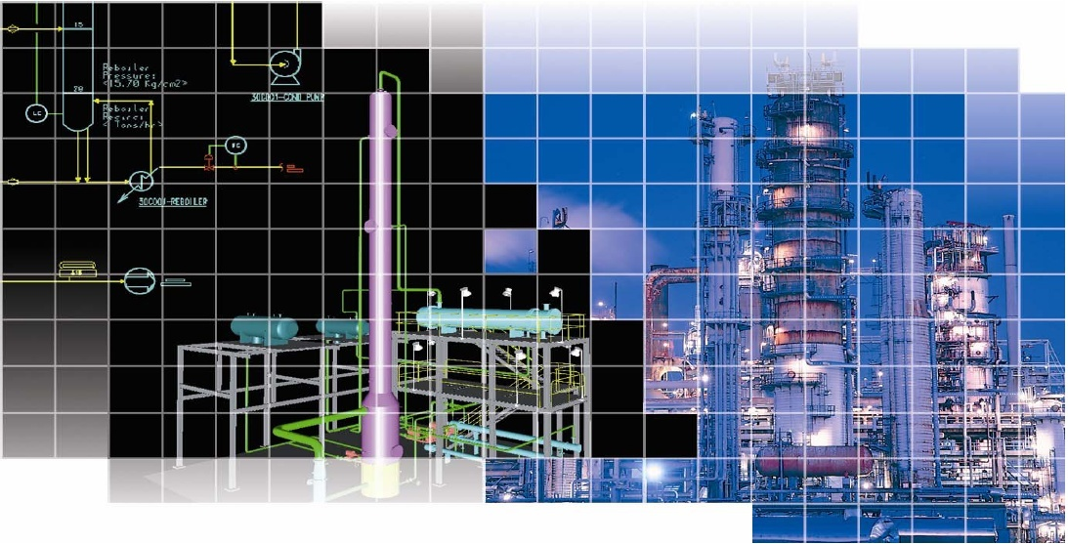

Lect./10
Cracking and Reforming)

Slide 2
A) Thermal cracking

Slide 3
Thermal cracking:
Is defined as the thermal decomposition, under pressure, of large HC molecules to form smaller molecules. Lighter, more valuable HC may be obtained from such relatively low value stocks as heavy gas oils (boiling up to 540 ºC (1005 ºF)) and residues.
These processes are considered as upgrading processes for vacuum residue.

Slide 4
Requirements of Thermal cracking:
Residual fractions (bottom of barrel) are the least valuable streams of a refinery.
Nearly 30-40 % of the typical C.O in Iraq contains 370 ⁺ ⁰C fractions.
Worldwide limited reserve of sweet crude oil.
Disposal problems due to stringent environmental regulations.
Decreasing demand of fuel oil.
Gradually increasing demand of middle distillates.

Slide 5
Advantages of Thermal cracking:
It is simple and cost effective process. However rapid uncontrolled thermal cracking produces undesirable products like gas and coke.
Limitation of catalytic cracking for resid processing :
In resid feed stock presence of high molecular weight compounds like resins, asphaltenes and metals it unsuitable for catalytic cracking, FCC can process resid feed only to certain limit.
Metal and sulfur compounds in resid feedstock as catalyst poison.

Slide 6
Coking:
Coking are severe thermal cracking operations, most commonly used carbon rejection process that upgrades residues to a wide range of lighter H.C gases and distillates through thermal cracking.
The byproduct of coking process is petroleum coke.
The goal of coker operation is to maximize the yield of clean distillates and minimize the yield of coke.

Slide 7
Feed stock of coking process:
Wide variety of feed stocks (can have considerable metals (nickel &vanadium) , sulfur, resin and asphaltens.
Most contaminants exit with coke.
Typical feed is vacuum resid.

Slide 8
The main produts:
Off-gas from which LPG is recovered.
Naphtha may be used as gasoline blending agent although its O.N =65-80 RON.
Gasoil may be catalytic cracking
Coke the main uses of petroleum coke:
Fuel
Manufacture of anode for electrolytic cell reduction of alumina
Direct use as chemical carbon source for manufacture of elemental phosphorus, calcium carbide, and silicon carbide.
Manufacture of electrodes for use in electric furnace production of elemental phosphorus, titanium dioxide, calcium carbide, and silicon carbide.
Manufacture of graphite.

Slide 9
The major coking processes:
1) Delayed Coking
Semi-continuous process.
Feed :atm. Residue, cracked tar, and heavy cycle oil
Feed heated and transferred to large soaking (or coking drum).
Long residence time need to allow the cracking reactions to complete.
Moderate heating : 482-516 ºC (900-960) º F
Soak drum : 452-482 ºC (845-900) º F
Residence time : until they are fill of coke.
Coke is removed hydraulically
Coke yield = 30 %

Slide 10
Fig 1: Delayed coking unit

Slide 11
2) Fluid Coking or flexicoking
A continuous process which uses the fluidized- solids technique to convert residues to more valuable products.
The residue is coked by being sprayed into a fluidized bed of hot, fine coke particles.
The use of a fluid bed permits the coking reaction to be conducted at higher temperature and shorter contact times than those in delayed coking: Fluidized bed with steam.
Severe heating 482- 566 ºC (900-1050) º F at 10 psig.
Higher yields of light ends.
Less coke yields ( 20 % for fluid coking and 2 % for flexicoking)

Slide 12
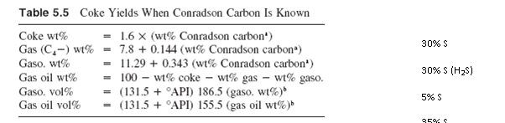
Coke & liquid yields may be estimated by simple equations:

Slide 13
Example ( 1 ) : Develop preliminary estimate of product yields on the processing of 1000⁺ Rc of 23760 BPD capacity. Conrad son carbon = 19%, 2.3% S, API = 10.7.
Solution :
(lb/bbl)
Feed BPD API lb/ hr lb/ hr wt% S lb/hr
(348.56)
1000⁺ RC 23700 10.7 14.52 345080 2.3 7940
Products wt% lb/ hr lb/ hr S
Coke wt % 30.4 104900 2382
Gas (C4 - ) wt% 10.5 36230 2382
Gasoline wt% 17.8 61450 397
Gas oil wt% 41.3 142500 2779
----- -------- -------
100 345080 7940

Slide 14
Visbreaking:
Visbreaking is a relatively mild thermal cracking operation mainly used to reduce the viscosities and pour points of vacuum tower bottoms to meet the requirements of fuel oil
reduce the amount of cutting stock required to dilute the residue to meet the specifications.
It is also used to increase catalyst cracker feed stocks and gasoline yields.

Slide 15
Visbreaking:
The principal reactions which occur during the visbreaking operation are :
1) Cracking of the side- chains attached to cyclo-paraffin and aromatic rings.
2) Cracking of resins to light HC (primarily olefins) and compounds which convert to asphaltenes.
3) At temperature above 900 ºF some cracking of naphthene rings.

Slide 16
Visbreaking:
There are two types of visbreaker operation
1) Coil or furnace cracker
Uses high furnace outlet temperature (885-930 ºF), and reaction time from 1-3 minutes. The feed is heated in a furnace or coil and quenched as it exits the furnace with gas oil or tower bottoms to slop the cracking reaction.
2) Soaker
The feed leaves the furnace at (800- 820) ºF and pass through a soaking drum which provides an additional reaction time, before it is quenched.

Slide 17
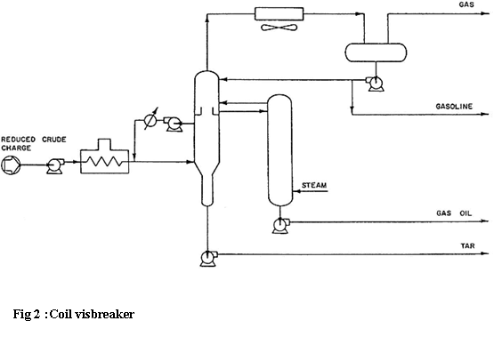

Slide 18
B) Catalytic cracking

Slide 19
Catalytic cracking is the most important and widely used refinery process for converting heavy oils into more valuable gasoline and lighter products.
Catalytic cracking breaks complex hydrocarbons into simpler molecules in order to increase the quality and quantity of lighter, more desirable products and decrease the amount of residuals.
This process rearranges the molecular structure of hydrocarbon compounds to convert heavy hydrocarbon feedstock into lighter fractions such as kerosene, gasoline, LPG, heating oil, and petrochemical feedstock.
Catalytic cracking is similar to thermal cracking except that catalysts facilitate the conversion of the heavier molecules into lighter products.
Use of a catalyst (a material that assists a chemical reaction but does not take part in it) in the cracking reaction increases the yield of improved-quality products under much less severe operating conditions than in thermal cracking.

Slide 20
There are three basic functions in the catalytic cracking process:
Reaction: Feedstock reacts with catalyst and cracks into different hydrocarbons;
Regeneration: Catalyst is reactivated by burning off coke; and
Fractionation: Cracked hydrocarbon stream is separated into various products.

Slide 21
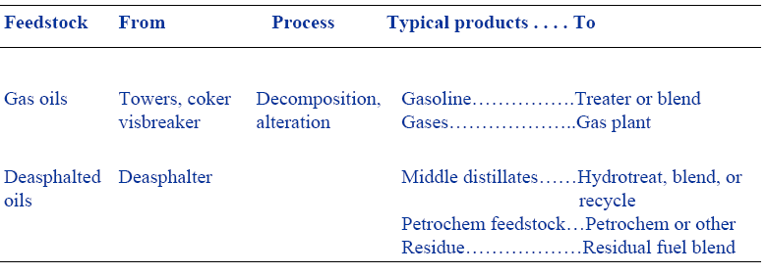
Catalytic Cracking

Slide 22
Fluid Catalytic Cracking (FCC)
• The most common process is FCC, in which the oil is cracked in the presence of a finely divided catalyst which is maintained in an aerated or fluidized state by the oil vapors.
• The fluid cracker consists of a catalyst section and a fractionating section that operate together as an integrated processing unit.
• The catalyst section contains the reactor and regenerator, which, with the standpipe and riser, forms the catalyst circulation unit.
• The fluid catalyst is continuously circulated between the reactor and the regenerator using air, oil vapors, and steam as the conveying media.
• A typical FCC process involves mixing a preheated hydrocarbon charge with hot, regenerated catalyst as it enters the riser leading to the reactor.

Slide 23
•The charge is combined with a recycle stream within the riser,
vaporized, and raised to reactor temperature (900°-1,000° F) by the hot catalyst.
• As the mixture travels up the riser, the charge is cracked at 10-30 psi. In the more modern FCC units, all cracking takes place in the riser.
• The "reactor" no longer functions as a reactor; it merely serves as a holding vessel for the cyclones.
• This cracking continues until the oil vapors are separated from the catalyst in the reactor cyclones.
• The resultant product stream (cracked product) is then charged to a fractionating column where it is separated into fractions, and some of the heavy oil is recycled to the riser.
• Spent catalyst is regenerated to get rid of coke that collects on the catalyst during the process.
• Spent catalyst flows through the catalyst stripper to the regenerator, where most of the coke deposits burn off at the bottom where preheated air and spent catalyst are mixed.
• Fresh catalyst is added and worn-out catalyst removed to optimize the cracking process.

Slide 24
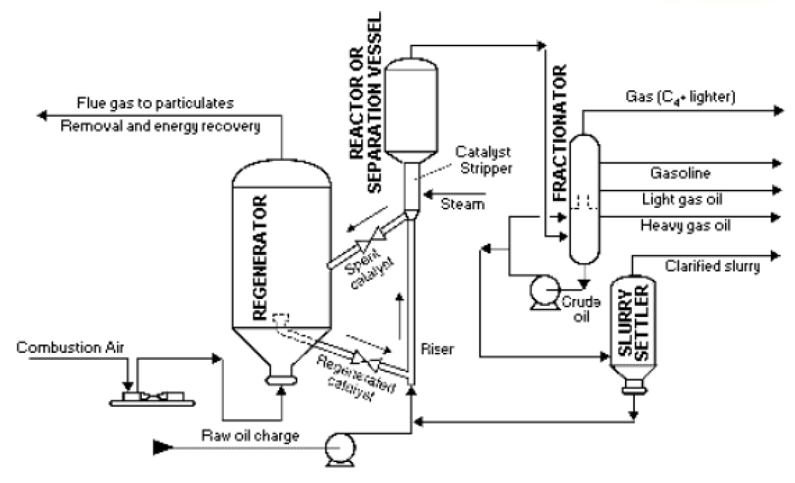
Fluid Catalytic Cracking

Slide 25
Moving-Bed Catalytic Cracking
• The moving-bed catalytic cracking process is similar to the FCC process.
• The catalyst is in the form of pellets that are moved continuously to the top of the unit by conveyor or pneumatic lift tubes to a storage hopper, then flow downward by gravity through the reactor, and finally to a regenerator.
• The regenerator and hopper are isolated from the reactor by steam seals.
• The cracked product is separated into recycle gas, oil, clarified oil , distillate, naphtha, and wet gas.

Slide 26
Catalyst
Both systems use basically similar catalysts but produced in a different form, in the shape of beds for moving bed and fine powder for fluidized bed.
Acid treated clays ground to a powder
Synthetic silica- alumina catalysts of higher activity (amorphous)
Crystalline synthetic silica – alumina catalyst called zealots or molecular sieves.
The advantages of zealots over the natural and synthesis amorphous catalyst are
1) Higher activity.
2) Higher gasoline yields at a given conversion.
3) Production of gasoline containing a larger % of paraffinic and aromatic HC.
4) Lower coke yield.
5) Increased iso-butane production.
6) Ability to go for higher conversion per pass without over cracking.

Slide 27
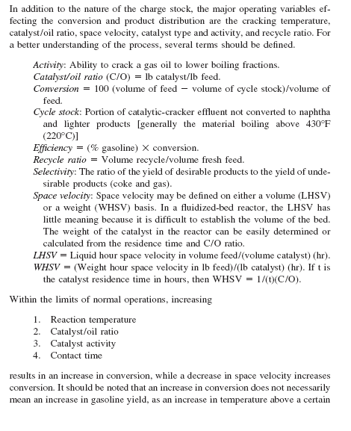
PROCESS VARIABLES

Slide 28
C) Catalytic Reforming

Slide 29
Catalytic Reforming
Catalytic reforming is the process of transforming C7–C10 hydrocarbons with low octane numbers to aromatics and iso-paraffins which have high octane numbers. It is a highly endothermic process requiring large amounts of energy.
Depending on the properties of the naphtha feedstock (as measured by the paraffin, olefin, naphthene, and aromatic content) and catalysts used, reformates can be produced with very high concentrations of toluene, benzene, xylene, and other aromatics useful in gasoline blending and petrochemical processing.
Hydrogen, a significant by-product, is separated from the reformate for recycling and use in other processes.
A catalytic reformer comprises a reactor section and a product recovery section.

Slide 30
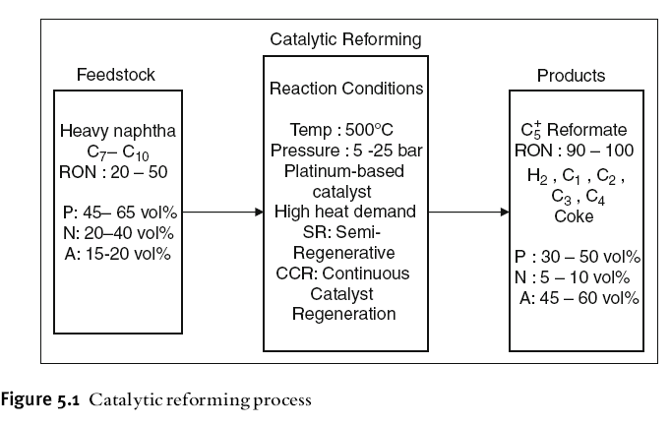

Slide 31
Role of Reformer in the Refinery and Feed Preparation
The catalytic reformer is one of the major units for gasoline production in refineries. It an produce 37 wt% of the total gasoline pool. Other units such as the fluid catalytic cracker (FCC), the methyl ter-butyl ether (MTBE) production unit, alkylation unit and isomerization unit, also contribute to this pool.
The straight run naphtha from the crude distillation unit is hydrotreated
to remove sulphur, nitrogen and oxygen which can all deactivate the reforming
catalyst.
The hydrotreated naphtha (HTN) is fractionated into light naphtha (LN), which is mainly C5–C6, and heavy naphtha (HN) which is mainly C7–C10 hydrocarbons.
Light naphtha (LN) is isomerized in the isomerization unit (I). Light naphtha can be cracked if introduced to the reformer.
The role of the heavy naphtha (HN) reformer is shown in Fig 5.2.
Hydrogen, produced in the reformer can be recycled to the naphtha hydrotreater, and the rest is sent to other units demanding hydrogen.

Slide 32
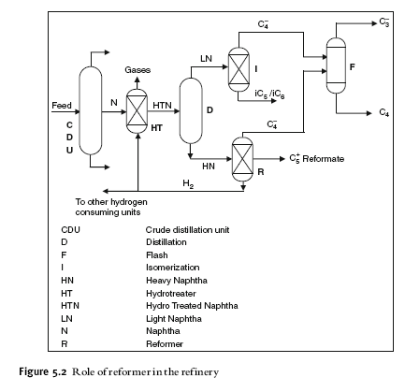

Slide 33
Reforming Reactions
(PONA) {Paraffin, Olefin, Naphthene, Aromatic}
1) P → isomerizes to some extent converted to N, and N subsequently converted to aromatics.
2) O → saturated to form P which then react as in (1) {hydro-cracking}.
3) N → converted to aromatics. {dehydrogenation}.
4) A→ unchanged.

Slide 34
Process Technology
There are several commercial processes available for reforming.
Semi-regenerative Fixed Bed Process :The name semi-regenerative comes from regeneration of the catalyst in the fixed bed reactors after shut down by burning off the carbon formed on the catalyst surface. (Low capital cost).
Continuous Regenerative (moving bed) CCR Platforming :Catalyst can be regenerated continuously and maintained at a high activity . (Higher capital cost).
Cyclic :compromise between the two extremes having a swing reactor for regeneration.

Slide 35
Catalyst
All of the reforming catalyst contains platinum supported on a silica alumina base.
In most cases rhenium is combined with platinum to form a more stable catalyst which permits operation at lower pressure.
Platinum serve as a catalytic site for hydrogenation and dehydrogenation reactions.
Chlorinated alumina provides an acids site for isomerization and hydro- cracking reactions and cyclization.

Slide 36
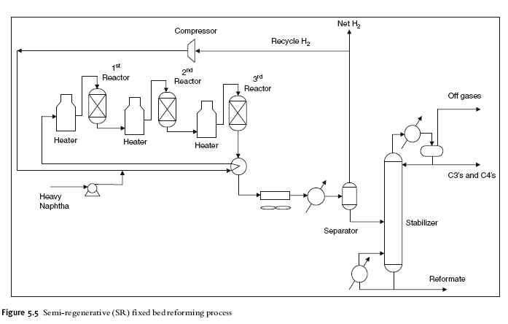

Slide 37
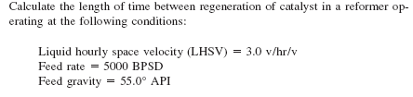
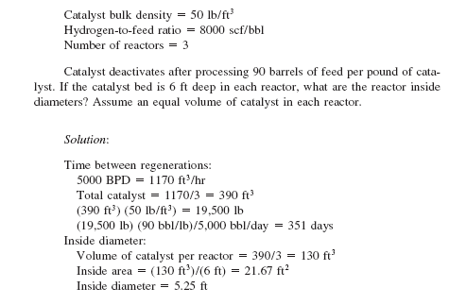
Example (2)

Slide 38
Example (3)
On processing 1200 ton / day of 27 API catalyst crackers feed stock at a temperature of 450 ºC, pressure =1050 mm Hg the following products were obtained:
Products wt % API Mw
Gases 15 -- 32
C₅⁺ gasoline 55 63 110
TCGO 26 5 260
Coke 4 -- 12
Given that: WHSV = 0.7 hr ⁻¹, Linear velocity of vapor (U) = 0.3 m/s,
ρ _{catalyst} = 420 Kg /m³
Calculate: a) diameter of the cracker, b) weight of catalyst needed, c) conversion, and d) efficiency.
Solution :
1200 ton/day * 1000 Kg/ton
m _{feed} = -------------------------- = 50000 Kg /hr
24 hr/day
m _{gases} = 0.15 * 50000 / 3600 =2.08 Kg/s
m _{C5}⁺ _{gasoline} = 0.55 * 50000/ 3600 =7.64 Kg/s
m _{TCGO} = 0.26 * 50000/ 3600 = 3.61 Kg/s
Total moles of vapor = (2.08/ 32) + (7.64/ 110) + (3.61/ 260 )
n = 0.1479 Kg mole / s

Slide 39
22.4 (m³/ kg mole) * 760 mm Hg
R = --------------------------------- = 62.359
1 Kg mole * 273
n R T 0.1479* 62.359 *(450+273)
V= -------- = ------------------------= 6.35 m³/s
P 1050
П V 6.35 m³/s
A =----- D² = ----- = ------- = 21.17 m²
4 U 0.3 m/s
m _{catalyst} = 50000/0.7 = 71428 Kg
V _{catalyst} = m/ ρ = 170 m³
4* 170
H= ---------------- = 8 m
3.14 * (5.19)²

Slide 40
D) Alkylation

Slide 41
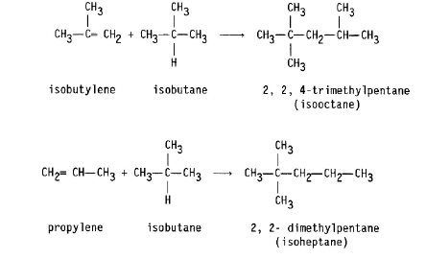
Alkylation combines low-molecular-weight olefins (primarily a mixture of propylene and butylene) with isobutane in the presence of a catalyst, either sulfuric acid or hydrofluoric acid.
The product is called alkylate and is composed of a mixture of high octane,
branched-chain paraffinic hydrocarbons.
Alkylate is a premium blending stock because it has exceptional antiknock properties and is clean burning.
The octane number of the alkylate depends mainly upon the kind of olefins used and upon operating conditions.

Slide 42
E) Isomerization

Slide 43
Isomerization is the process in which light straight chain paraffins of low RON (C6, C5 and C4) are transformed with proper catalyst into branched chains with the same carbon number and high octane numbers.
The hydrotreated naphtha (HTN) is fractionated into heavy naphtha between 90–190 C (190–380 F) which is used as a feed to the reforming unit. Light naphtha C5 - 80 C (C5 - 180 F) is used as a feed to the isomerization unit.
Isomerization Reactions:
Isomerization is a reversible and slightly exothermic reaction:
n-paraffin i-paraffin
The isomerization reactions are slightly exothermic and the reactor works in
the equilibrium mode. There is no change in the number of moles and thus
the reaction is not affected by pressure change. Better conversions are achieved at lower temperature
The conversion to iso-paraffin is not complete since the reaction is equilibrium conversion limited. It does not depend on pressure, but it can be increased by lowering the temperature. However operating at low temperatures will decrease the reaction rate. For this reason a very active catalyst must be used.

Slide 44
Isomerization Catalysts
There are two types of isomerization catalysts:
The standard Pt/chlorinated alumina with high chlorine content, which is considered quite active,
and the Pt/zeolite catalyst.

