Slide 1
Change of Phase
Phase changes, such as vaporization and melting, are accompanied by relatively large changes in internal energy and enthalpy as bonds between molecules are broken and reformed.
Latent heat: Heat transferred to or from a system causing change of phase at constant temperature and pressure.
Types of latent heat are:
(i) latent heat of vaporization (∆h_{v}). heat required to vaporize a liquid;
(ii) latent heat of fusion (∆h_{f}): heat required to melt a solid;

Slide 2
(iii) latent heat of sublimation (∆h_{s}): heat required to directly vaporize a solid.
Condensation of gas to liquid requires removal rather than addition of heat; the latent heat evolved in condensation is -∆h.
Similarly, the latent heat evolved in freezing or solidification of liquid to solid is - ∆h_{f}.
Latent heat is a property of substances and, like heat capacity, varies with temperature.
Tabulated values of latent heats usually apply to substances at their normal boiling, melting or sublimation point at 1 atm, and are called standard heats of phase change.

Slide 3

The change in enthalpy resulting from phase change is calculated directly from the latent heat.
For example, increase in enthalpy due to evaporation of liquid mass M at constant temperature is:

Slide 4
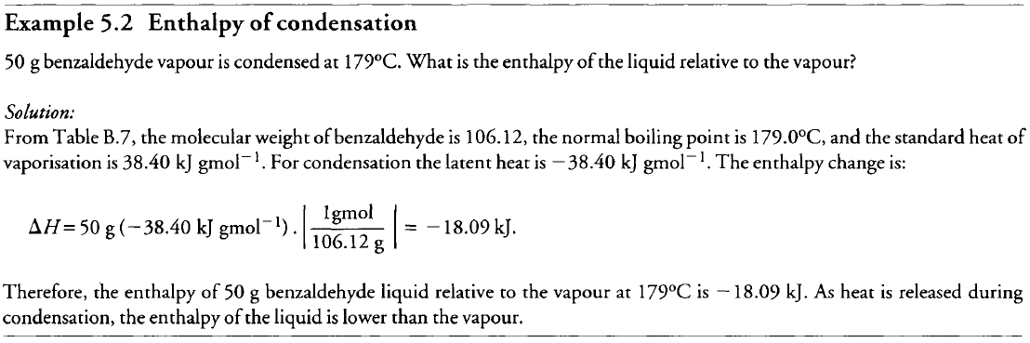

Slide 5
Phase changes often occur at temperatures other than the normal boiling, melting or sublimation point;
Example, water can evaporate at temperatures higher or lower than 100°C
How can we determine ∆H when the latent heat at the actual temperature of the phase change is not listed in the tables?
This problem is overcome by using a hypothetical process path.
Suppose a substance is vaporized isothermally at 30°C although tabulated values for standard heat of vaporization refer to 60°C (Figure 5.3).

Slide 6
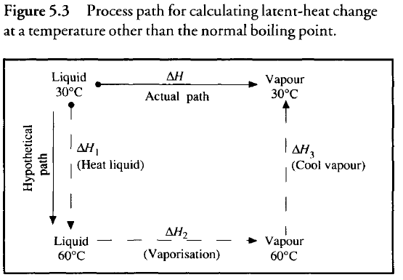

Slide 7
Consider a process whereby liquid is heated from 30°C to 60°C vaporized at 60°C and the vapor cooled to 30°C.
The total enthalpy change for this process is the same as if vaporization occurred directly at 30°C ∆H₁ and ∆H₃ are sensible heat changes and can be calculated using heat-capacity values and the methods described in Section 5.4.1.
∆H₂ is the latent heat at standard conditions available from tables.
Because enthalpy is a state property, ∆H for the actual path is the same as ∆H₁ + ∆H₂ + ∆H₃ .

