Slide 1
Mixing and Solution
For an ideal solution or ideal mixture of several compounds, the thermodynamic properties of the mixture are a simple sum of contributions from the individual components.
When compounds are mixed or dissolved, bonds between molecules in the solvent and solute are broken and reformed.
In real solutions a net absorption or release of energy accompanies these processes resulting in changes in the internal energy and enthalpy of the mixture.
Dilution of sulfuric acid with water is a good example; in this case energy is released.

Slide 2

For real solutions there is an additional energy term to consider in evaluating enthalpy: the integral heat of mixing or integral heat of solution, ∆h_{m}.
The integral heat of solution: the change in enthalpy which occurs as one mole of solute is dissolved at constant temperature in a given quantity of solvent.
The enthalpy of a non-ideal mixture of two compounds A and B is:
where ∆H_{m} is the heat of mixing.

Slide 3
Heat of mixing is a property of the solution components and is dependent on the temperature and concentration of the mixture.
As a solution becomes more and more dilute, an asymptotic (approximated) value of ∆h_{m} is reached.
This value is called the integral heat of solution at infinite dilution.
When water is the primary component of solutions ∆h_{m} at infinite dilution can be used to calculate the enthalpy of the mixture.
∆h_{m} values for selected aqueous solutions are listed in Chemical Engineers' Handbook, Handbook of Chemistry and Physics and Biochemical Engineering and Biotechnology Handbook.

Slide 4
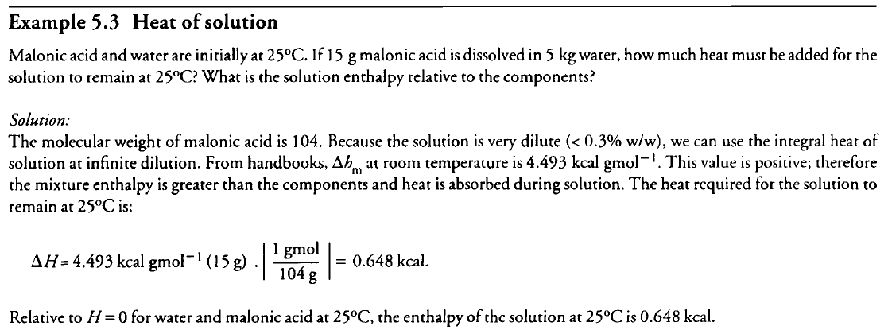

Slide 5
Procedure For Energy-Balance Calculations Without Reaction
Many of the points described in Section 4.3 for material balances also apply when setting out an energy balance.
(i) Drawn and labelle flow diagram for inlet & outlet
Indicate T, P & phases of the material.
(ii) Use unified units for all labeling & indication.
(iii) Choose a base for calculation.
(iv) The reference state for H= 0 is determined.
In the absence of reaction, reference states for each molecular species in the system can be arbitrarily assigned.

Slide 6
(v) State all assumptions used in solution of the problem.
Assumptions such as absence of leaks and steady-state operation for continuous processes are generally applicable.
(a) The system is homogeneous or well mixed. Under these conditions, product streams including gases leave the system at the system temperature.
(b) Heats of mixing are often neglected for mixtures containing compounds of similar molecular structure. Gas mixtures are always considered ideal.
(c) Sometimes shaft work can be neglected even though the system is stirred by mechanical means.

Slide 7
This assumption may not apply when vigorous agitation is used or when the liquid being stirred is very viscous.
(d) Evaporation in liquid systems may be considered negligible if the components are not particularly volatile or if the operating temperature is relatively low.
(e) Heat losses from the system to the surroundings are often ignored; this assumption is generally valid for large insulated vessels when the operating temperature is close to ambient.

Slide 8
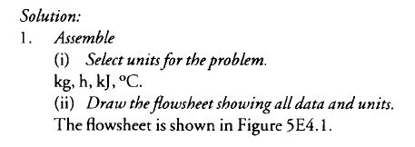
Energy-Balance Worked Examples Without Reaction
Continuous water heater Water at 25°C enters an open heating tank at a rate of 10 kg h⁻¹. Liquid water leaves the tank at 88°C at a rate of 9 kg h⁻¹;
1 kg h⁻ ¹ water vapor is lost from the system through evaporation. At steady state, what is the rate of heat input to the system?

Slide 9
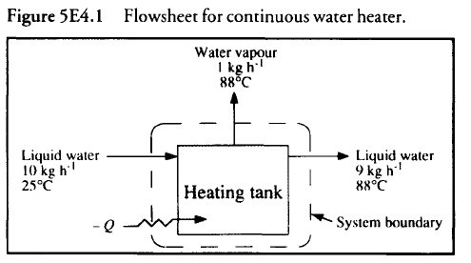


Slide 10
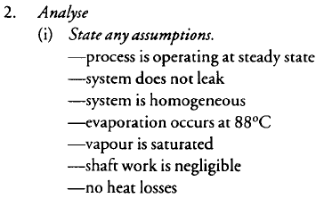

Slide 11
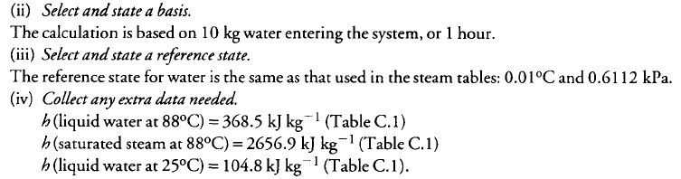

Slide 12
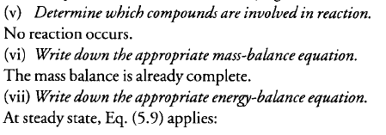

Slide 13
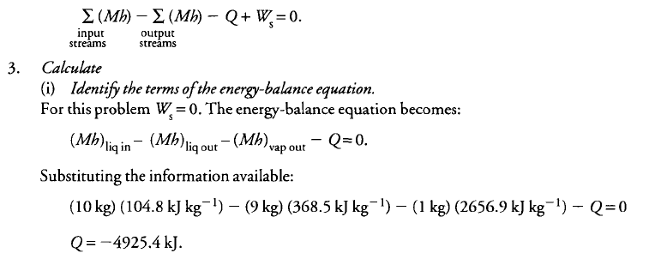

Slide 14
Q has a negative value. Thus, heat must be supplied to the system from the surroundings.
4. Finalize
The rate of heat input is 4.93 * 10³ kJ h⁻ ¹.
Enthalpy Change Due to Reaction
Reactions in bioprocesses occur as a result of enzyme activity and cell metabolism.
Large changes in internal energy and enthalpy occur as bonds between atoms are rearranged.
Heat of reaction ∆H_{rxn} is the energy released or absorbed during reaction, and is equal to the difference in enthalpy of reactants and products:

Slide 15



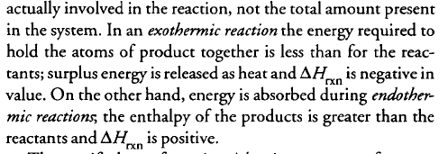

Slide 16
