Slide 1
Chemical Engineering
Thermodynamics
Chapter 8
VAPOR/LIQUID EQUILIBRIUM

Slide 2
So far we have only dealt with pure substances and constant composition mixtures.
We will move a step further where the desired outcome is the composition change.
In system such as distillation & absorption, if the system is not in equilibrium, the mass transfer between system will alter their composition.

Slide 3
Chapter Outline (Smith)
10.1 Nature of Equilibrium
  Definition
  Measures of composition
10.2 The Phase Rule
  Duhem’s Theorem
10.3 VLE : Qualitative behavior
10.4 Simple Models for VLE
- Raoult’s Law
-Dewpoint & Bubblepoint Calculations with
Raoult’s Law
- Henry’s Law

Slide 4
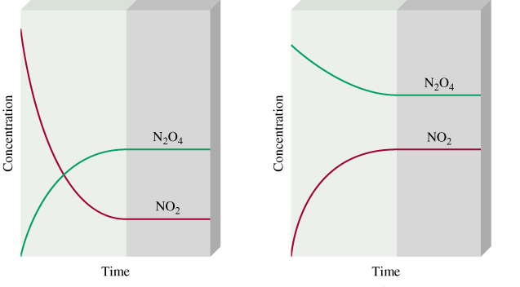
10.1 THE NATURE OF EQUILIBRIUM
Equilibrium : A static condition in which no changes occur in the macroscopic properties of a system with time.
The T, P, composition reaches final value which will remain fixed: equilibrium

Slide 5
  Measures of composition

Slide 6
10.2 PHASE RULE & DUHEM’S THEORY
Equilibrium states are determined by;
  Phase Rule
  Duhem’s Theory

Slide 7
  The Phase Rule
Number of variables that may be independently fixed in a system at equilibrium =
Difference between total number of variables that characterize the intensive state of the system and number of independent equation
F = 2-π+N
Where : F – degrees of freedom
π – No of phase
N – No of species

Slide 8
  Duhem’s Theory
For any closed system formed initially from given masses of prescribed chemical species, the equilibrium state is completely
determined when any two (2) independent variables are fixed

Slide 9
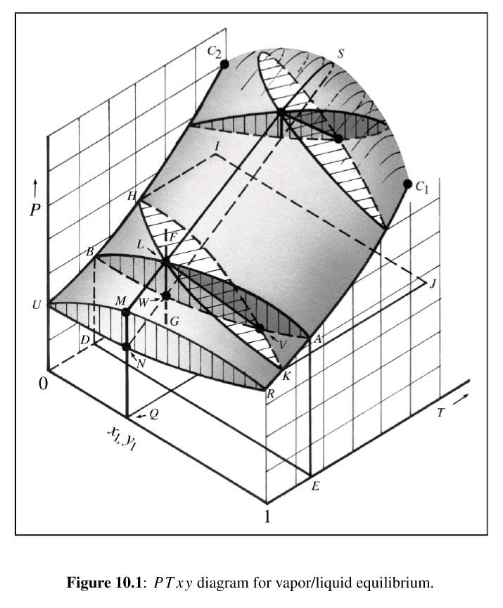
10.3 VLE: QUALITATIVE BEHAVIOR
VLE: State of coexistence of L & V phases
Fig. 10.1 – Shows the P-T-composition surfaces of equilibrium states of saturated V & saturated L of a binary system

Slide 10
Under surface- sat. V states (P-T-y1)
Upper surface- sat. L states (P-T-x1)
Liquid at F, reduces pressure at constant T & composition along FG, the first bubble appear at L – bubble point
As pressure reduces, more & more L vaporizes until completed at W; point where last drop of L (dew) disappear – dew point

Slide 11
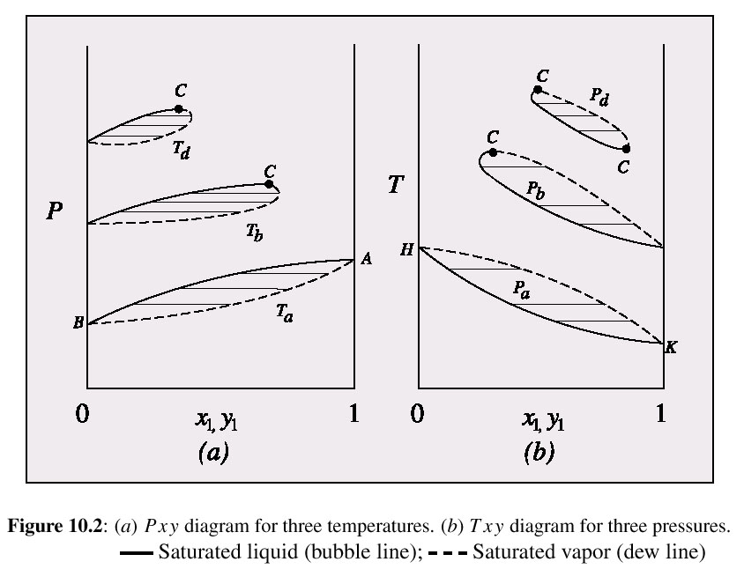

Slide 12
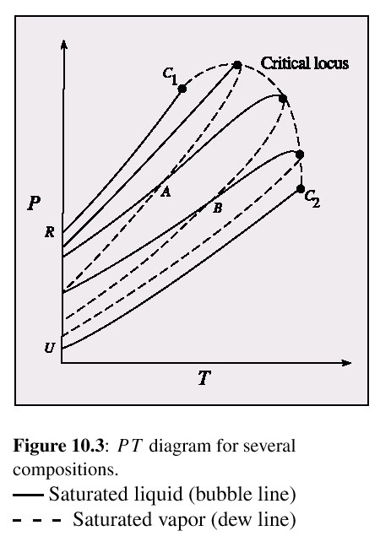
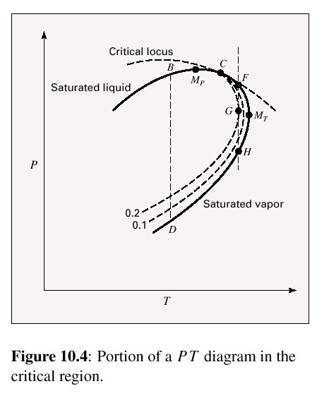

Slide 13
10.4 SIMPLE MODELS FOR VLE

Slide 14
Raoult’s Law
Assumptions;
V phase is an ideal gas
  Applicable for low to moderate pressure
L phase is an ideal solution
  Valid only if the species are chemically similar (size, same chemical nature e.g. isomers such as ortho-, meta- & para-xylene)

Slide 15
Where;

Slide 16
Dewpoint & Bubblepoint Calculations with Raoult’s Law
FIND
GIVEN
BUBL P: Calculate {y_{i}} and P, given {x_{i}} and T
DEW P: Calculate {x_{i}} and P, given {y_{i}} and T
BUBL T: Calculate {y_{i}} and T, given {x_{i}} and P
DEW T: Calculate {x_{i}} and T, given {y_{i}} and P

Slide 17
For binary systems to solve for bubblepoint calculation (T is given);

Slide 18
Raoult’s law equation can be solved for x_{i} to solve for dewpoint calculation (T is given)

Slide 19
Example 10.1
Binary system acetonitrile(1)/nitromethane(2) conforms closely to Raoult’s law. Vapor pressure for the pure species are given by the following Antoine equations:
Prepare a graph showing P vs. x₁ and P vs. y₁ at temperature 75⁰C
Prepare a graph showing t vs. x₁ and t vs. y₁ for a pressure of 70 kPa

Slide 20
a) BUBL P calculations are required. Since this is a binary system, Eq. 10.2 may be used.
At 75⁰C, the saturated pressure is given by Antoine equation;
Substitute both values in (A) to find P;

Slide 21
The corresponding value of y₁ is found from Eq. 10.1.
x₁ | y₁ | P/kPa
0.0 | 0.0000 | 41.98
0.2 | 0.3313 | 50.23
0.4 | 0.5692 | 58.47
x₁ | y₁ | P/kPa
0.6 | 0.7483 | 66.72
0.8 | 0.8880 | 74.96
1.0 | 1.0000 | 83.21

Slide 22
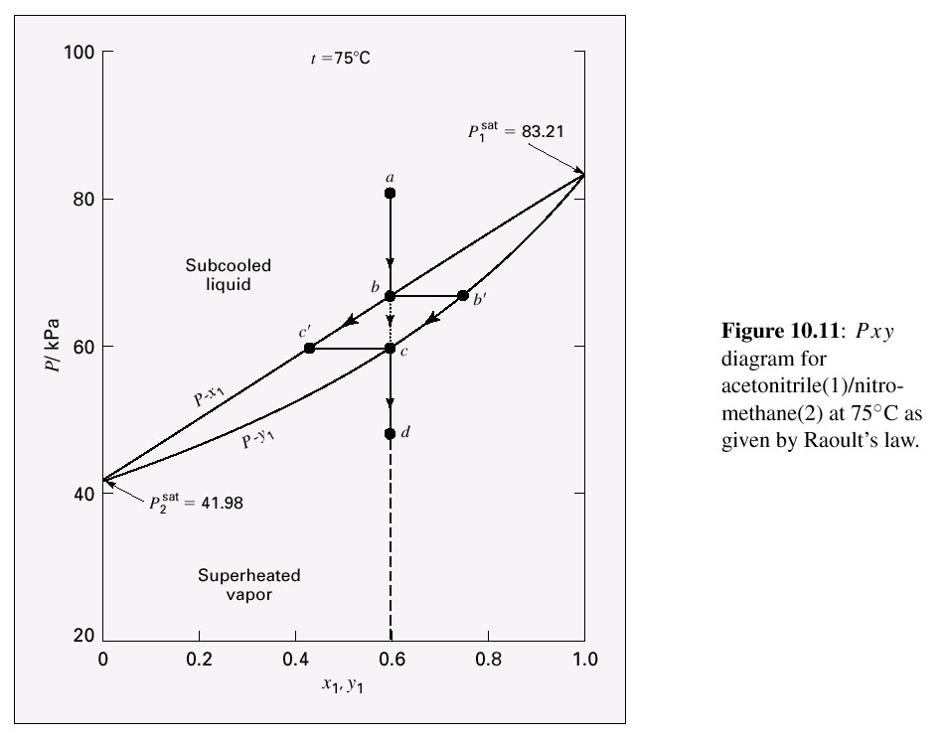

Slide 23
At point c, the vapor composition is y₁=0.6, but the composition of liquid at c’ and the pressure must read from graph or calculated. This is DEW P, by Eq. 10.3;
For y₁=0.6 and t=75⁰C

Slide 24
And by Eq. 10.1,
This is the liquid-phase composition at point c’
b) When P is fixed, the T varies along T₁^{sat} and T₂^{sat}, with x₁ & y₁. T₁sat & T₂sat are calculated from Antoine equation;

Slide 25
For P=70kPa, T₁sat=69.840C, T₂sat=89.580C. Select T between these two temperatures and calculate P₁sat & P₂sat for the two temperatures.
Evaluate x₁ by Eq. (A). For example;
Get y₁ from Eq. 10.1

Slide 26
Summary;
x₁ | y₁ | P/kPa
0.0000 | 0.0000 | 89.58 (t2sat)
0.1424 | 0.2401 | 86
0.3184 | 0.4742 | 82
0.5156 | 0.6759 | 78
0.7378 | 0.8484 | 74
1.0000 | 1.0000 | 69.84 (t1sat)

Slide 27
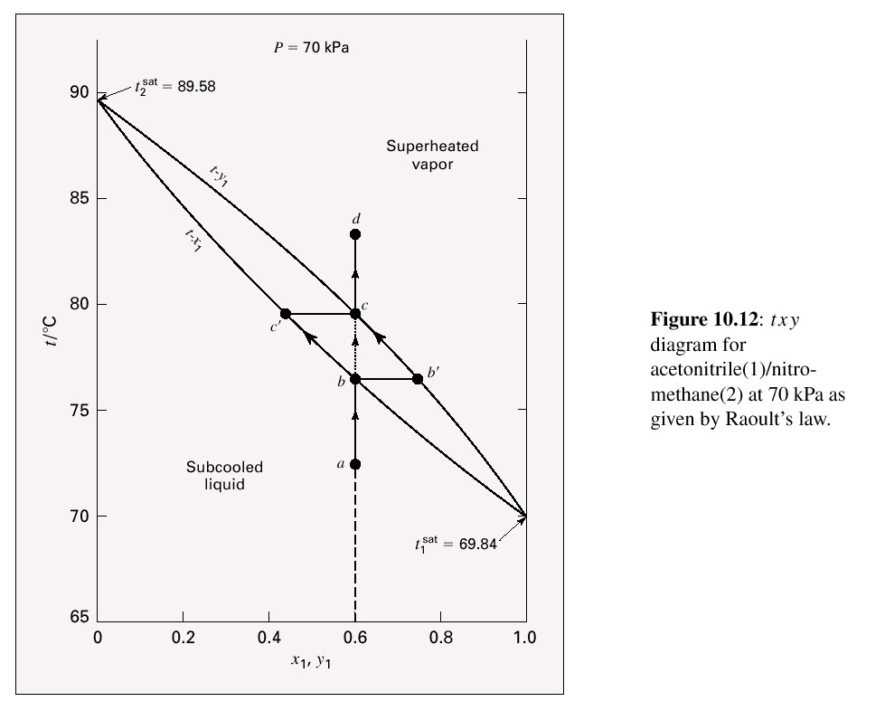

Slide 28
For x1=0.6 & P=70kPa, T is determined by BUBL T calculation, which requires iteration. Eq. 10.2 is rewritten;
Where;
Subtracting lnP₂sat from lnP₁sat as given by Antoine equations yields;
Initial value for α is from arbitrary intermediate t

Slide 30
The result is t=76.42⁰C. From Antoine eq., P1sat=87.17kPa and by (10.1), the composition at b’ is;
Vapor composition at point c is y=0.6. P is known (p=70kPa), a DEW T calculation is possible.
The steps are the same as BUBL T, but it is based on P1sat, rather than P2sat.
The result is t=79.58⁰C. From Antoine eq., P1sat=96.53kPa and by (10.1), the composition at c’ is;

Slide 31
This shows that the temperature rises from 76.420C to 79.580C during vaporization step from point b to c. Continued heating simply superheats the vapor to point d.

Slide 32
Henry’s Law
Assumptions;
For pressure low
  It is so low that it can be assume as ideal
  gas
For species present as a very dilute solution in liquid phase

Slide 33
Henry’s Law
Where;

Slide 34
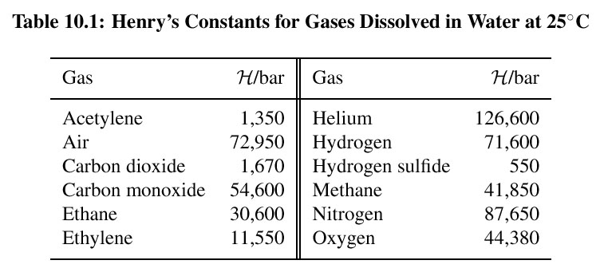

Slide 35
Example 10.2
Assuming that carbonated water contains only CO₂(1) and H₂O(2), determine the compositions of the V & L phases in a sealed can of ‘soda’ & the P exerted on the can at 10⁰C. Henry’s constant for CO₂ in water at 10⁰C is about 990 bar and x₁=0.01.

Slide 36
Henry’s law for species 1 & Raoult’s law for species 2 are written;
With H₁=990 bar & P₂sat = 0.01227 bar (from steam tables at 10⁰C)

Slide 37
Then by Raoult’s law, Eq. 10.1 written for species 2;
Whence y₁=1-y₂=0.9988, and the vapor phase is nearly pure CO₂, as expected.

Slide 38
Review
What is bubble point?
What is dew point?
We have previously went through the 2 simplest models for solving VLE problems
  Raoult’s Law
  Henry’s Law

Slide 39
Chapter Outline
10.5 VLE by modified Raoult’s law
10.6 VLE from K-value correlations
- Flash calculation

Slide 41
10.5 VLE BY MODIFIED RAOULT’S
LAW
The 2nd assumption of Raoult’s Law is abandoned, taking into account the deviation from solution ideality in L phase.
Thus, activity coefficient is introduced in Raoult’s Law

Slide 42

Activity coefficients are function of T & liquid phase composition, x
Since;
For bubble point
For dew point
(See Example 10.3)

Slide 43
BUBL P

Slide 44
DEW P

Slide 45
BUBL T

Slide 46
DEW T

Slide 47
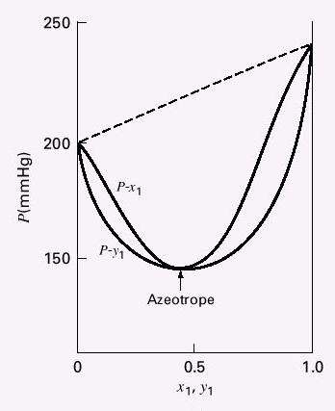
AZEOTROPE
When x1=y1, the dew point and bubble point curves are tangent to the same horizontal line
A boiling L of this composition produce a vapor exactly the same composition; L does not change in composition as it evaporates

Slide 48
Relative volatility;
If one limit is >1 &
the other limit is
<1; azeotrope
exists.

Slide 49
10.6 VLE FROM K-VALUE CORRELATTIONS
The partition between liquid and vapor phases of a chemical species is equilibrium ratio, K_{i.}
This quantity is called K-value.

Slide 50
K-value for Raoult’s Law
K-value for modified Raoult’s Law

Slide 51
For binary systems to solve for bubble point calculation;
Hence,
For binary systems to solve for
dew point calculation;
Hence,

Slide 52
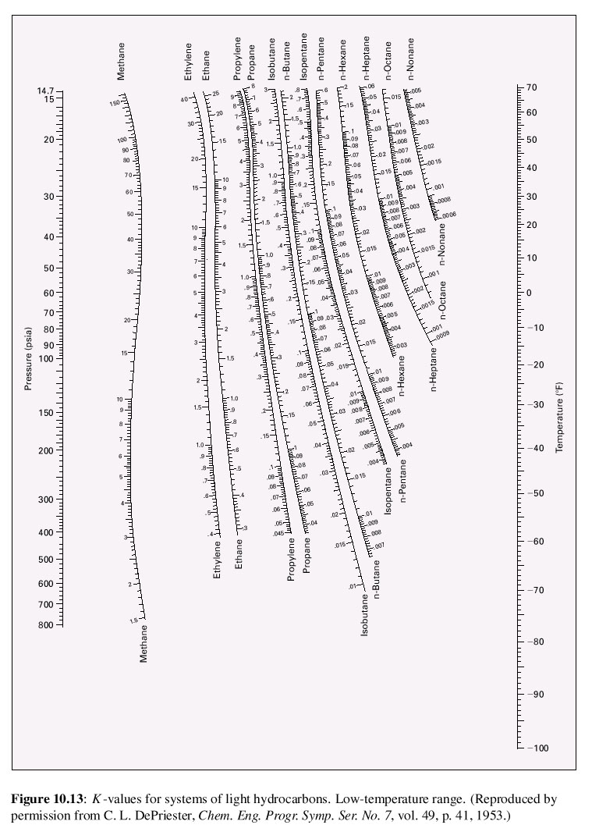
K-value from DePriester chart
-Low T range

Slide 53
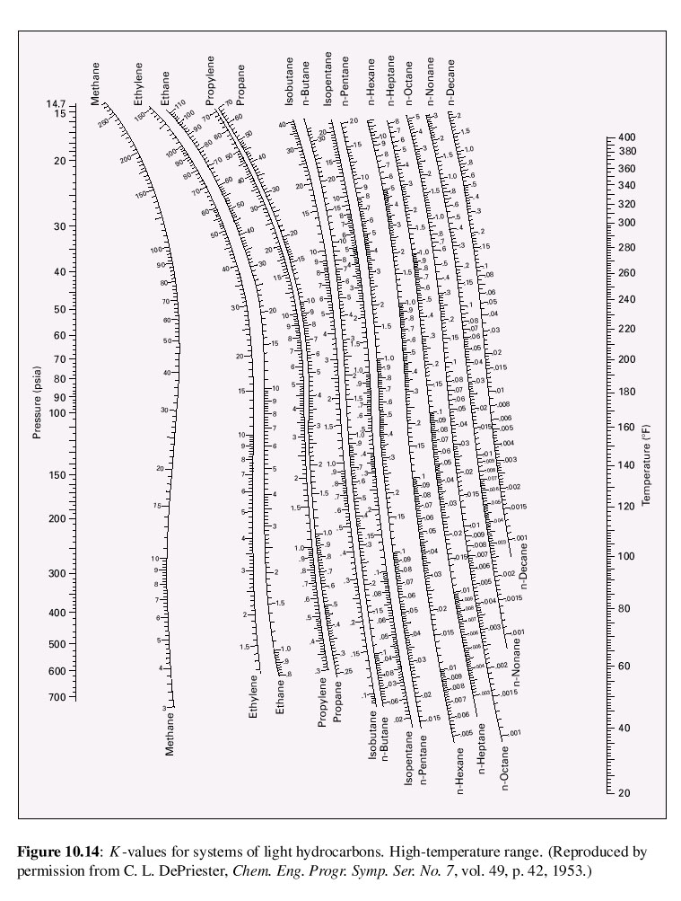
K-value from DePriester chart
-High T range

Slide 54
When given a mixture of composition at certain T or P;
Bubble point
Dew point
- Insignificant L
The given mole fraction is yi
Need to satisfy equation 10.14
- Composition of dew is xi=yi/Ki
System is almost condensed
The given mole fraction is xi
Need to satisfy equation 10.13
- Composition of buble is yi=Kixi

Slide 55
Flash Calculation
The most important application of VLE.
Originates from a fact that a liquid at a pressure equal to or greater that its bubble point pressure ‘flashes’ or evaporates when the pressure is reduced, producing a two-phase system of vapor and liquid in equilibrium.

Slide 56
FLASH CALCULATION
Vapor, V
V
L
Liquid at P > P_{bubble} partially evaporates when P is reduced, producing 2-phase system of V & L in equilibrium
Feed, F
Liquid, L
Find; T, P, z

Slide 57
In a system with one mole chemical species with an overall composition by set of mole fraction, z_{i}.
L_{i} would be the moles of liquid with mol fraction x_{i} and V be the moles of vapor with the mol fraction of y_{i}:

Slide 58
From
Eliminate for L gives:
From K-value
Hence solving for y_{i},

Slide 59
Because
Hence,
(See Example 10.5 and 10.6)

Slide 60
Flowchart for flash pressure

Slide 61
The End

