Slide 1
Two-Phase

Slide 2
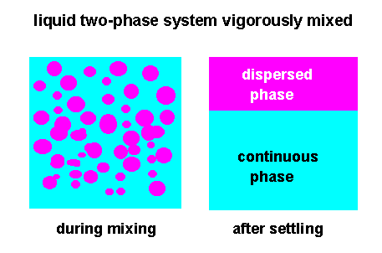

Slide 3
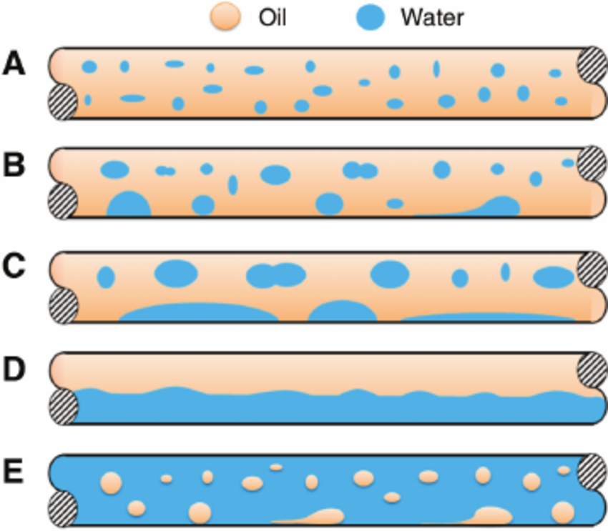
Two-Phase Horizantal pipes

Slide 4
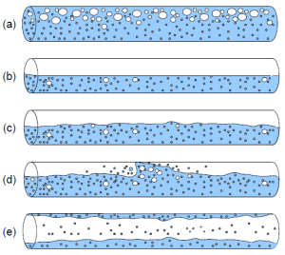
Horizontal fluid flow [(a) bubble flow, (b) stratified flow,
(c) wavy flow, (d) slug flow, (e) annular flow]:

Slide 5
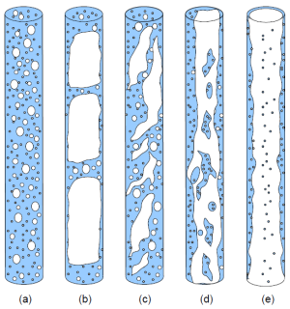
Vertical fluid flow [(a) bubble flow, (b) plug slug flow, (c) foam flow, (d) annular streak flow, (e) annular flow]:

