Slide 1
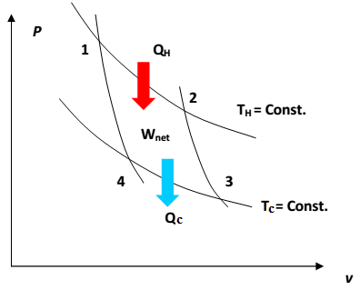
Ideal-Gas Temperature Scale; Carnot's Equations
That means two adiabatic reversible processes and two isothermal processes. The cycle traversed by an ideal gas serving as the working fluid in a Carnot engine is shown by a PV diagram in Fig. 5.3. It consists of four reversible steps:
Figure 5.3 PV diagram showing Carnot cycle for an ideal gas

Slide 2
a b Adiabatic compression until the temperature rises from Tc to TH.
b c Isothermal expansion to arbitrary point c with absorption of heat|QH|.
c d Adiabatic expansion until the temperature decreases to Tc .
d a Isothermal compression to the initial state with rejection of heat|QC|.
For the isothermal steps b c and d a, Eq. (3.27) yields:

Slide 3



Therefore,
For an adiabatic process Eq. (3.22) with dQ=0 becomes, P=RT/v

Slide 4




Because of the left sides of these two equations are the same,
Equation (5.6) now becomes:

Slide 5

Substitution of Eq. (5.7) into Eq. (5.2) gives:
Equations (5.7) and (5.8) are known as Carnot's equations. Theses equations can use only for Carnot engine, but Eq. 5.2 can be used for the entire engine if it is ideal or not.
Equation (5.8) shows that the thermal efficiency of a Carnot engine can approach unity only when TH approaches infinity or Tc approaches zero. Neither of these conditions is attainable;all heat engines therefore operate with thermal efficiencies less than unity.

Slide 6
There are some terms when you see or hear it directly remember the Carnot engine like:
1. Ideal
2. Theoretical
3. Reversible
4. Maximum work
5. Maximum temperature.

Slide 7

The cold reservoirs naturally available on earth are the atmosphere, lakes and rivers, and the oceans, for which Tc = 300 K. Hot reservoirs are objects such as furnaces where the temperature is maintained by combustion of fossil fuels and nuclear reactors where the temperature is maintained by fission of radioactive elements. For these practical heat sources,TH = 600 K. With these values,

Slide 8
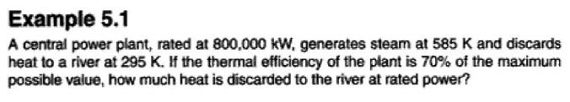
This is a rough practical limit for the thermal efficiency of a Carnot engine; actual heat engines are irreversible, and their thermal efficiencies rarely exceed 0.35.

Slide 9
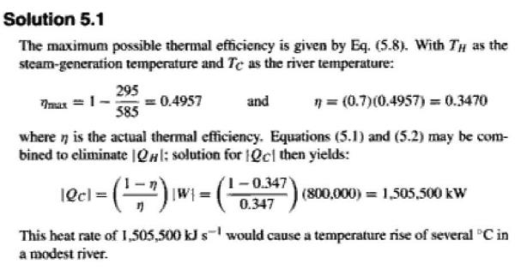

Slide 10

ENTROPY
Equation (5.7) for a Carnot engine may be written:
If the heat quantities refer to working fluid in the engine (rather than to the heat reservoirs), the numerical value of QH is positive and that of Qc is negative. The equivalent equation written without absolute-value signs is therefore,

Slide 11
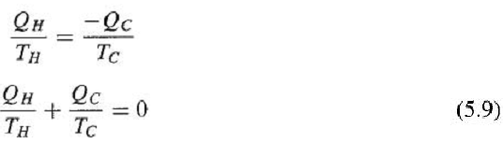
Our purpose now is to show that Eq. (5.9), applicable to the reversible Carnot cycle, also applies to other reversible cycles.
Each Carnot cycle has its own pair of isotherms TH and Tc and associated heat quantities QH and QC.

Slide 12

When the adiabatic curves are so closely spaced that the isothermal steps are infinitesimal, the heat quantities become dQH and dQc, and Eq. (5.9) for each Carnot cycle is written:
In this equation TH and Tc, absolute temperatures of the working fluid of the Carnot engines, are also the temperatures traversed by the working fluid of the arbitrary cycle.

Slide 13

Summation of all quantities dQ/ T for the Carnot engines leads to the integral:
where the circle in the integral sign signifies integration over the arbitrary cycle, and the subscript "rev" indicates that the cycle is reversible. Thus the quantities Qrev/ T sum to zero for the arbitrary cycle, exhibiting the characteristic of a property. The property is called entropy (en'-tro-py), and its differential changes are:

Slide 14

where St is the total (rather than molar) entropy of the system. Alternatively,
If a process is reversible and adiabatic, dQrev = 0; then by Eq. (5.11), dst = 0. Thus the entropy of a system is constant during a reversible adiabatic process, and the process is said to be isentropic.

Slide 15
This discussion of entropy can be summarized as follows:
• There exists a property called entropy S, which is an intrinsic property of a system, functionally related to the measurable coordinates which characterize the system. For a reversible process, changes in this property are given by Eq. (5.11).
• The change in entropy of any system undergoing a finite reversible process is:

Slide 16

When a system undergoes an irreversible process between two equilibrium states, the entropy change of the system ΔSt is evaluated by application of Eq. (5.13).
Integration is not carried out for the irreversible path. Since entropy is a state function, the entropy changes of the irreversible and reversible processes are identical.

