Slide 1
The Second Law of Thermodynamics
The differences between the two forms of energy, heat and work, provide some insight into the second law.
Work is readily transformed into other forms of energy: for example, into potential energy by elevation of a weight, into kinetic energy by acceleration of a mass, into electrical energy by operation of a generator. These processes can be made to approach a conversion efficiency of 100% by elimination of friction, a dissipative process that transforms work into heat. Indeed, work is readily transformed completely into heat, as demonstrated by Joule's experiments.

Slide 2
On the other hand, all efforts to devise a process for the continuous conversion of heat completely into work or into mechanical or electrical energy have failed. Drawing further on our experience, we know that the flow of heat between two bodies always takes place from the hotter to the cooler body, and never in the reverse direction. This fact is of such significance that its restatement serves as an acceptable expression of the
second law.

Slide 3
STATEMENTS OF THE SECOND LAW
Statement 1: No apparatus can operate in such a way that its only effect (in system and surroundings) is to convert heat absorbed by a system completely into work done by the system.
Statement 2: No process is possible which consists solely in the transfer of heat from one temperature level to a higher one.

Slide 4
HEAT ENGINES
Heat engines, devices or machines that produce work from heat in a cyclic process. An example is a steam power plant in which the working fluid (steam) periodically returns to its original state. In such a power plant the cycle (in its simplest form) consists of the following steps:
The word cyclic requires that the system be restored periodically to its original state.

Slide 5
Liquid water at ambient temperature is pumped into a boiler at high pressure.
Heat from a fuel (heat of combustion of a fossil fuel or heat from a nuclear reaction) is transferred in the boiler to the water, converting it to high-temperature steam at the boiler pressure.
Energy is transferred as shaft work from the steam to the surroundings by a device such as a turbine, in which the steam expands to reduced pressure and temperature.
Exhaust steam from the turbine is condensed by transfer of heat to the surroundings, producing liquid water for return to the boiler, thus completing the cycle.

Slide 6
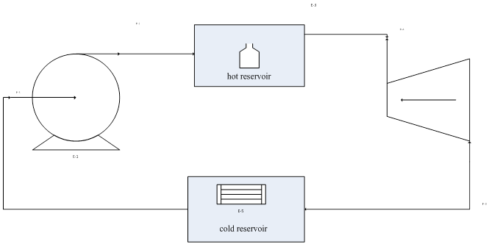
Figure (1) Steps of heat engine

Slide 7
Essential to all heat-engine cycles are absorption of heat into the system at a high temperature, rejection of heat to the surroundings at a lower temperature, and production of work. In the theoretical treatment of heat engines, the two temperature levels which characterize their operation are maintained by heat reservoirs, bodies imagined capable of absorbing or rejecting an infinite quantity of heat without temperature change.
In operation, the working fluid of a heat engine absorbs heat |QH| from a hot reservoir,

Slide 8

produces a net amount of work |W|, discards heat |QC| to a cold reservoir, and returns to its initial state. The first law therefore reduces to:
The thermal efficiency of the engine is defined as: η= net work output/heat absorbed .With Eq. (5.1) this becomes:

Slide 9

Absolute-value signs are used to make the equations independent of the sign conventions for Q and W. For q to be unity (100% thermal efficiency),|QC| must be zero. No engine has ever been built for which this is true; some heat is always rejected to the cold reservoir

Slide 10
The Carnot Cycle (Carnot engine)
If a thermal efficiency of 100% is not possible for heat engines, what then determines the upper limit. One would certainly expect the thermal efficiency of a heat engine to depend on the degree of reversibility of its operation. Indeed, a heat engine operating in a completely reversible manner is very special, and is called a Carnot engine. The four steps that make up a Carnot cycle are performed in the following order:

Slide 11
Step 1: A system at the temperature of a cold reservoir Tc undergoes a reversible adiabatic process that causes its temperature to rise to that of a hot reservoir at TH.
Step 2: The system maintains contact with the hot reservoir at TH, and undergoes a reversible isothermal process during which heat |QH| is absorbed from the hot reservoir.

Slide 12
Step 3: The system undergoes a reversible adiabatic process in the opposite direction of step 1 that brings its temperature back to that of the cold reservoir at Tc.
Step 4: The system maintains contact with the reservoir at Tc, and undergoes a reversible isothermal process in the opposite direction of step 2 that returns it to its initial state with rejection of heat |QC| to the cold reservoir.

Slide 13
https://youtu.be/axG9HuqViDY

