Slide 1
THE HEAT PUMP
The heat pump, a reversed heat engine, is a device for heating houses and commercial buildings during the winter and cooling them during the summer. In the winter it operates so as to absorb heat from the surroundings and reject heat into the building.
The heat pump also serves for air conditioning during the summer. The flow of refrigerant is simply reversed, and heat is absorbed from the building and rejected through underground coils or to the outside air.

Slide 2
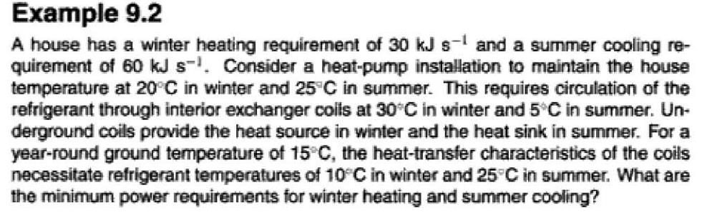

Slide 3
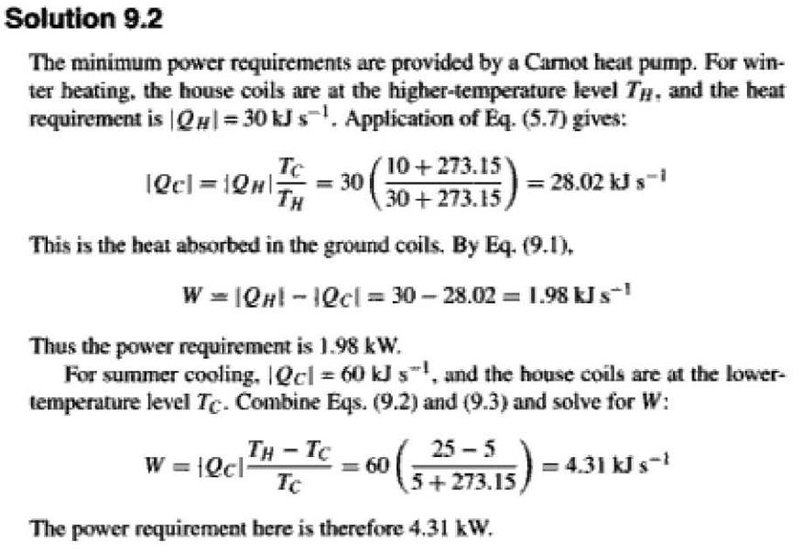

Slide 4
LIQUEFACTION PROCESSES
Liquefied gases are in common use for a variety of purposes. For example, liquid propane in cylinders serves as a domestic fuel, liquid oxygen is carried in rockets, natural gas is liquefied for ocean transport, and liquid nitrogen is used for low-temperature
refrigeration. In addition, gas mixtures (e.g., air) are liquefied for separation into their component species by fractionation.
Liquefaction results when a gas is cooled to a temperature in the two-phase region. This may be accomplished in several ways:

Slide 5
1. By heat exchange at constant pressure.
2. By an expansion process from which work is obtained.
3. By a throttling process.
The Linde liquefaction process, which depends solely on throttling expansion, is shown in Fig. 9.6. After compression, the gas is precooled to ambient temperature. It may be even further cooled by refrigeration.

Slide 6
The lower the temperature of the gas entering the throttle valve, the greater the fraction of gas that is liquefied. For example, a refrigerant evaporating in the cooler at 233.15 K (-40°C) provides a lower temperature at the valve than if water at 294.15 K (21°C) is the cooling medium.

Slide 7
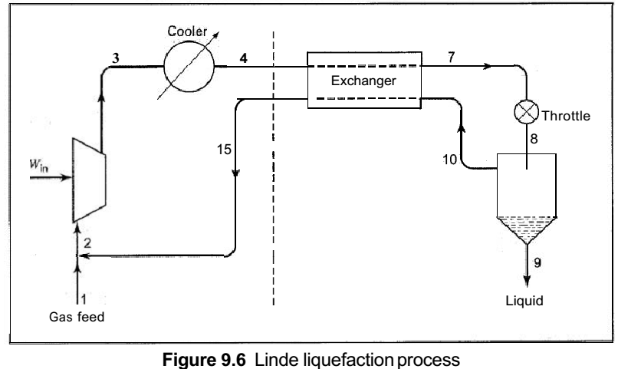

Slide 8
