Slide 1
Refrigeration and liquefaction
Refrigeration is best known for its use in the air conditioning of buildings and in the treatment, transportation, and preservation of foods and beverages. It also finds large scale Industrial application, for example, in the manufacture of ice and the dehydration of gases. Applications in the petroleum industry include lubricating-oil purification, low Temperature reactions, and separation of volatile hydrocarbons.

Slide 2
A closely related process is gas liquefaction, Which has important commercial applications. The purpose of this chapter is to present a thermodynamic analysis of refrigeration and liquefaction processes. However, the details of equipment design are left to specialized books. The word refrigeration implies the maintenance of a temperature below that of the surroundings. This requires continuous absorption of heat at a low temperature level, usually accomplished by evaporation of a liquid in a steady-state flow process.

Slide 3
The vapor formed may be returned to its original liquid state for re-evaporation in either of two ways. Most commonly, it is simply compressed and then condensed. Alternatively, it may be
absorbed by a liquid of low volatility, from which it is subsequently evaporated at higher pressure.
THE CARNOT REFRIGERATOR
In a continuous refrigeration process, the heat absorbed at a low temperature is continuously rejected to the surroundings at a higher temperature.

Slide 4
Basically, a refrigeration cycle is a reversed heat-engine cycle.
Heat is transferred from a low temperature level to a higher one; according to the second law, this requires an external source of energy. The ideal refrigerator, like the ideal heat engine, operates on a Carnot cycle, consisting in this case of two isothermal steps in which heat |Qc| is absorbed at the lower temperature Tc and heat |QH| is rejected at the higher temperature T, and two adiabatic steps. The cycle requires the addition of net work W to the system.

Slide 5

Since ΔU of the working fluid is zero for the cycle, the first law is written:
The measure of the effectiveness of a refrigerator is its coefficient of performance , or (COP) defined as:

Slide 6

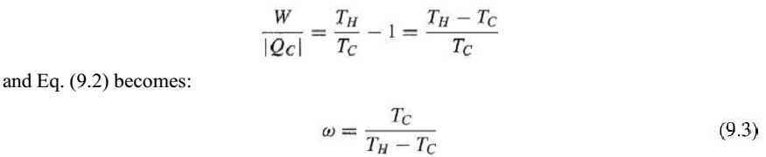
Equation (9.1) may be divided by |Qc| :
Combination with Eq. (5.7) gives:

Slide 7
This equation applies only to a refrigerator operating on a Carnot cycle, and it gives the maximum possible value of for any refrigerator operating between given values of TH and Tc. It shows clearly that the refrigeration effect per unit of work decreases as the temperature of heat absorption Tc decreases and as the temperature of heat rejection TH increases. For refrigeration at a temperature level of 278.15 K (5°C) in a surroundings at 303.15 K (30°C), the value of for a Carnot refrigerator is:

Slide 8

THE VAPOR-COMPRESSION CYCLE
The vapor-compression refrigeration cycle is represented in Fig. 9.1. Shown on the T-S diagram are the four steps of the process.

Slide 9
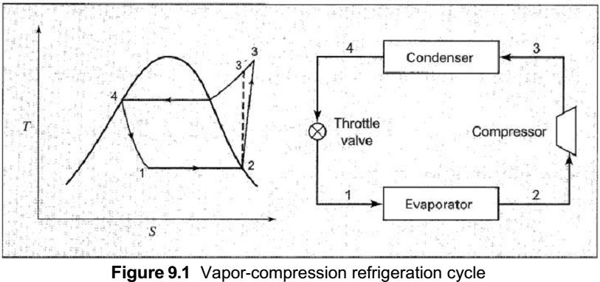

Slide 10
A liquid evaporating at constant pressure (line 1- 2) provides a means for heat absorptionat a low constant temperature. The vapor produced is compressed to a higher pressure, and is then cooled and condensed with rejection of heat at a higher temperature level. Liquid from the condenser returns to its original pressure by an expansion process. In principle, this can be carried out in an expander from which work is obtained, but for practical reasons is accomplished by throttling through a partly open valve.

Slide 11
In Fig. 9.1 line 4 - 1 represents this throttling process. The dashed line 2 - 3' is the path of isentropic compression (Fig. 7.6). Line 2 - 3, representing the actual compression process, slopes in the direction of increasing entropy, reflecting inherent ir-reversibilities.
On the basis of a unit mass of fluid, the equations for the heat absorbed in the evaporator and the heat rejected in the condenser are:

Slide 12

These equations follow from Eq. (2.32) when the small changes in potential and kinetic energy are neglected. The work of compression is simply:
and by Eq. (9.2), the coefficient of performance is:

Slide 13


To design the evaporator, compressor, condenser, and auxiliary equipment one must know the rate of circulation of refrigerant. This is determined from the rate of heat absorption in evaporate by the equation:

Slide 14
The vapor-compression cycle of Fig. 9.1 is shown on a PH diagram in Fig. 9.2. Such diagrams are more commonly used in the description of refrigeration processes than TS diagram. Although the evaporation and condensation processes are represented by constant-pressure paths, small pressure drops do occur because of fluid friction, because they show directly the required enthalpies. For given values of Tc and TH, the highest possible value of is attained for Carnot- cycle refrigeration.

Slide 15
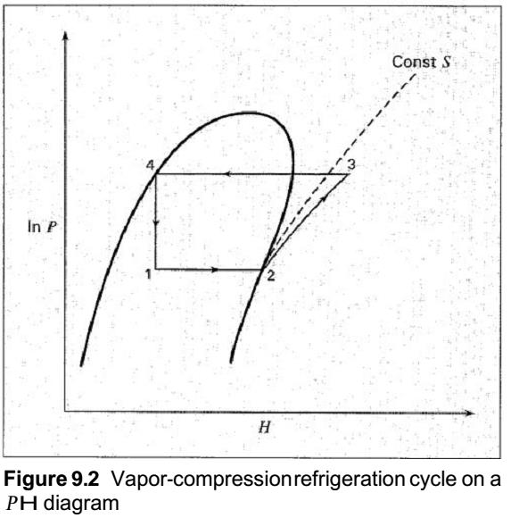

Slide 16
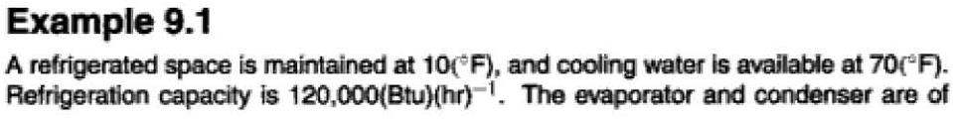
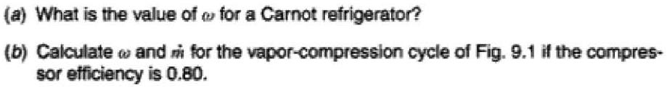

Slide 17
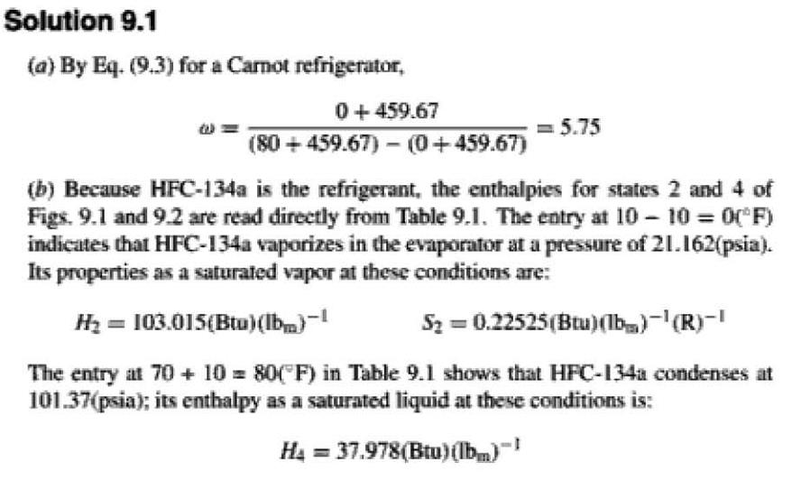

Slide 18
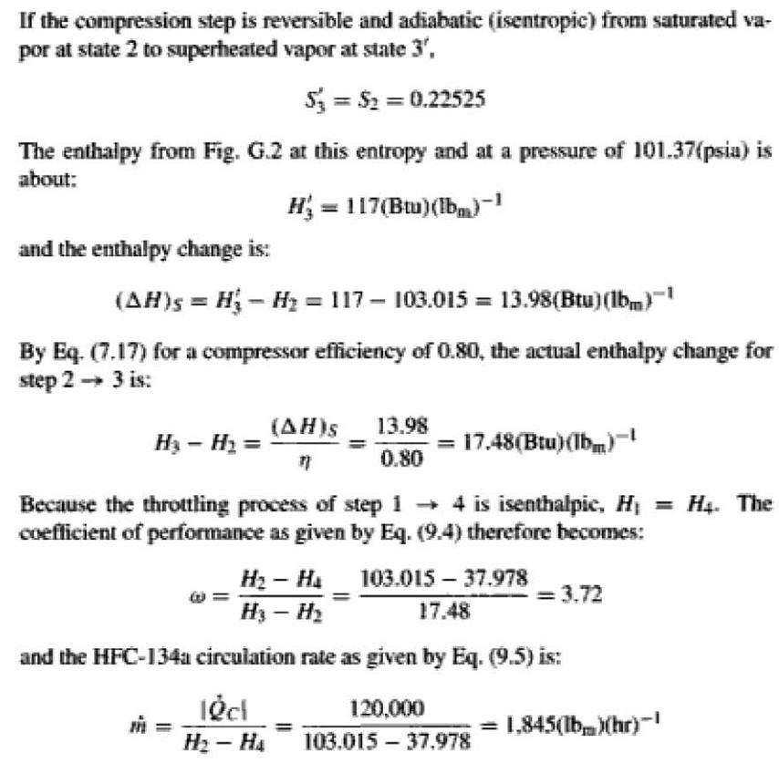

Slide 19
