Slide 1
Henry's Law
Application of Raoult's law to species i requires a value for pisat at the temperature of application, and thus is not appropriate for a species whose critical temperature is less than the temperature of application. If a system of air in contact with liquid water is presumed at equilibrium, then the air is saturated with water. The mole fraction of water vapor in the air is usually found from Raoult's law applied to the water with the assumption that no air dissolves in the liquid phase. Thus, the liquid water is regarded as pure and Raoult's law for the water (species 2) becomes y2P =P2sat at 298.15 K (25C)and atmospheric pressure, this equation yields:

Slide 2

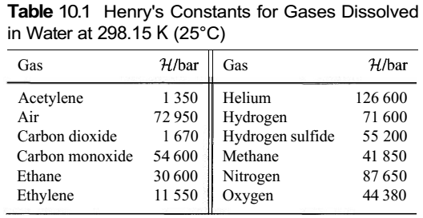
where the pressures are in kPa, and p2sat comes from the steam tables.

Slide 3
If one wishes to calculate the mole fraction of air dissolved in the water, then Raoult's law cannot be applied, because the critical temperature of air is much lower than 298.15 K (25°C). This problem can be solved by Henry's law, applied here for pressures low enough that the vapour phase may be assumed an ideal gas. For a species present as a very dilute solute in the liquid phase, Henry's law then states that the partial pressure of the species in the vapour phase is directly proportional to its liquid-phase mole fraction. Thus,

Slide 4

where is Henry's constant. Values of come from experiment, and Table 10.1 lists values at 298.15 K (25°C) for a few gases dissolved in water. For the air/water system at 298.15 K (25°C) and atmospheric pressure, Henry's law applied to the air (species 1) with yl = 1 - 0.0312 = 0.9688 yields:
This result justifies the assumption made in application of Raoult's law to the water.

Slide 5
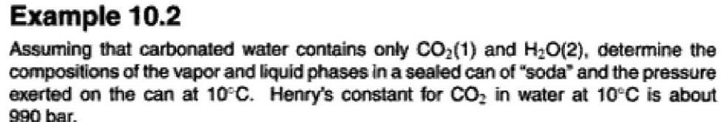

Slide 6
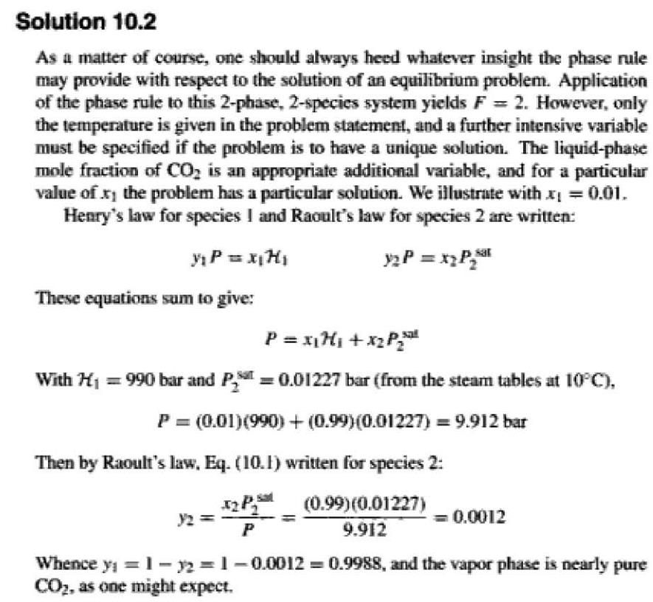

Slide 7
VLE BY MODIFIED RAOULT'S LAW :
For low to moderate pressures a much more realistic equation for VLE results when the second major Raoult's-law assumption is abandoned, and account is taken of deviations from solution ideality in the liquid phase by a factor inserted into Raoult's law, modified to read:

Slide 8
The factor is called an activity coeficient. Bubble point and dew point calculations made with this equation are only a bit more complex than the same calculations made with Raoult's law. Activity coefficients are functions of temperature and liquid-phase composition, and ultimately are based on experiment (Sec. 12.1). For present purposes, the necessary values are assumed known.

Slide 9


Because ∑yi=1 Eq. (10.5) may be summed over all species to yield:
Alternatively, Eq. (10.5) may be solved for xi, in which case summing over all species yields:

Slide 10
