Slide 1
INTERNAL-COMBUSTION ENGINES
In a steam power plant, the steam is an inert medium to which heat is transferred from a burning fuel or from a nuclear reactor. It is therefore characterized by large heat-transfer surfaces: (1) for the absorption of heat by the steam at a high temperature in the boiler, and (2) for the rejection of heat from the steam at a relatively low temperature in the condenser. The disadvantage is that when heat must be transferred through walls (as through the metal walls of boiler tubes) the ability of the walls to withstand high temperatures and pressures imposes a limit on the temperature of heat absorption.

Slide 2
In an internal-combustion engine, on the other hand, a fuel is burned within the engine itself, and the combustion products serve as the working medium, acting for example on a piston in a cylinder. High temperatures are internal, and do not involve heat-transfer surfaces.
Burning of fuel within the internal-combustion engine complicates thermodynamic analysis. Moreover, fuel and air flow steadily into an internal-combustion engine and combustion products flow steadily out of it; no working medium undergoes a cyclic process, as does steam in a steam power plant.

Slide 3
However, for making simple analyses, one imagines cyclic engines with air as the working fluid that are equivalent in performance to actual internal-combustion engines. In addition, the combustion step is replaced by the addition to the air of an equivalent amount of heat. In what follows, each internal-combustion engine is introduced by a qualitative description. This is followed by a quantitative analysis of an ideal cycle in which air, treated as an ideal gas with constant heat capacities, is the working medium.

Slide 4
The Otto Engine
The most common internal-combustion engine, because of its use in automobiles, is the Otto
engine. Its cycle consists of four strokes, and starts with an intake stroke at essentially constant
pressure, during which a piston moving outward draws a fuell air mixture into a cylinder. This
is represented by line 0 1 in Fig. 8.8.

Slide 5
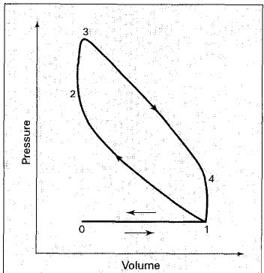
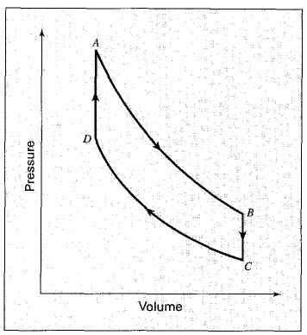
Figure 8.8 Otto engine cycle
Figure 8.9 Air-standard Otto cycle

Slide 6

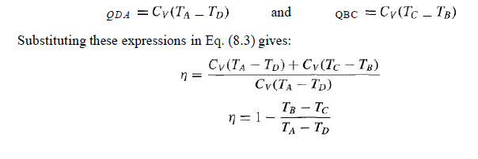
The thermal efficiency Q of the air-standard cycle shown in Fig. 8.9 is simply:
For 1 mol of air with constant heat capacities,

Slide 7
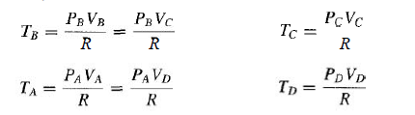
The thermal efficiency is related in a simple way to the compression ratio, r = Vc / VD.
Each temperature in Eq. (8.4) is replaced by an appropriate group PVIR, in accord with the ideal-gas equation. Thus,

Slide 8


Substituting into Eq. (8.4) leads to:
For the two adiabatic, reversible steps, P VY = const. Hence:

Slide 9
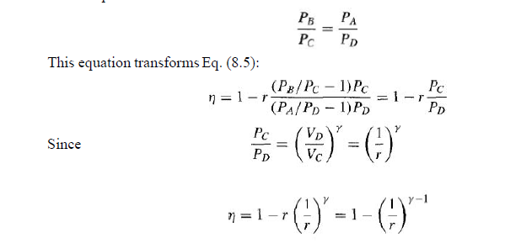
These expressions are combined to eliminate the volumes:

Slide 10
This equation shows that the thermal efficiency increases rapidly with the compression ratio r at low values of r, but more slowly at high compression ratios. This agrees with the results of actual tests on Otto engines.

Slide 11

Ranking Cycle

Slide 12
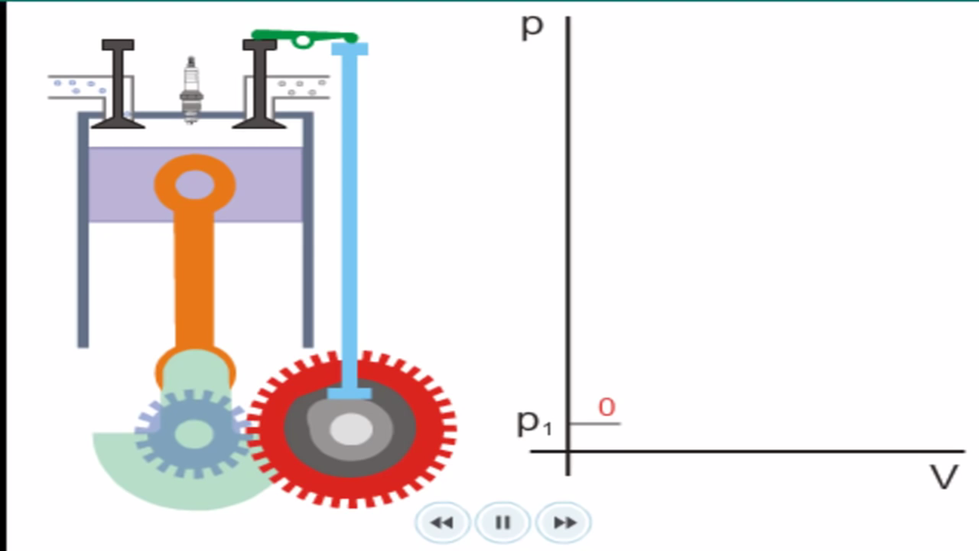
Otto-Cycle

Slide 13
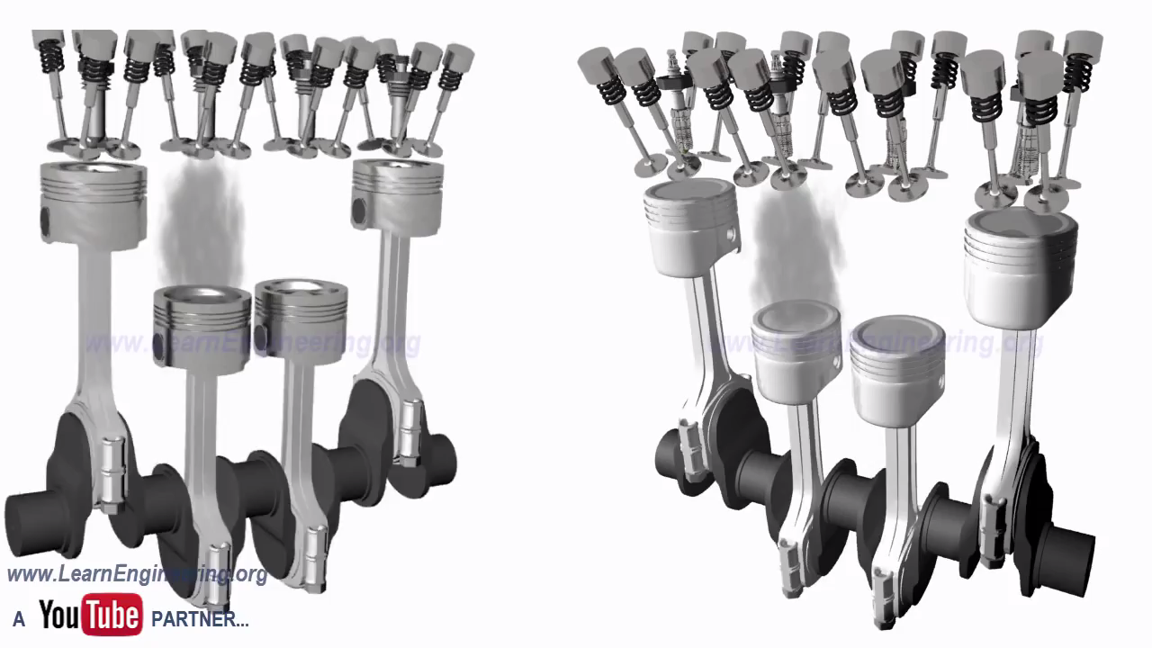

Slide 14

Open-cycle (gas-turbine)

Slide 15

Diesel-Engine

