Slide 1
Syllabus)/ Course Title
Course Text
Material Eng. (Ι)
Duration | Contents | No.
4hr | Classification of Materials Classification of materials, classification of materials based on structure and its application. | 1
6hr | Mechanical Properties of Materials Stress-strain behavior, ductility, brittleness, toughness, modulus of resilience, poison’s ratio, hardness, effect of temperature. | 2
6hr | Atomic structure The structure of atom, atomic bonding, bonding energy and inter-atomic spacing | 3
8hr | Atomic order in solids Types of atomic or ionic arrangements, crystal structure, lattice,unit cells, crystal systems, crystal direction and crystal planes , diffraction techniques for crystal structure analysis | 4
6hr | Thermal and electrical properties of materials Heat capacity, thermal expansion, thermal conductivity, thermal stress, Glass transition temperature, Creep resistance, electrical conductivity, electron mobility, electrical resistivity of metals | 5
1-Donaled R. Askeland, The science and engineering of materials, international student edition, 2006 . 2-William D. Callister, Jr. , Materials science and engineering, Fifth edition, 2000. 3-Lawrence H. Vanvlack , Elements of materials science and engineering, Fifth edition, 1987.

Slide 2
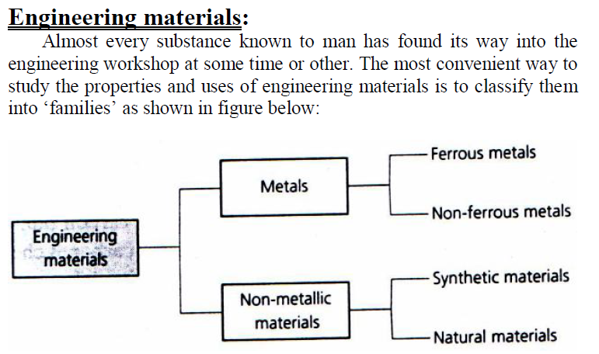
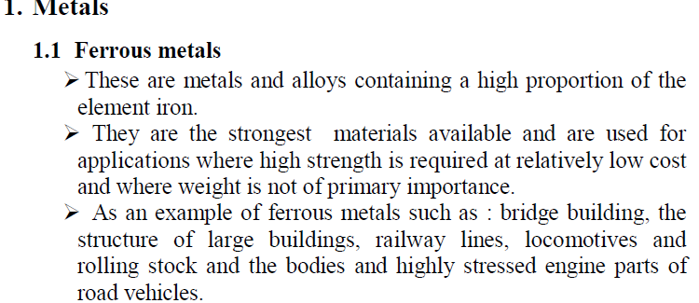

Slide 3
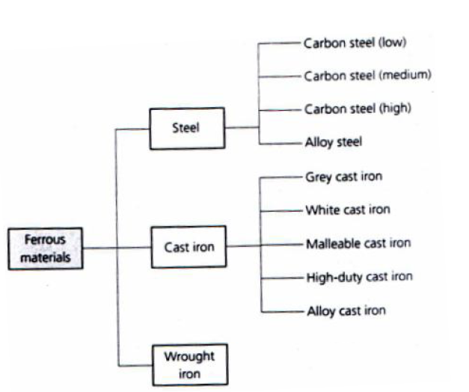
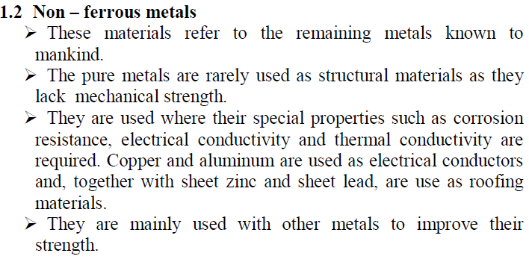

Slide 4
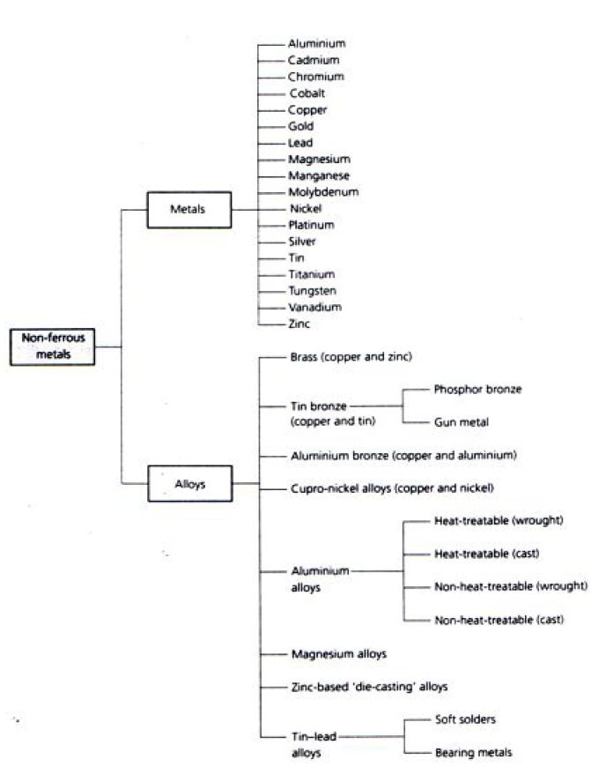
Figure 3. Classification of non-ferrous metals and alloys.

Slide 5
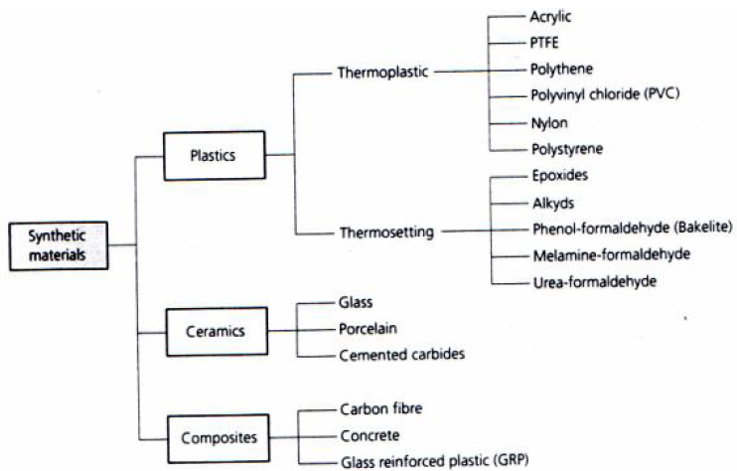
Figure 4. classification of synthetic materials.

Slide 6
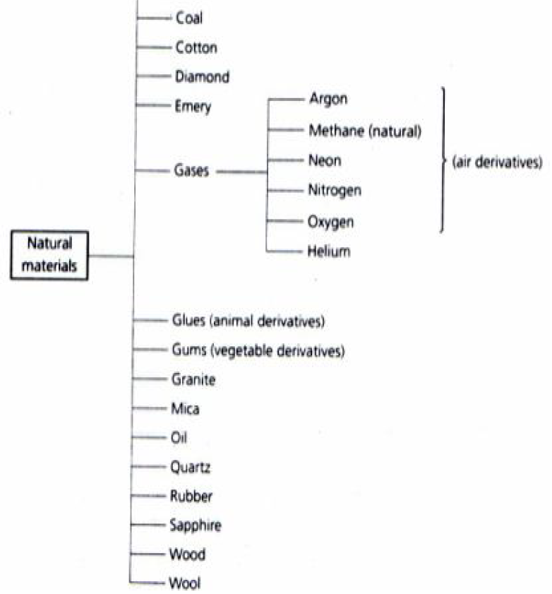
Figure 5. Classification of natural materials.

Slide 7
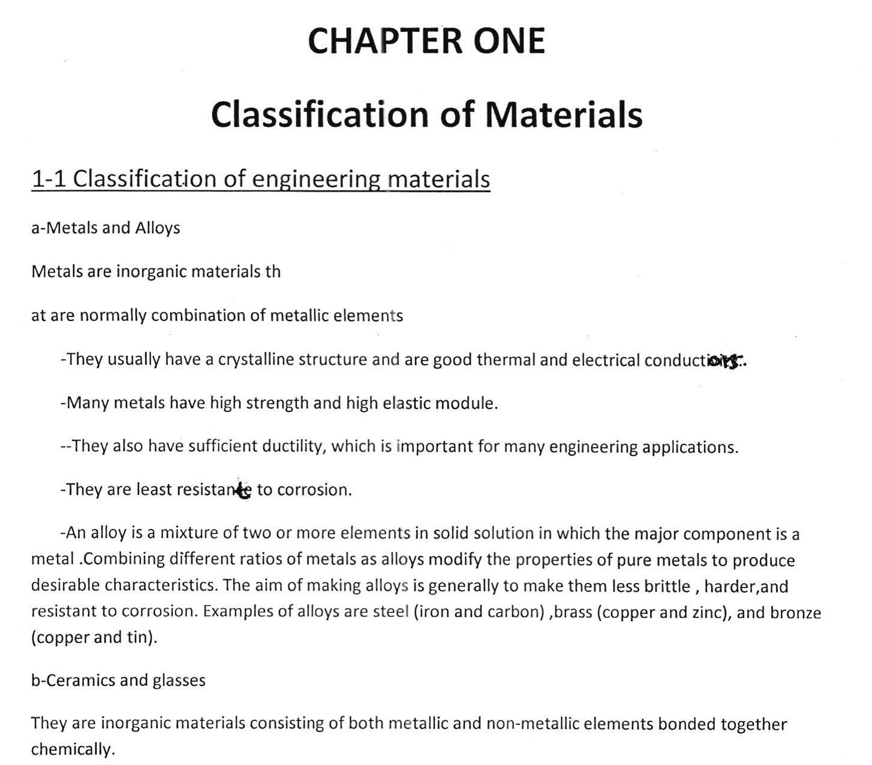

Slide 8
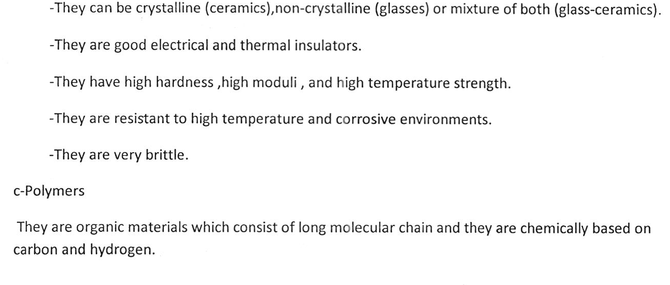
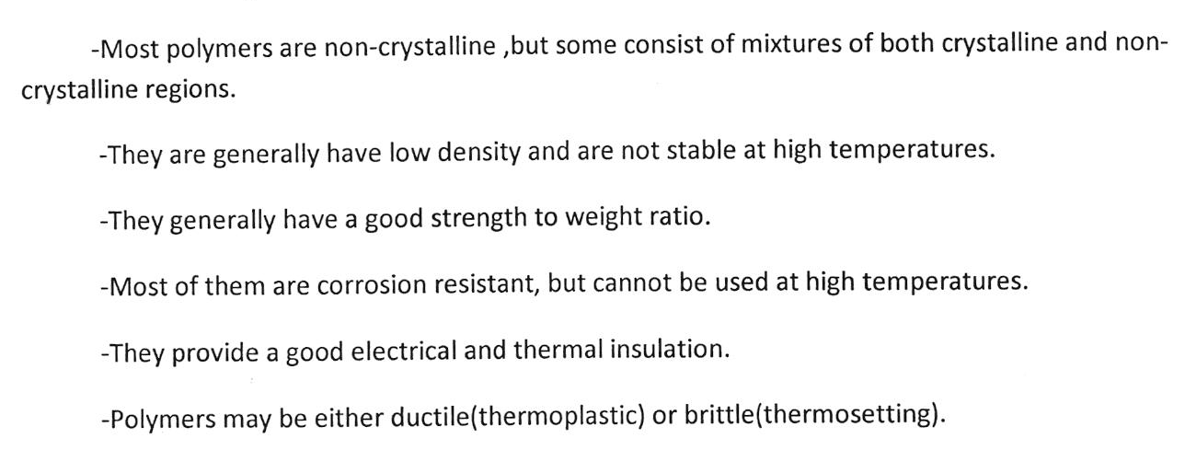

Slide 9
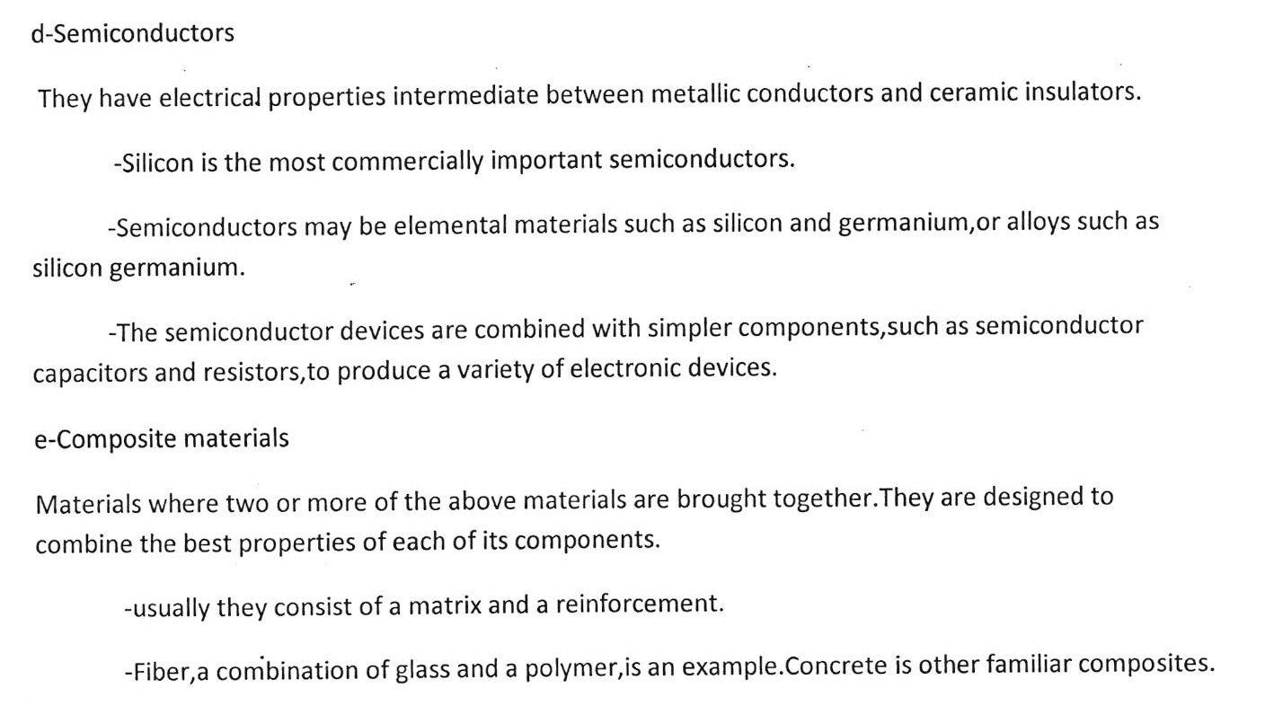

Slide 10
