Slide 1
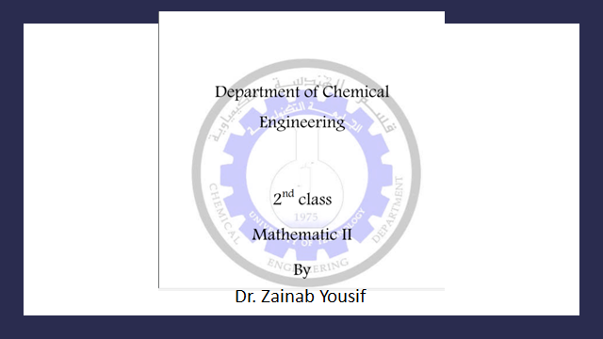

Slide 2
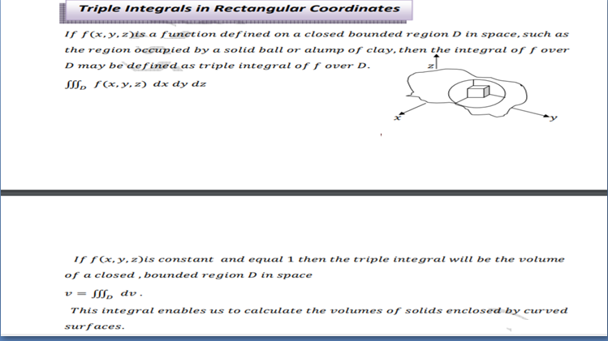

Slide 3
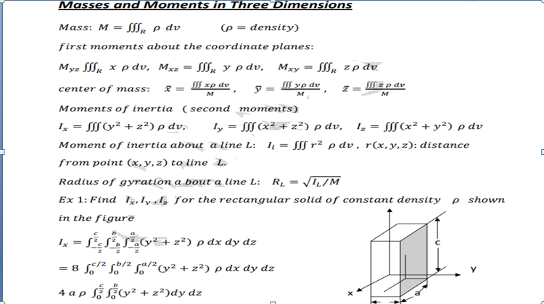

Slide 4
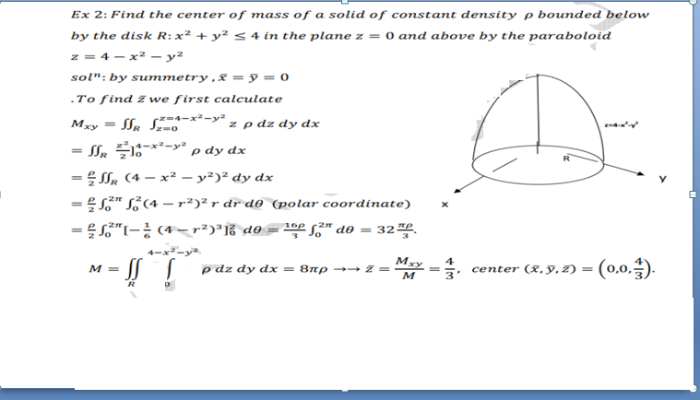

Slide 5
References
1. G. B. Thomas, M. D. Weir and J. R. Hass, Thommas' Calculus, 12th Edition, Copyright© 2010, Pearson Education.
2. B.S.Grewal, Higher Engineering Mathematics, Khanna Publishers, 40th Edition, 2007.
Other support books :-
Erwin Kreyszig, Advanced Engineering Mathematics, 8th edition, 2007.

